Slide 1



Translational AI Applications in Prostate Cancer
Baris Turkbey M.D.
Senior Clinician
Head of MRI and AIR, NCI
Molecular Imaging Branch, NCI, NIH

Slide 2
Disclosures
CRADA: NVIDIA
CRADA: Philips
Royalties from NIH
Patents in the field of AI
Research samples of an MRI artificial intelligence (AI) algorithm developed in NCI in collaboration with NVIDIA will be shown in this talk

Slide 3
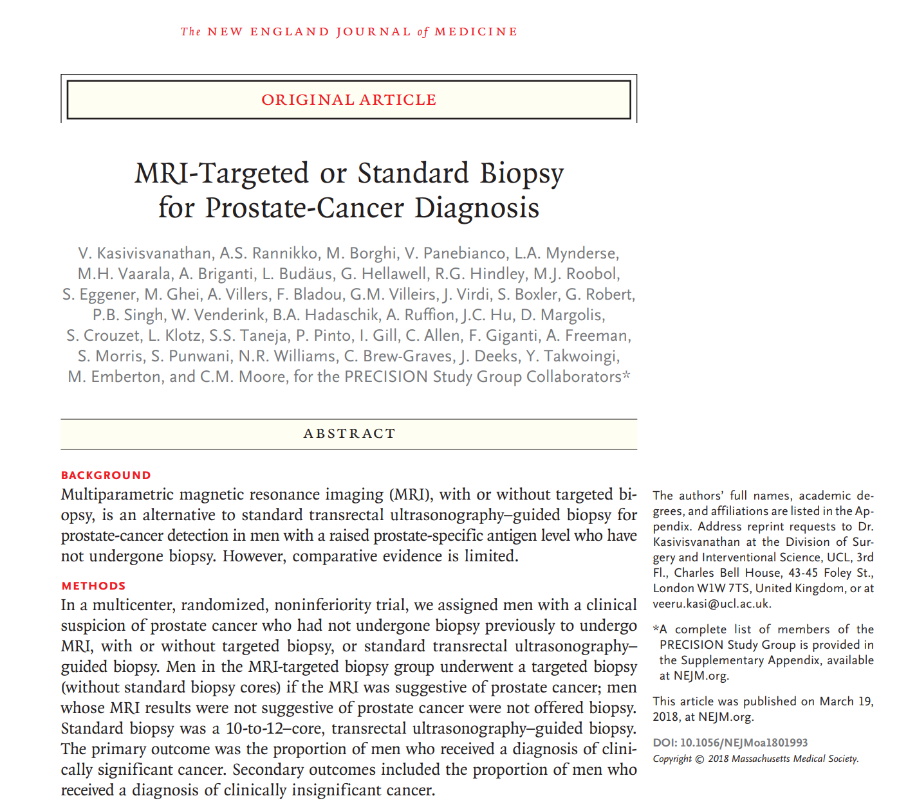
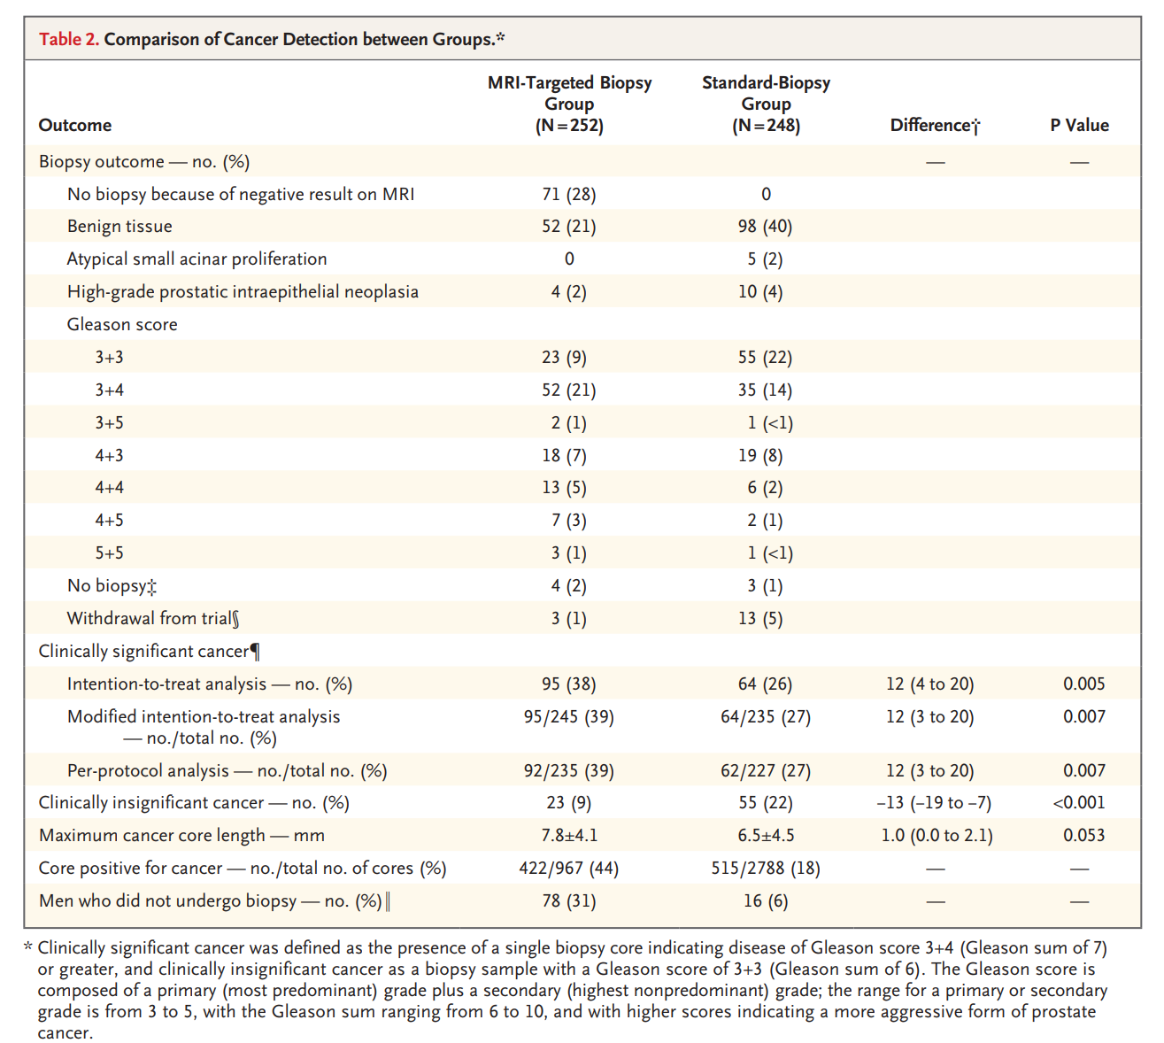

Slide 4
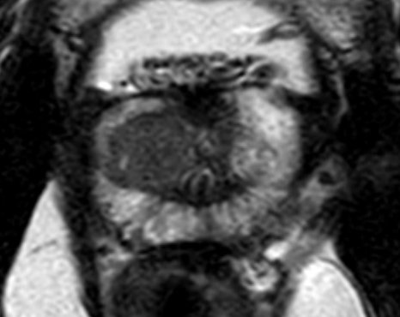
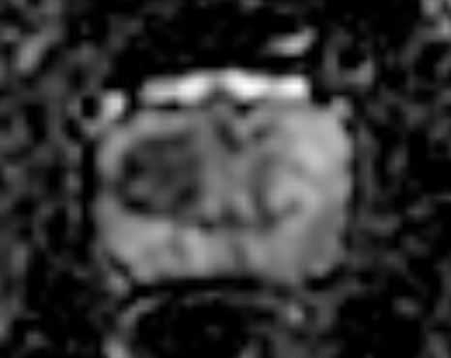
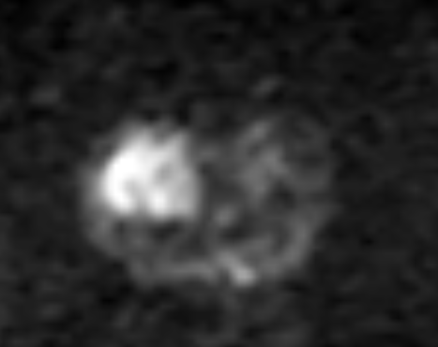
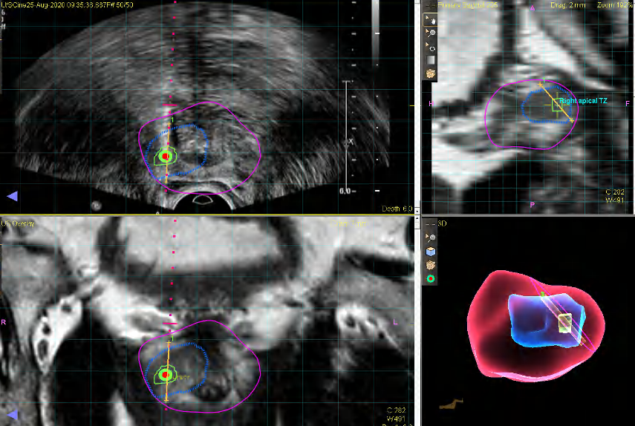
63-year old, serum PSA 15ng/mL
Gleason 4+4

Slide 5
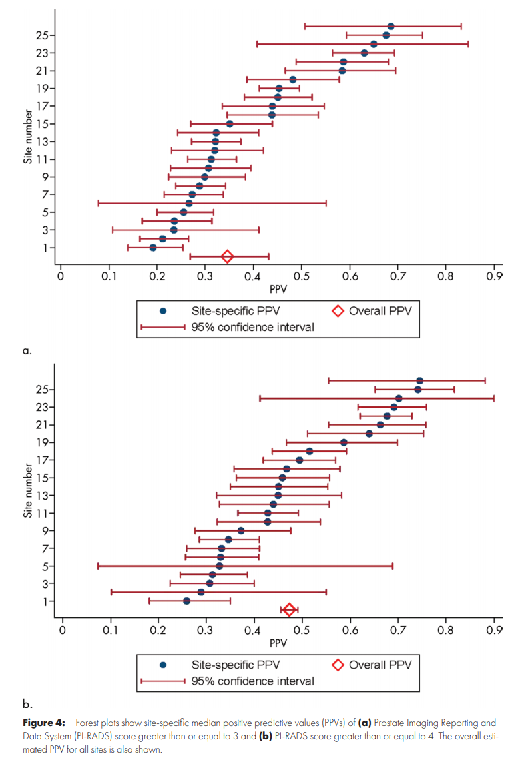
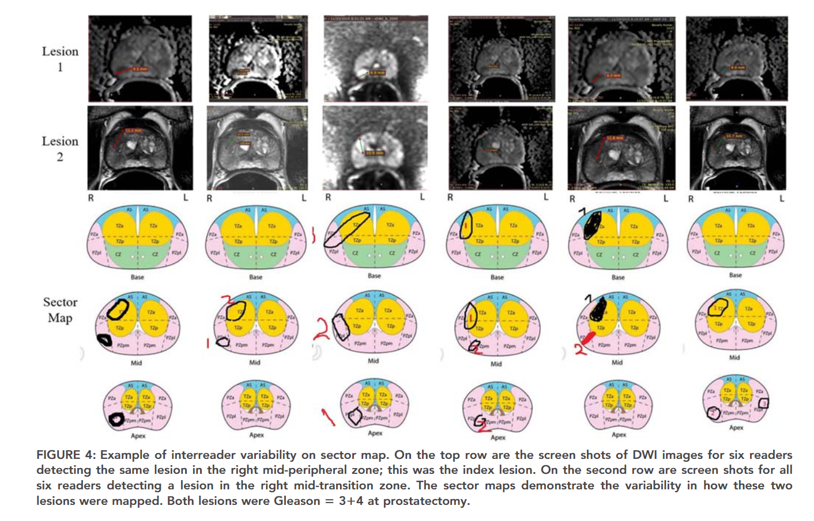
AI for Prostate Cancer Diagnosis
Problem: Inconsistent diagnostic performance of prostate MRI for localized prostate cancer diagnosis
Can a fully automated AI model solve this problem?
Greer, Turkbey JMRI, 2018
SAR Article (Radiology 2020)

Slide 6
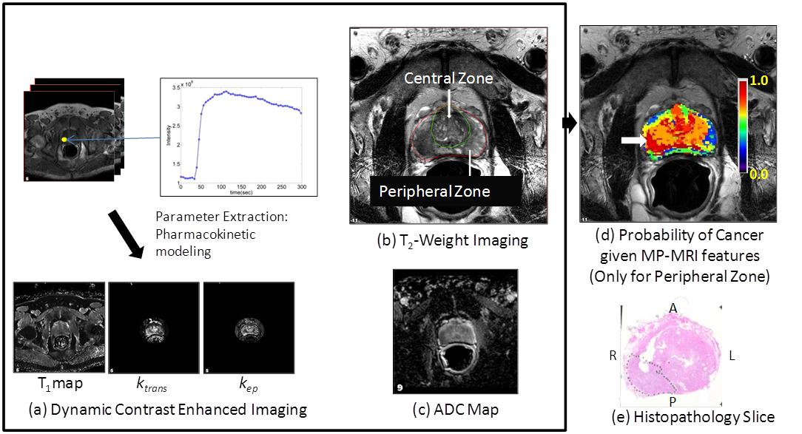
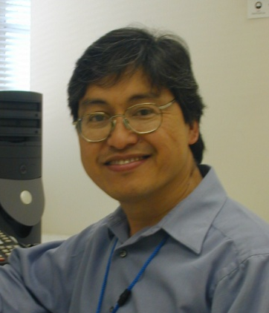
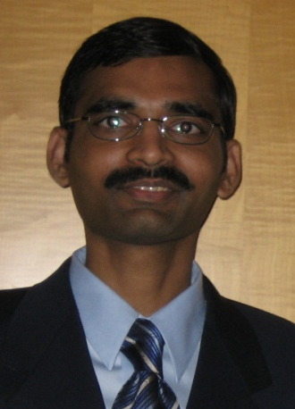
AI/CAD 1.0 (made in MIP)
Shah V et al. 2012 Medical Physics

Slide 7
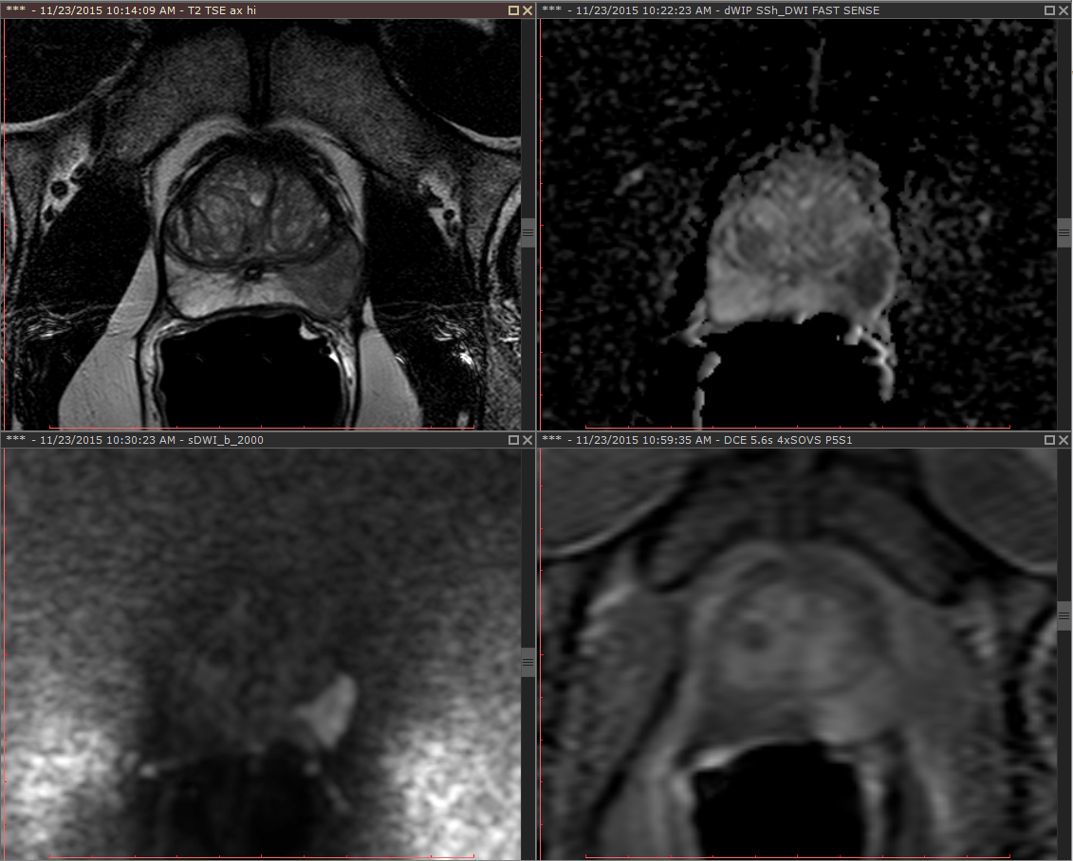
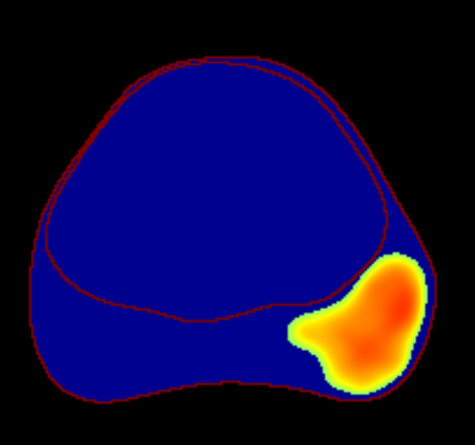
AI/CAD 2.0 (Inside NIH Validation)
Trained on segmentations of tumor proven biopsy regions
Intensity-based and Haralick-based features for texture analysis
Random forest classifier
T2W
DCE
CAD Probability Map
ADC
b-2000
Lay N et al. 2017 JMI

Slide 8
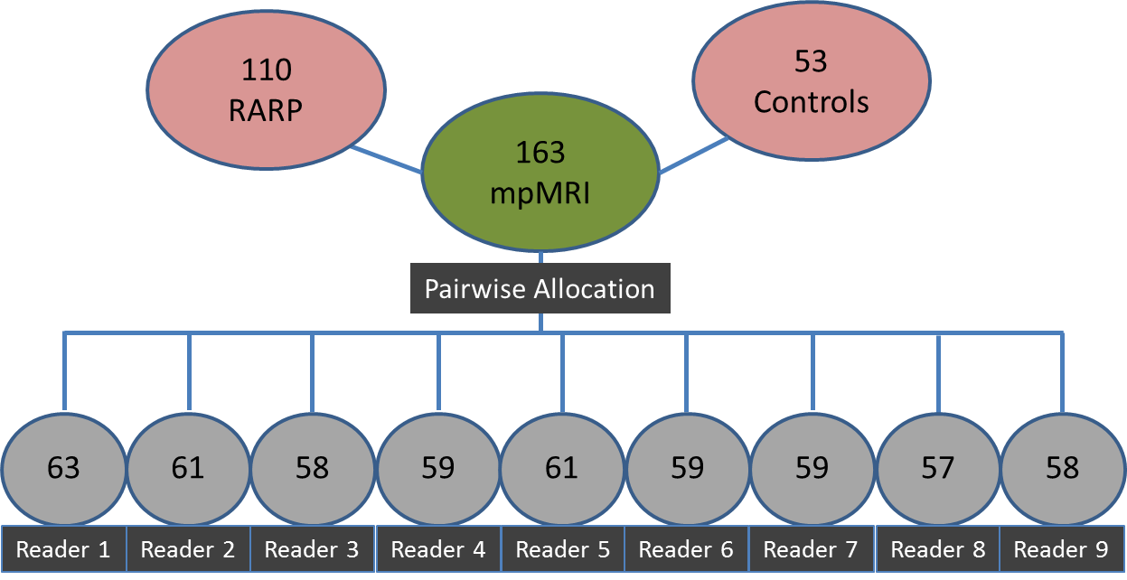
AI/CAD 2.0 (Inside NIH Validation)
Prostatectomy
# Pts Read
USA
UK
Brazil
USA
Singapore
Egypt
USA
Turkey
USA
mpMRI
Experience
>2000 cases
500-1500 cases
<500 cases
M. Greer et al. European Radiology (04/12/2018)

Slide 9
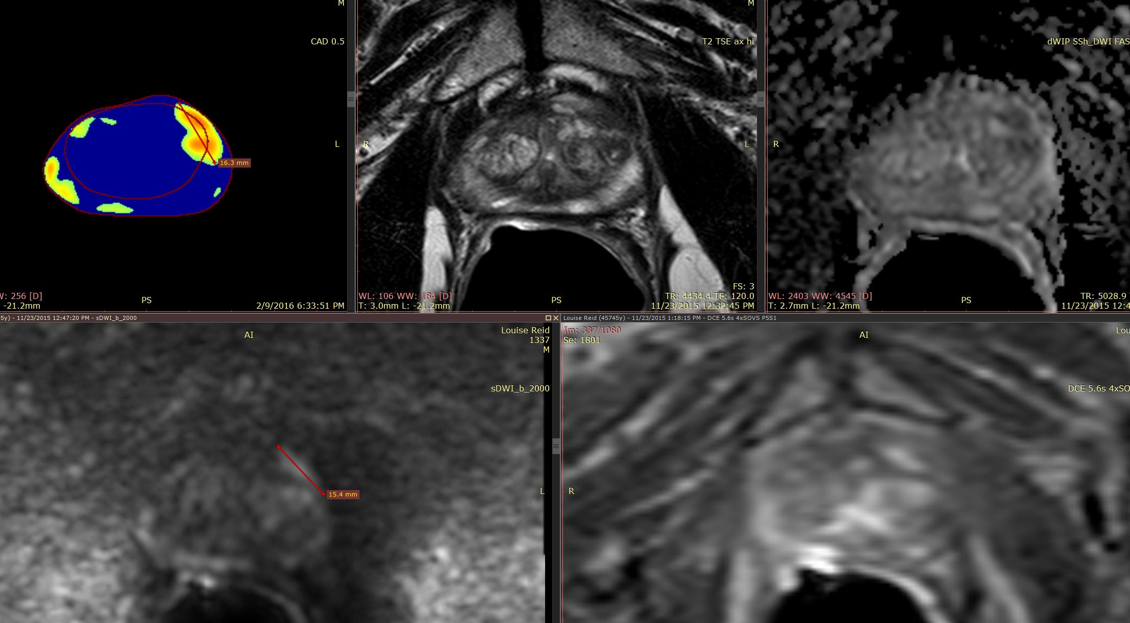
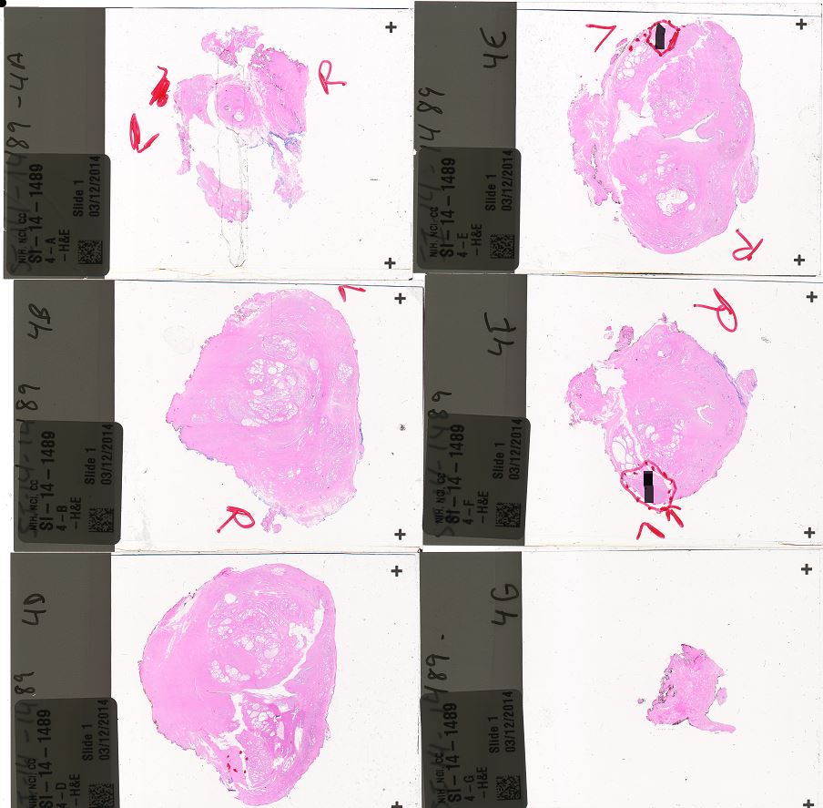
AI/CAD 2.0 (Inside NIH Validation)
PI-RADS Score For Each Reader
Reader | 1 | 2 | 3 | 4 | 5 | 6 | 7 | 8 | 9
CAD | 5 | 2 | 4 | 4 | 4 | 2 | 4 | 4 | 3
MRI | 4 | ND | 4 | 4 | 4 | ND | 4 | ND | ND
M. Greer et al. European Radiology (04/12/2018)
*ND= Not Detected

Slide 10
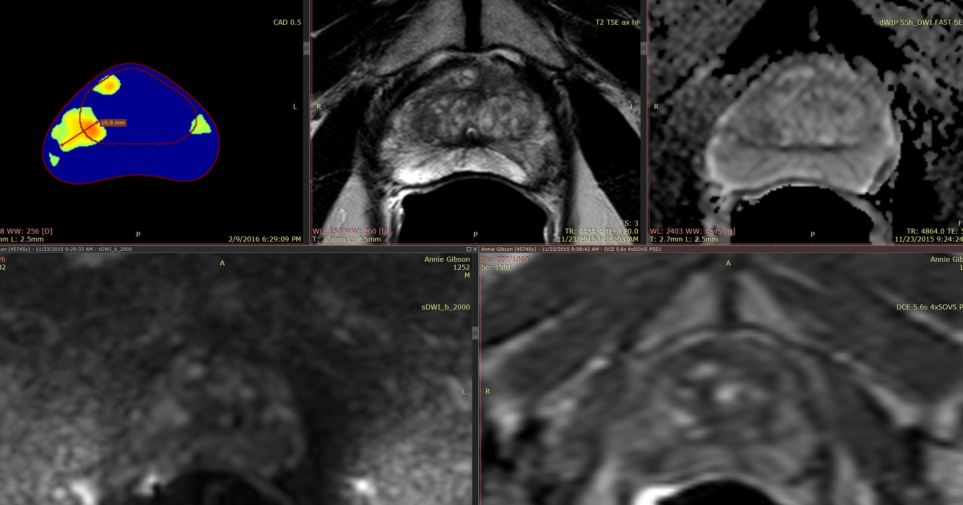
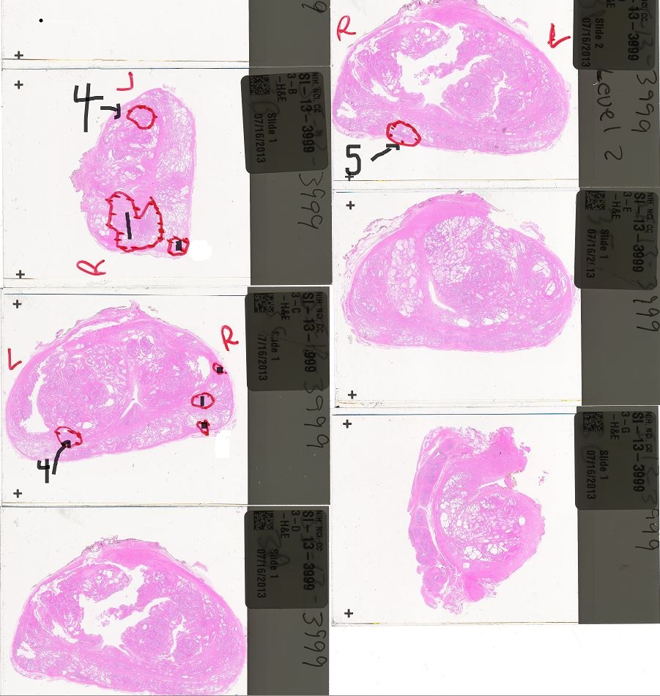
Challenges with AI/CAD 2.0
PI-RADS Score For Each Reader
Reader | 1 | 2 | 3 | 4 | 5 | 6 | 7 | 8 | 9
CAD | 1 | 1 | 2 | 4 | ND | 2 | 4 | ND | 2
MRI | ND | ND | ND | 3 | 3 | ND | ND | ND | 3
M. Greer et al. European Radiology (04/12/2018)
*ND= Not Detected

Slide 11
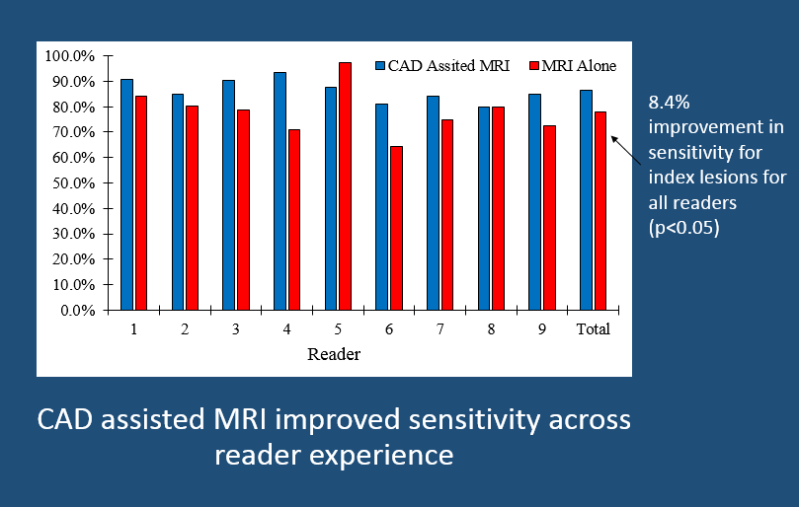
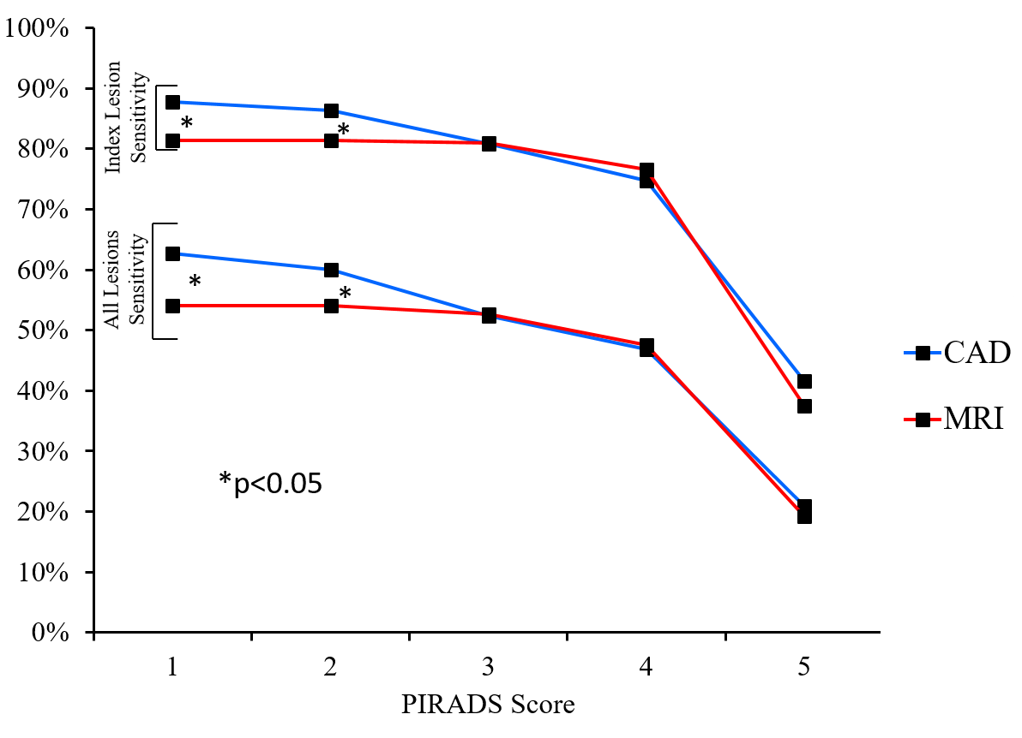
AI/CAD 2.0 (Inside NIH Validation)
M. Greer et al. European Radiology (04/12/2018)

Slide 12
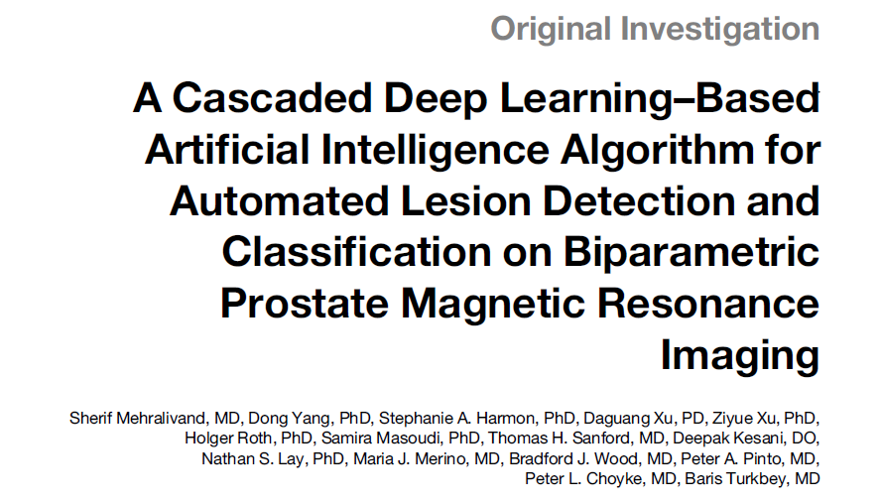
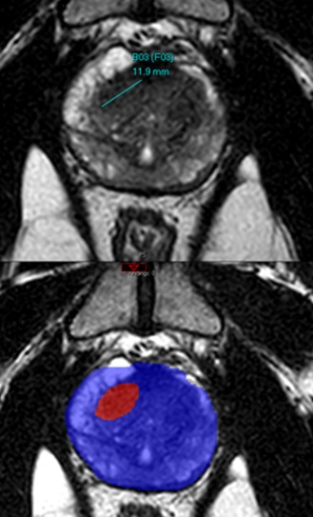
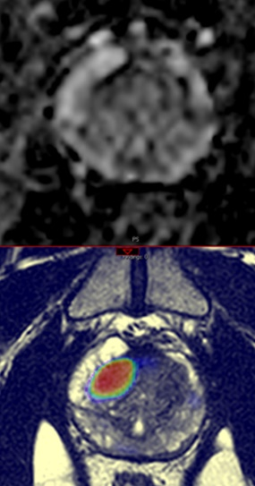
1390 patients (n=350 outside NIH)
train/test (89%/11%)
Lesions were contoured + assigned PI-RADS category
3D U-Net: lesion detection and segmentation
Two 3D residual neural network: PI-RADS categorization
PPV (CDR) = 63%
False positives/patient = 0.44 lesion/patient
TP= 82% were cancer
FP=51% were benign
Lesion segmentation (DSC) = 0.36
PI-RADS classification accuracy=58%

Slide 13
Cascaded (end-to-end) bpMRI AI model
https://github.com/Project-MONAI/research-contributions/tree/main/prostate-mri-lesion-seg
April 2019-September 2022
658 patients (median age=67 years, PSA=6.7ng/ml)
1029 lesions
31% biopsy naïve
78% Caucasian
40% positive family history of prostate cancer
Lin Y, et al. Radiology (2024)

Slide 14
Analysis | TP | FN | FP | TN | Sensitivity |  | PPV |  | FDR |  | Specificity |  | DSC
 |  |  |  |  | % | 95% CI | % | 95% CI | % | 95% CI | % | 95% CI
Lesion-level | 566 | 463 | 370 | NA | 55 (566/1029) | 52, 58 | 60 (566/936) | 57, 64 | 40 (370/936) | 36, 43 | NA | NA | 0.29
Participant-level | 519 | 41 | 72 | 23 | 93 (519/559) | 90, 95 | 88 (519/591) | 85, 90 | 12 (72/591) | 10, 15 | 23 (23/98) | 15, 32 | 0.34
Mean number of false positive lesions per participant= 0.56 (range 0–3).
CDR for GG>1 Prostate cancer:
AI=96% (281/294; 95% CI: 94, 98) vs. Radiologist= 98% (287/294; 95% CI: 96, 99) (p = 0.24).
GG1=84% (103/122)
GG2=96% (152/159)
GG3=96% (47/49)
GG4=95% (38/40)
GG5=98% (45/46)
Lin Y, et al. Radiology (2024)

Slide 15
72-year-old male PSA= 9.1ng/mL
Two distinct lesions were detected by the radiologist representing the ground truth
Lesion 1 (arrow) PI-RADS 4
Bx=Gleason score 7 (3+4)
Lesion 2 (arrow heads) PI-RADS 3 Bx=benign
Lin Y, et al. Radiology (2024)

Slide 16
64-year-old male PSA= 8.1ng/mL
No distinct lesion was detected by the radiologist
AI detected left mid PZ lesion
Bx=Gleason score 7 (3+4)
Lin Y, et al. Radiology (2024)

Slide 17
74-year-old male PSA= 12.9ng/mL
One distinct lesion was detected by the radiologist representing the ground truth
Lesion 1 (arrow) PI-RADS 4
Bx=Gleason score 7 (3+4)
AI did not detect this lesion
Lin Y, et al. Radiology (2024)

Slide 18
Clinical or preclinical scientific question
Curation
Data Preprocessing
Data
Annotation
Academic publication
Deployment (PACS-HALO-HPC/Biowulf)
Testing & Failure analysis
AI model development
Open-source availability*
Keep the expert in the loop
Future use in clinical-preclinical environment
Next stage AI related projects
Translational AI Practice

Slide 19
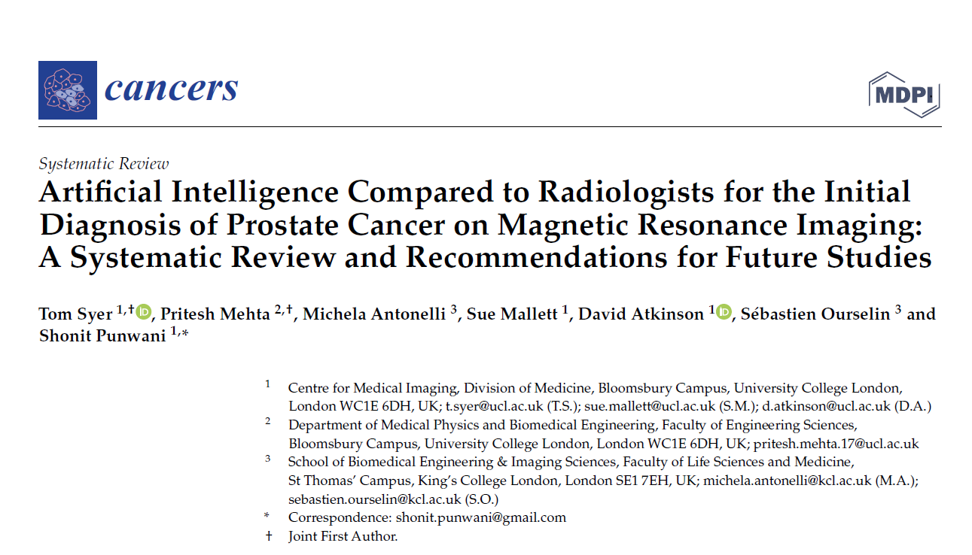
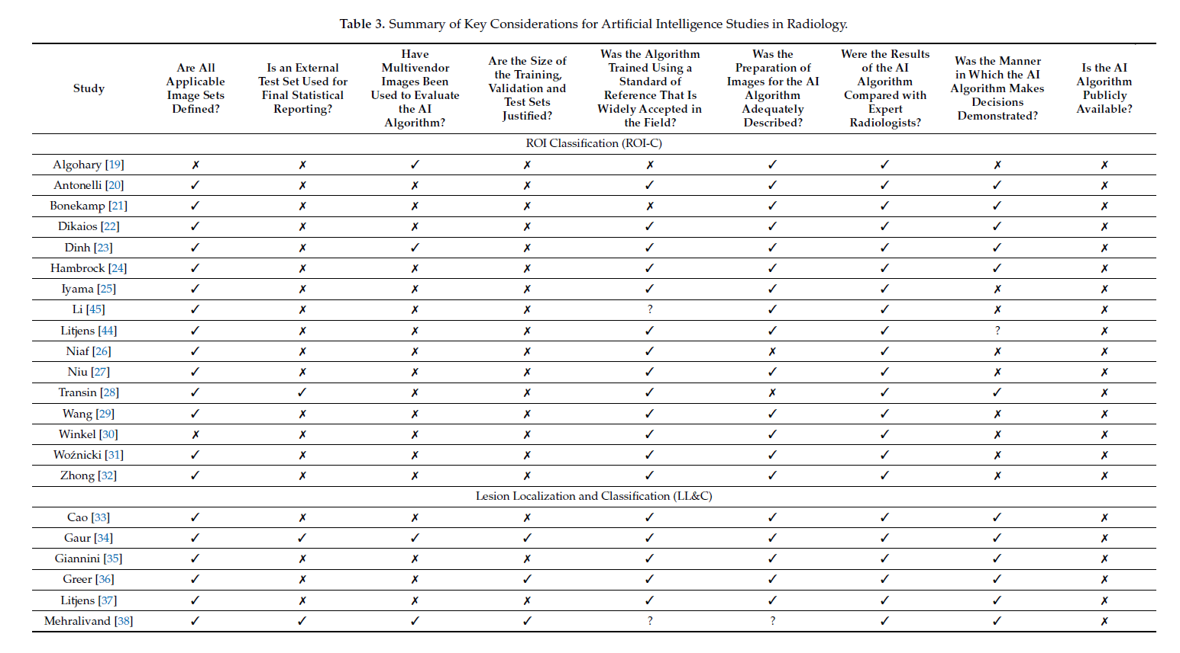
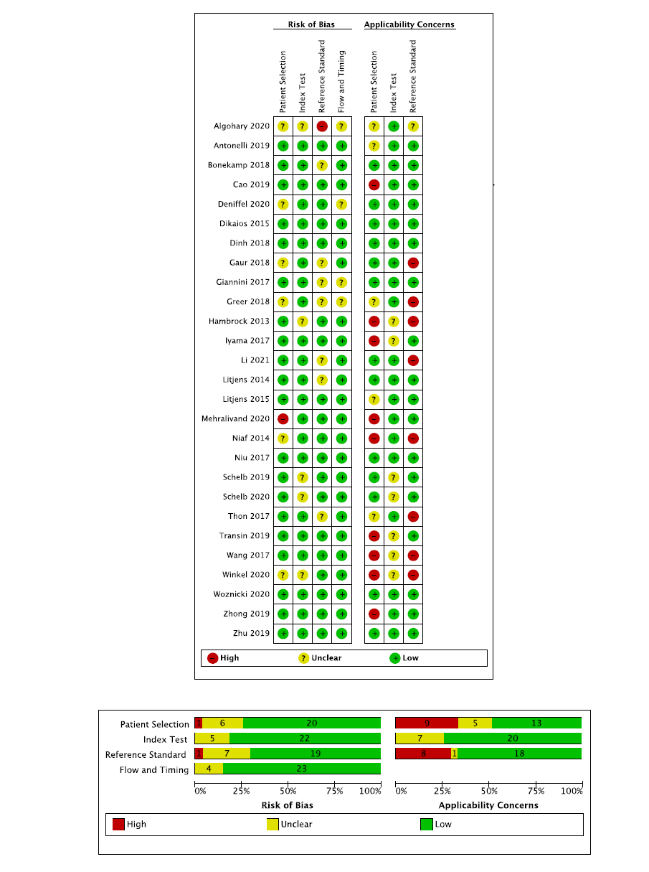
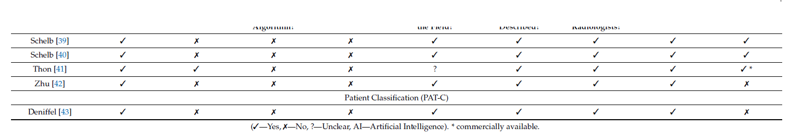

Slide 20
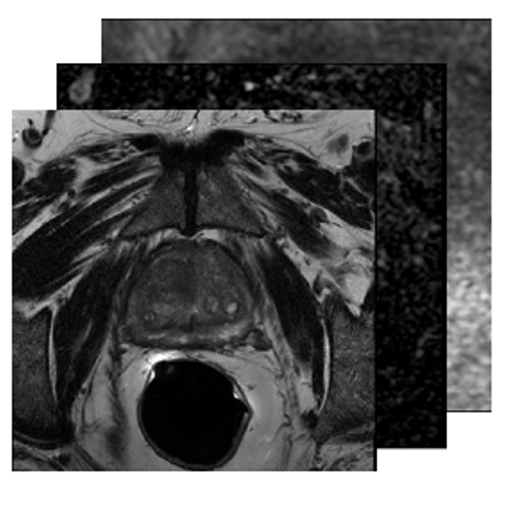
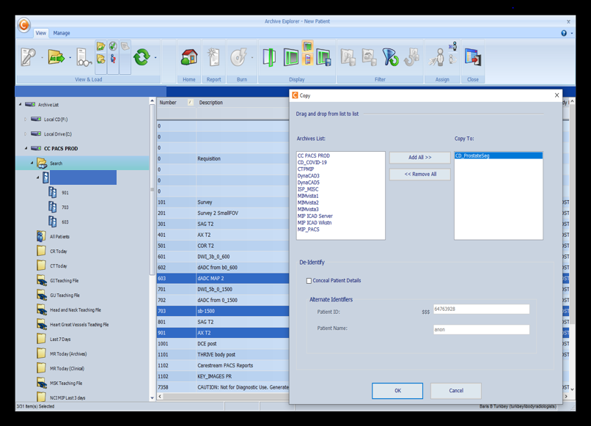
Workflow
user-controlled series selection
DICOM images pushed from PACS under Application Entity Titles specifically associated to each inference pipeline
Patient selection and pipeline execution are controlled by the PACS user (radiologist)

Slide 21
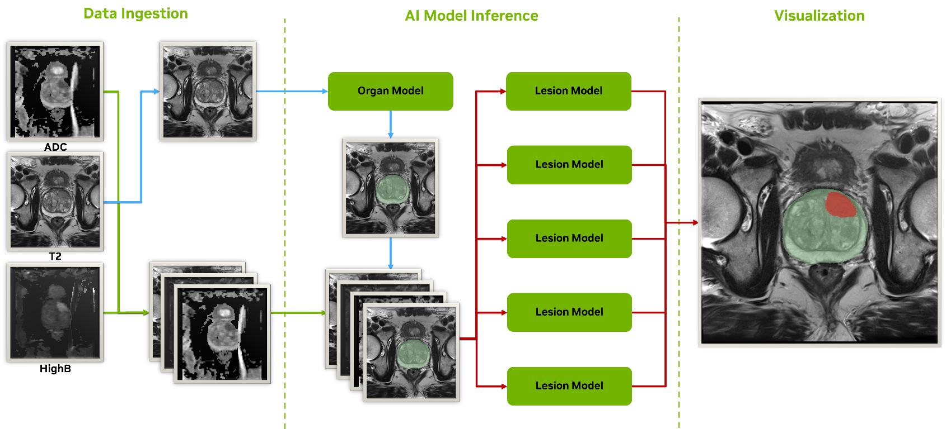
AI Pipeline
MONAI Deploy Express
Notes:
AE Title triggers separate operators for series selection, organ segmentation, lesion segmentation, and lesion classification.
The resulting output files of the pipeline included both organ and lesion segmentation masks, a DICOM-wrapped PDF report with computed lesion information, and STL files embedded in DICOM private tags for 3D visualization.

Slide 22
PACS Display

Slide 23

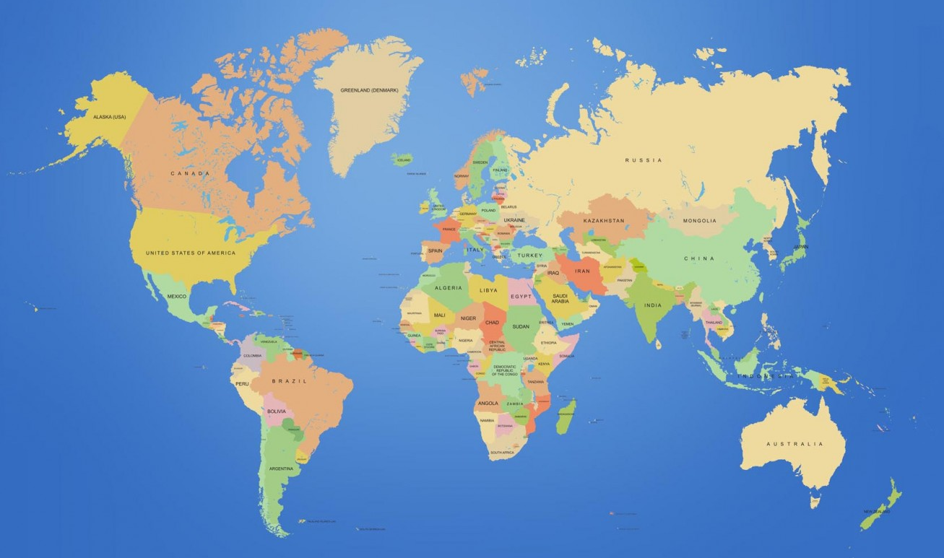
NCI Prostate MRI AI model
NCI CCR:
Guiding prostate biopsies (UOB)
Radiotherapy planning (ROB)
Prostatectomy specimen processing (UOB, LP)
Focal therapy planning (UOB)

Slide 24
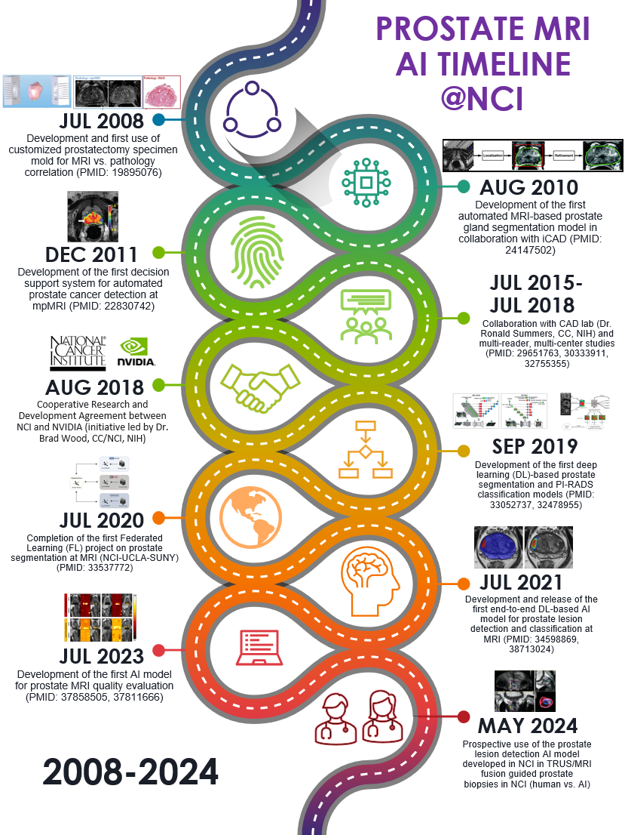
Prognosis
Lesion detection, classification
Organ segmentation

Slide 25
Artificial Intelligence Resource (AIR)
Mission: To develop translational AI tools that enhance advanced image analysis and computer vision, empowering researchers both within and outside NIH to effectively integrate AI into their research.
Projects/data:
Clinical and preclinical
Radiology (CT, MRI, ultrasonography, PET/CT, x-ray), digital pathology (H&E, IHC), endoscopy (GI, GU, robotic surgery), EHR

Slide 26
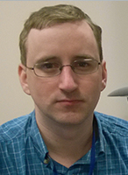
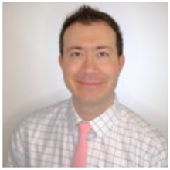
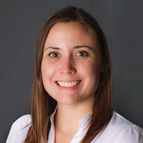
https://ostr.ccr.cancer.gov/emerging-technologies/air/
G. Thomas Brown MD PhD
Staff Clinician
Stephanie A. Harmon PhD
Stadtman Investigator
Nathan S. Lay PhD
Staff Scientist
Sushant Patkar PhD
Research Fellow
Fahmida Haque PhD
Post-doc Fellow
Emma Stevenson BS
Post-bac Fellow
Affiliated AIR Members:
Rosina Lis, MD, AIR Pathologist
Kutsev Ozyoruk PhD, MIB post-doc Fellow
Zhijun Chen PhD, SH post-doc Fellow
Harry Zhang, PhD, SH post-doc Fellow
Omer Esengur, MD, MIB post-doc Fellow
Hunter Stecko, BS, MIB, MRSP Fellow
Benjamin Simon, NIH-OxCam PhD Student
Philip Eclarinal NMT, IT Support
Steering Committee:
Brad Wood, CC
Steve Hewitt, NCI
Clem McDonald, NLM
Ulas Bagci, Northwestern
Peter Choyke, NCI
Baris Turkbey, NCI
Admin Support:
Beth Hardisty, AO
Karen Wong, MIB (purchase)
Betty Garcia, MIB (travel)

Slide 27



Thank you…
MIB
Peter Choyke
Stephanie Harmon
Nathan Lay
G. Tom Brown
Esther Mena
Liza Lindenberg
Kutsev Ozyoruk
Omer Esengur
Benjamin Simon
Hunter Stecko
Emma Stevenson
Mason Belue
Enis Yilmaz
David Gelikman
Yue Lin
Sushant Patkar
Fahmida Haque
Rosina Lis
Frank Lin
MIB
Yolanda McKinney
Linda Burke Prout
Hisataka Kobayashi
Freddy Escorcia
Amy LeBlanc
Dagane Daar
Tieu Hoa
Philip Eclarinal
Mona Cedo
Bryanna Frith
Juanita Weaver
Beth Hardisty
Betty Garcia
Karen Wong
Steve Adler
Anita Ton
Marcelino Bernardo
Interventional Radiology
Brad Wood
Mike Kassin
Charisse Garcia
Lindsey Hazen
Meredith Digennaro
UOB
Peter Pinto
Sandeep Gurram
ROB
Deborah Citrin
Krishnan Patel
Kilian Salerno
Murali Cherukuri
Radiology (CC)
Ashkan Malayeri
Elizabeth Jones
Te Chen
Evrim Turkbey
Laboratory of Pathology
Maria Merino
NCI Leadership
James Gulley
Deborah Citrin
GMB
Ravi Madan
Fatima Karzai
Anna Couvillon
Biostatistics
Erich Huang
Joanna Shih
NIBIB
Marcial Garmendia
Northwestern University
Ulas Bagci
NVIDIA
Daguang Xu
Dong Yang
Ziyue Xu
Jesse Tetreault
Holger Roth
Mona Flores
linkedin.com/in/baris-turkbey-56b507a4/
@radiolobt

