Slide 1
Data and Bioinformatics Resources from the NIH Library
Doug Joubert
NIH Library
Notes:
Data service is part of our Research Analytics program

Slide 2
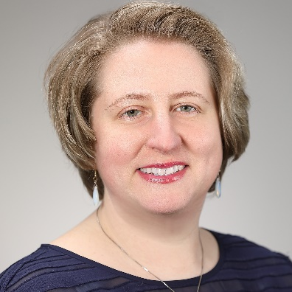
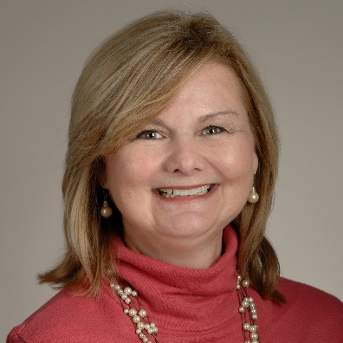
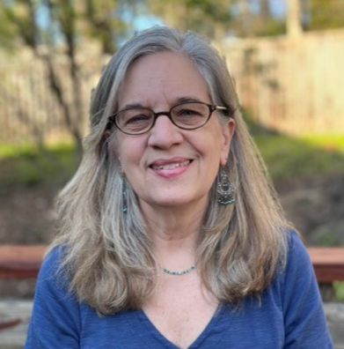
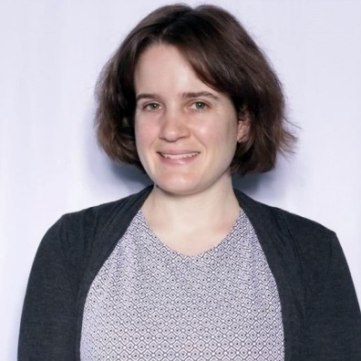
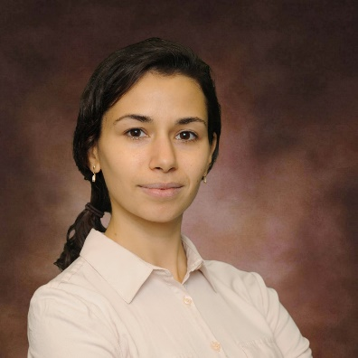
Research Analytics Branch
Data Services
Data Services
Biostatistics
Data Scientist: Data
Data Scientist: Bio
Bibliometrics
Bibliometrics/Data
Bibliometrics
Branch Chief
OpenAI. (2024). DALL-E [AI Image Generator]. https://openai.com/dall-e

Slide 3
What We Do
Provides comprehensive support to NIH staff at every stage of the data life-cycle, from data generation and collection to analysis, interpretation, and sharing
Two primary drivers of our service model
Leveraging NIH Library tools and expertise to support data analytics, data visualization, and bioinformatics
Supporting mission-critical efforts to sustain advances in the sciences, medicine, and public health

Slide 4
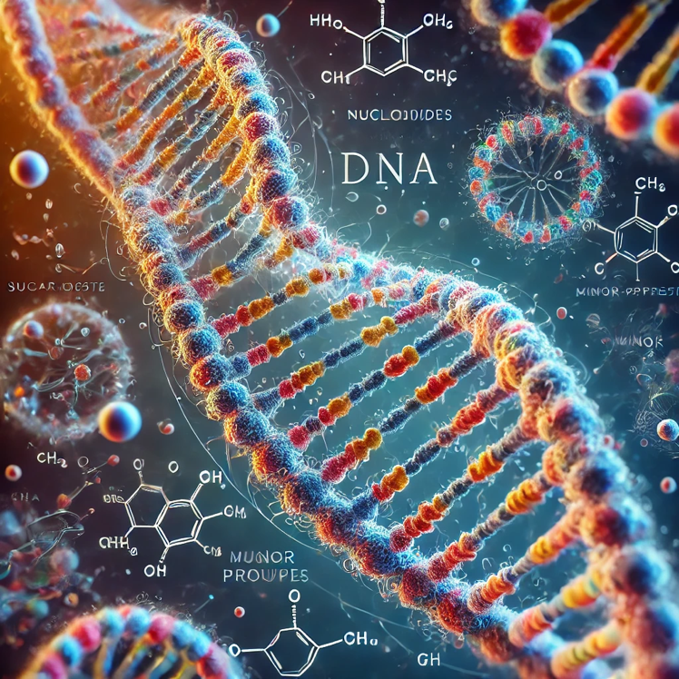
Bioinformatics
Who We Are
Support NIH researchers and clinicians who seek solutions for retrieving and analyzing biological data
What We Provide
Software for data analysis and interpretation
Access to high-performance workstations
Resources to support data and pathway analysis
OpenAI. (2024). DALL-E [AI Image Generator]. https://openai.com/dall-e
Notes:
We offer:
High Performance Computing - Three high-performance workstations are available in the NIH Library. These computers are dedicated to high-throughput analysis and may be reserved online.
Analysis Tools and Databases - Resources cover both raw data analysis such as next generation sequencing data and further refinement of these results using pathway analysis, variant filtering, or other methods.
Training - Basic bioinformatics classes using open source software and public databases, as well as vendor-led training for NIH Library-licensed bioinformatics resources are offered through the Bioinformatics Support Program.
Doug Joubert, who is an Adjunct Faculty Member at Catholic has recently returned to the library to be the Bioinformatics Coordinator.

Slide 5
Bioinformatics Workstations
Bioinformatics 1
JMP (statistics software)
Partek Flow
Partek Genomics Suite
Partek Pathway
Go to: Workspaces Reservation
OpenAI. (2024). DALL-E [AI Image Generator]. https://openai.com/dall-e
Notes:
We have two workstations here in the library equipped with bioinformatics tools. The workstations can be accessed in the library in person, and remotely.

Slide 6
Bioinformatics Workstations
Bioinformatics 2
CLC Genomics Workbench
JMP (statistics software)
MATLAB (Bioinformatics Toolbox)
Go to: Workspaces Reservation
OpenAI. (2024). DALL-E [AI Image Generator]. https://openai.com/dall-e
Notes:
We have two workstations here in the library equipped with bioinformatics tools. The workstations can be accessed in the library in person, and remotely.

Slide 7
Bioinformatics Licensed Resources

Slide 8
Bioinformatics: Resources
Access to licensed bioinformatics analysis
Access to two high-performance bioinformatics workstations optimized for bioinformatics

Slide 9
Bioinformatics: Genomics Suite
Vendor: Partek
Advanced statistics and interactive data tool designed to reliably extract biological signals for user data:
Annotation
Hierarchical Clustering Analysis
Gene Ontology ANOVA
Visualizations

Slide 10
Bioinformatics: Partek Flow
Vendor: Partek
Analysis program:
Upload your own data
Analyze your data
Create visualizations
Develop workflows

Slide 11
Bioinformatics: IPA
Vendor: Qiagen
Analysis program:
Upload your own data
Analyze your data
Create visualizations
Explore pathways

Slide 12
Bioinformatics: QCI Interpret Translational
Vendor: Qiagen
Evaluates genomic variants in the context of:
Published/unpublished biomedical evidence
Professional association guidelines
Publicly available databases, annotations
Drug label data
Clinical trials

Slide 13
Bioinformatics: Human Mutation Database
Vendor: Qiagen
Attempt to collate all known (published) gene lesions responsible for human inherited disease
Screenshot contains mutations for Per2 gene

Slide 14
Data Science Training
Notes:
Now we'll run through the various Data classes offered by the library.

Slide 15
Training Through Publication Life Cycle
Focus is on reproducibility
Supporting staff through publication life cycle:
Analysis
Visualization
Publication

Slide 16
Data Management and Sharing
Two-part course for those who want to learn about research data management and sharing
Managing and sharing data through the entire data life cycle
Data management best practices
Data management tools
Resources that enable data sharing
See: Data Management and Sharing: Part 1 and Part 2

Slide 17
Finding and Sharing Research Data
Overview of resources for locating research datasets, data repositories, and data publications for data sharing and re-use
Overview of key issues to consider when re-using datasets or when locating a data repository for sharing and preservation purposes will be discussed
See: Resources for Finding and Sharing Research Data
Related Subject Guide: Finding Datasets, Data Repositories, and Data Standards

Slide 18
How to Cite Data
30-minute lunch & learn
Learning objectives
Discuss the importance of data citation
Identify key components of a data citation
Locate style guidelines for data citation
Attendees are strongly encouraged to bring a data set to cite as a working example for this training
Please contact Stacy.brody@nih.gov for more information

Slide 19
Managing Data in Excel Series
Managing Data in Excel: Introductory training for those who need to quickly learn basic Excel data management features and for those who are interested in a refresher
Creating Pivot Tables in Excel: How to create and manipulate pivot tables in Excel
Creating Charts in Excel: Participants will review and select chart types, layout, and styles, and explore colors and format options

Slide 20
Introduction to R and RStudio
Basic overview of the functionality of R programming language and RStudio
Lists reasons for using R
Describes the purpose of the scripts
Describes methods for finding help on R and Rstudio
Describes how to organize files and directories for a set of analyses as an R Project
See: Introduction to R and RStudio

Slide 21
Data Wrangling in R
Focus on data wrangling using tidy data principles
Discussion of what makes data "tidy," and methods for reshaping data using dplyr and tidyr functions
See: Data Wrangling Workshop

Slide 22
Data Visualization in R: ggplot
Describe how perception and cognition inform visualizations
Discuss the visual properties that “pop-out," and how these inform visualizations
Distinguish between aesthetic mappings and geometric objects, the fundamental building blocks of ggplot
Create a simple scatterplot
Create a plot and save it in a high-resolution format
See: Introduction to Data Visualization in R: ggplot

Slide 23
Data Visualization in R: Customization
Overview of options for customizing a ggplot graph
Methods for creating small multiples
Options for customizing a graphs
Applying ggplot themes
See: Data Visualization in ggplot: Customizations

Slide 24
Git in RStudio
Focuses on using Git and GitHub, with Rstudio
Participants will have a chance to experiment with this integration and understand its advantages for collaboration and version control
See: Git in RStudio

Slide 25
Version Control and GitHub
Introduces version control and using GitHub for project versioning
Participants will have a better understanding of version control and its advantages for collaboration and version control
See: Version Control and GitHub

Slide 26
Project Management in RStudio
Data and project management using R and RStudio
Best practices for setting up RStudio for projects
Create a new RStudio Project
Discuss best practices for organizing data in an RStudio project
Designed to be relevant to students from different disciplines
See: Project Management in RStudio

Slide 27
Python for Data Science
Non-programming class that demonstrate integrated development and learning (IDE) platforms for learning Python
Overview of the fundamentals of Python coding
Why it is advantageous to develop these skills
See: Python for Data Science

Slide 28
Quarto for Scholarly Publishing
Quarto is an open-source scientific and technical publishing system that offers multilingual programming language support
Three classes that covers the basics of R Markdown and apply those skills in Quarto:
Introduction to Quarto for Scholarly Publishing
Quarto for Scholarly Publishing: Advanced Formatting
Quarto for Scholarly Publishing: Working with Citations

Slide 29
Data Science Training (Vendor-Led)
Notes:
Now we'll run through the various Data classes offered by the library.

Slide 30
Generalist Repositories Ecosystem
Learn about generalist repositories, including key repository features and how generalist repositories fit into the NIH data sharing landscape
Repositories participating in the NIH Generalist Repository Ecosystem Initiative:
Dataverse
Dryad
Figshare
Mendeley Data
Open Science Framework
Vivli
Zenodo
See: Data Sharing: Generalist Repositories Ecosystem Initiative

Slide 31
Vendor Lead Training: MATLAB
Coding
Optimizing MATLAB and Accelerating Code
MATLAB Automated Labeling and Iterative Learning
Data Tools
MATLAB for Excel Users
Using MATLAB on Biowulf
MATLAB with Python
MATLAB for Open Science
Notes:
Finally Vendor trainings by both MATLAB and SAS support data analysis of all kinds of advanced data analysis.

Slide 32
Vendor Lead Training: MATLAB
Deep Learning
Hands-On Virtual Lab
Image Analysis
Medical Image Analysis and AI with MATLAB
Medical Imaging Datasets Using MATLAB
Signals and Time Series Datasets Using MATLAB
Notes:
Finally Vendor trainings by both MATLAB and SAS support data analysis of all kinds of advanced data analysis.

Slide 33
Vendor Lead Training: SAS
Tips for Getting Started with SAS Training
Coding Macros in SAS
Advanced Coding Macros in SAS
Integration of SAS with Open-Source Tools
Notes:
Finally Vendor trainings by both MATLAB and SAS support data analysis of all kinds of advanced data analysis.

Slide 34
Vendor Lead Training: SAS
Working with Large Datasets in SAS
Using SAS/STAT®
Slides from past trainings on Teams
Notes:
Finally Vendor trainings by both MATLAB and SAS support data analysis of all kinds of advanced data analysis.

Slide 35
Vendor Lead Training: LLM Expert AMA
Presented by speakers from NIH Cloud Lab
Provides an overview of the generative artificial intelligence (AI) services across three major cloud service providers (CSPs), including Amazon Web Services (AWS), Microsoft Azure, and Google Cloud
Steps to follow for setting up AI chatbots in cloud environments
Q&A session
AI Large Language Model Experts: Ask Me Anything Discussion
Notes:
Finally Vendor trainings by both MATLAB and SAS support data analysis of all kinds of advanced data analysis.

Slide 36
Peer-to-Peer Training

Slide 37
Peer-to-Peer Training
NIH Library has a history of partnering with subject-matter experts (SME)
We help with scheduling, marketing, and student engagement
Reach out to us to collaborate on training

Slide 38
Peer Training: Stats and Epidemiology
Clinical Center's Biostatistics and Clinical Epidemiology Service (BCES)
"Statistics and Epidemiology Class Series": (March 2023)
Overview of Statistical Concepts
Overview of Study Design
Overview of Common Statistical Tests
Review of Epidemiology Concepts and Statistics
Meta-Analysis: Quantifying a Systematic Review
Notes:
This was a Special Sessions was supported by our colleague Alicia Livinski, and it is an example of Peer-to-Peer Training mentioned earlier. This five-part lecture series taught by Dr. Ninet Sinaii from the NIH Clinical Center's Biostatistics and Clinical Epidemiology Service. This series helped attendees better understand statistical and epidemiological features in biomedical research, interpret results and findings, design and prepare studies, and critically review the results in published literature. Click on the links below to register:
Overview of Statistical Concepts: Part 1 March 7, 1:00–4:00 pm
Overview of Study Design: Part 2 March 8, 1:00–3:00 pm
Overview of Common Statistical Tests: Part 3 March 14, 12:30–4:45 pm
A Review of Epidemiology Concepts and Statistics: Part 4 March 15, 1:00–4:00 pm
Meta-Analysis: Quantifying a Systematic Review: Part 5 March 20, 1:00–3:00 pm

Slide 39
Peer to Peer Training: Bioinformatics
NCI Computational Genomics and Bioinformatics Branch (CGBB)
Series of Galaxy Bioinformatics Classes:
Exome Sequencing Data Analysis
RNA-Sequence Analysis
ChIP Sequencing Data Analysis
Pathway Analysis
NGS Visualization Tool
Notes:
Then we also offer these classes on genomics as Peer to Peer training.

Slide 40
Please Contact Us for Support
Douglas Joubert, MS, MLIS
he/him
Chief, Research Analytics Branch
National Institutes of Health Library | ORS Division of Library Services
NIHBC 10 – Clinical Center 1L13A
Contact: douglas.joubert@nih.gov | 301-827-3829
NIH Library: Website | Ask a Question | News via Email
ORCID ID: https://orcid.org/0000-0003-4090-5587
We want to hear from you—tell us how we’re doing!

