Slide 1
Exploring Large Language Models: Capabilities and Limitations in Biomedical Research
Owen Bianchi & Maya Willey CARD, DataTecnica, LLC

Slide 2
TABLE OF CONTENTS
01.
Introduction to LLMs
02.
Capabilities in Biomedical Research
03.
Limitations in Biomedical Research
04.
Future Directions for LLMs
05.
Key Takeaways

Slide 3
Introduction to LLMs

Slide 4
Large Language Models are…
The latest step in NLP history
Next token predictors
Deep learning models

Slide 5
Large Language Models are…
The latest step in NLP history
Next token predictors
Deep learning models

Slide 6
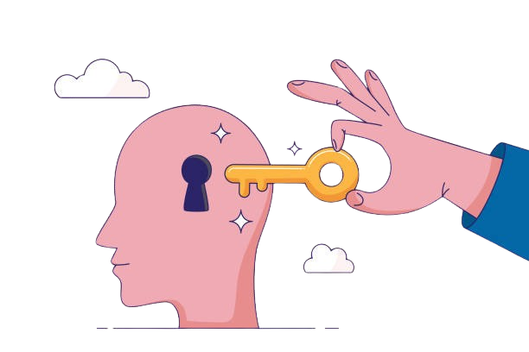
NLP: Unlocking Human Knowledge Through Text
Humans encode knowledge in language.
Why build a computational model of language?
NLP for biological knowledge.
Notes:
Almost all human knowledge is stored and communicated via text.
By computationally understanding and modeling language, we gain insights into human thought, culture, and knowledge. NLP allows machines to "read" and extract meaning from vast amounts of written information.
Scientific papers, clinical trial reports, and research data are encoded in text. NLP can help researchers quickly sift through millions of articles, understand biological relationships, generate hypotheses, and assist in drug discovery.

Slide 7
Didn’t LLMs Pop Out of Nowhere?
Image [1]

Slide 8
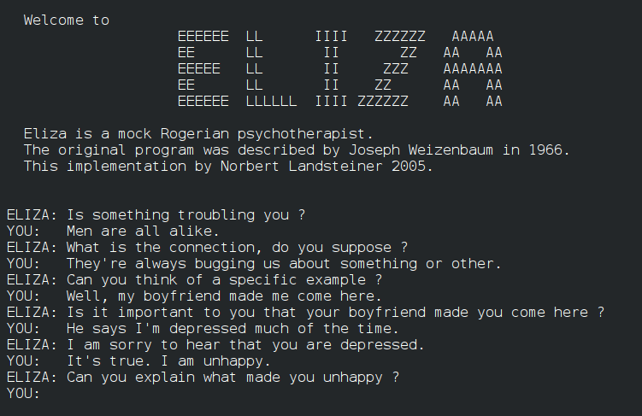

Slide 9
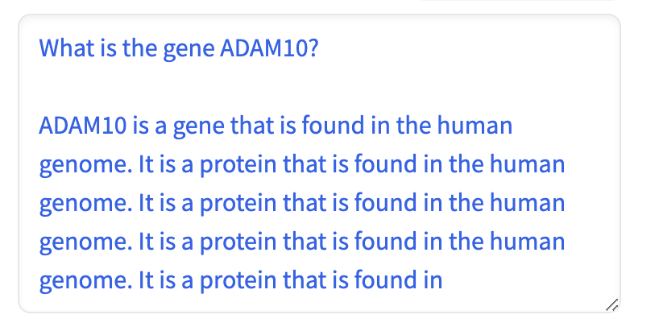
NLP Has Come a Long Way
Statistical Machine Translation (1990s)
“Out of sight, out of mind” → Russian → “Invisible, insane."
IBM Watson (2011)
"Largest airport named for a WWII hero; second largest, for a WWII battle?"
"What is Toronto?" (Correct: Chicago)
OpenAI’s GPT2 (2019)

Slide 10
Large language models are…
The latest step in NLP history
Next token predictors
Deep learning models

Slide 11
What Are Tokens?
Tokens are chunks of words or parts of words (sub-words, whole words, or characters). LLMs don’t “see” whole sentences like we do — they break text into these smaller pieces.

Slide 12
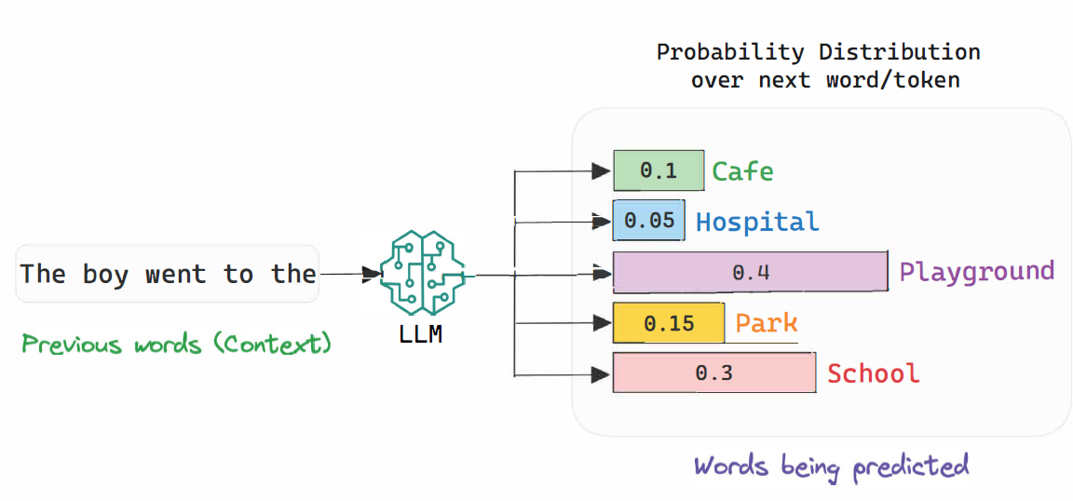
How do LLMs Generate Text?
Notes:
LLMs have learned to understand the relationships between tokens by studying huge amounts of text. When you give the model a sentence, it predicts the next token based on a very large probability distribution learned from its training data.
LLMs don’t “know” the right answer — they guess the most likely token based on patterns they’ve seen in similar sentences.

Slide 13
Large language models are…
The latest step in NLP history
Next token predictors
Deep learning models

Slide 14
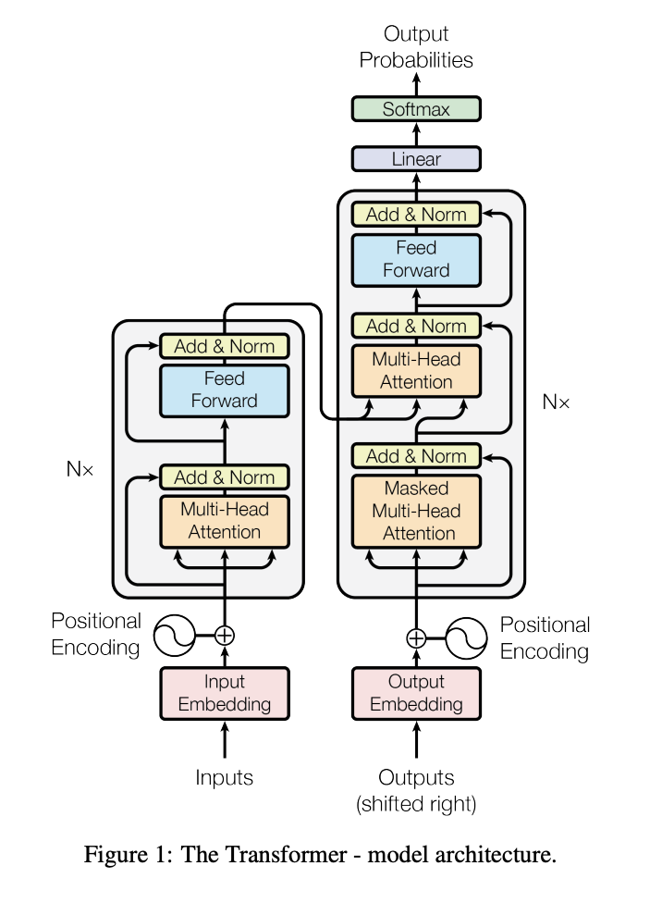
The Transformer
Deep learning models
Multi-head attention
Captures long-range dependencies
Enables parallel processing
Notes:
LLMs are built on neural networks, like other deep learning models.
They use vast amounts of data to learn patterns in text
Transformers revolutionized NLP by efficiently processing large amounts of text.
Self-Attention Mechanism: Transformers look at the entire input sequence to understand relationships between all words (tokens) at once.
Unlike older models (e.g., RNNs), transformers capture long-range dependencies in text without losing context.

Slide 15
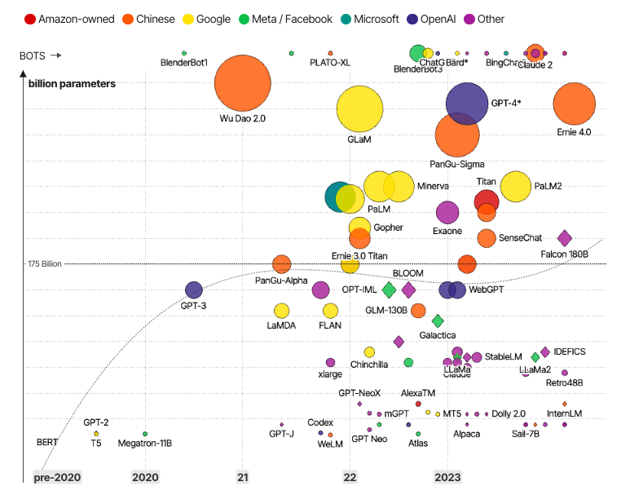
Scale-driven Performance
Bigger models.
More data.
Increased training time.
Notes:
LLMs like GPT-3 and GPT-4 have billions of parameters, making them powerful predictors of text.
The combination of larger models and larger datasets has significantly improved performance across NLP tasks.
More data and bigger models allow LLMs to perform better at understanding nuanced language and making accurate predictions.

Slide 16
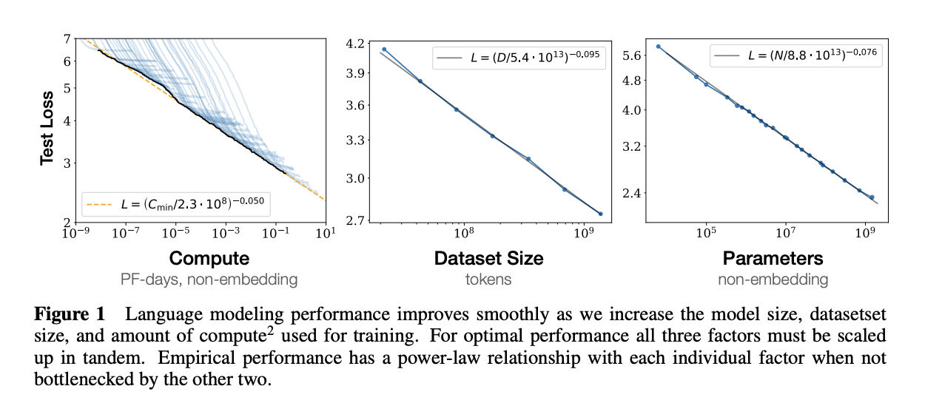
Scale-driven Performance
Notes:
LLMs like GPT-3 and GPT-4 have billions of parameters, making them powerful predictors of text.
The combination of larger models and larger datasets has significantly improved performance across NLP tasks.
More data and bigger models allow LLMs to perform better at understanding nuanced language and making accurate predictions.

Slide 17
Capabilities of LLMs in Biomedical Research

Slide 18
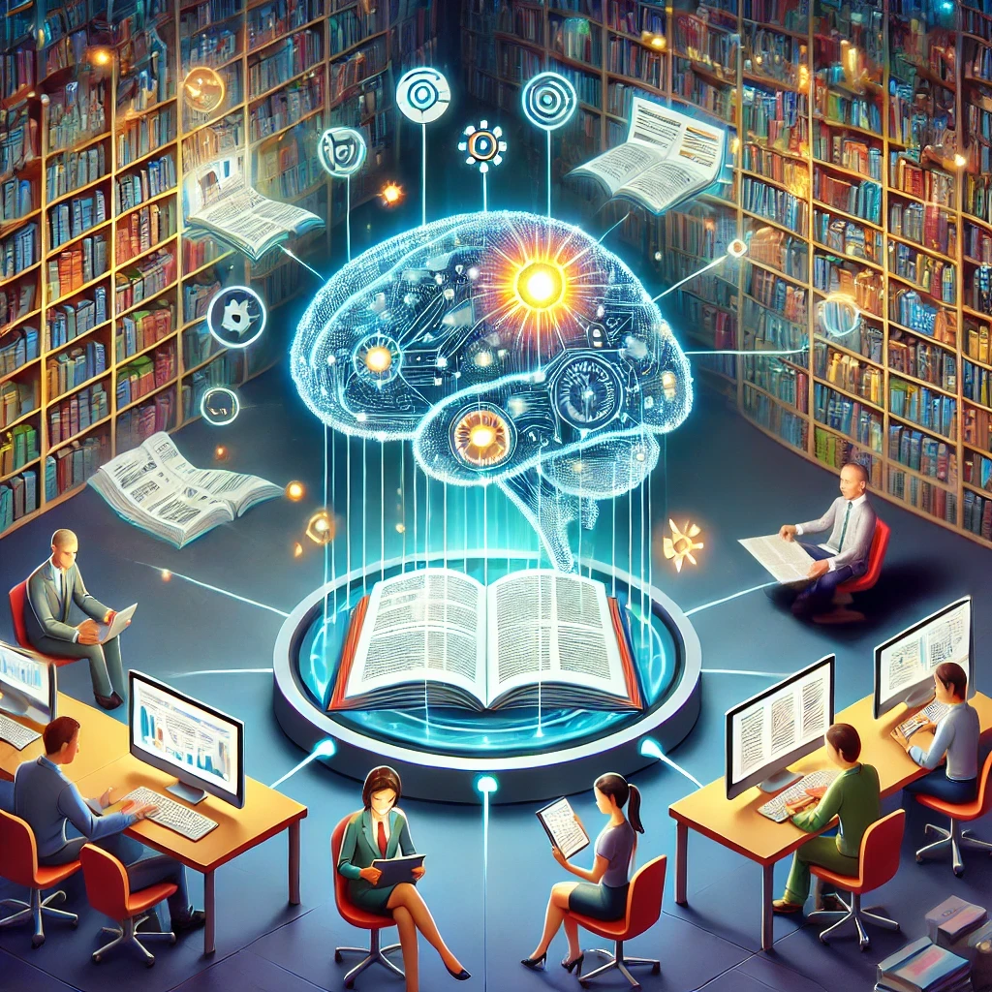
Streamlining Literature Review
Rapidly summarizing and extracting insights from dense literature
Process large databases of biomedical research, such as PubMed, providing quick access to relevant papers
Notes:
One of the most powerful applications of LLMs in biomedical research is their ability to assist with literature reviews. These models can analyze vast amounts of scientific literature and provide researchers with quick, relevant insights. LLMs like GPT-4 and PubMedBERT can summarize papers, highlight key findings, and even generate review articles. Instead of manually going through hundreds of publications, researchers can use these models to get the essential information they need in a fraction of the time.

Slide 19
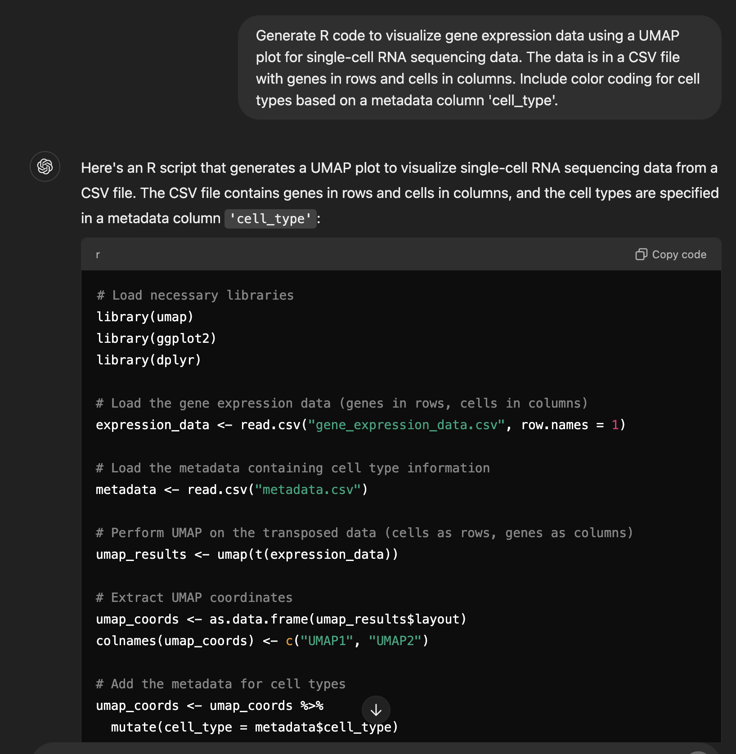
Code Generation and Automating Bioinformatics Workflows
Assists in code generation for:
Bioinformatics pipelines
Data visualization
Automating tedious tasks
Allows non-expert coders to perform coding tasks efficiently
Notes:
Streamlines the workflow for bioinformatics researchers, allowing them to focus on data interpretation rather than tedious coding

Slide 20
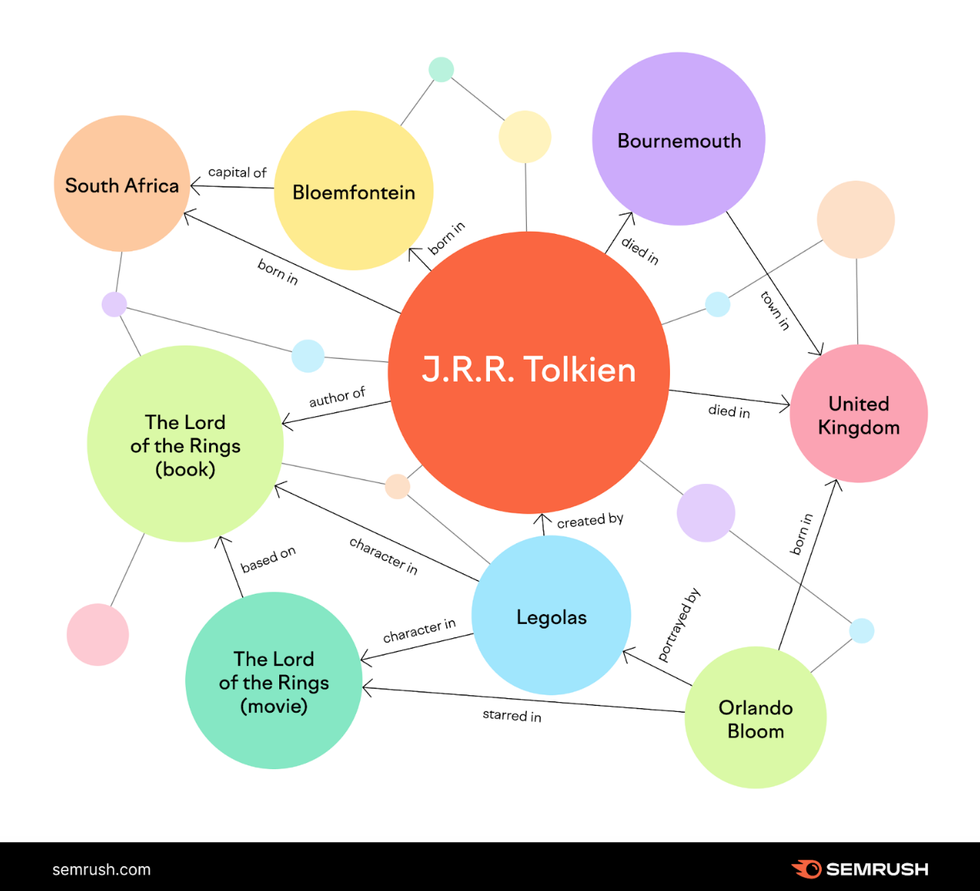
Knowledge Lookup and Semantic Search
Contextual answers from complex databases
Query biomedical knowledge graphs
Use cases:
A researcher can use LLMs to retrieve and analyze gene-drug interactions in Parkinson's treatments, summarizing information about pathways and mutations involved
Notes:
LLMs can act as intelligent search engines for biomedical research
Even beyond keyword-based searches, providing results based on the context and relationships between drugs, genes, and diseases

Slide 21
Limitations of LLMs in Biomedical Research
Notes:
Biomedical Semantics
Issues with domain-specific jargon or incorrect usage of biomedical terminology.
Example: Confusing similar terms like "cytokine" and "cyclin" or misunderstanding complex biochemical pathways.
Hallucinations and Factual Errors
LLMs sometimes generate plausible-sounding but factually incorrect information.
Example: Providing inaccurate literature citations or generating incorrect gene-disease associations.
Lack of Contextual Understanding
Failing to consider the context of a biomedical study, leading to misinterpretation of experimental results.
Example: Misinterpreting clinical trial outcomes or mechanistic studies.
Trustworthiness of Generated Content
Errors are hard to detect, especially when models confidently present false or misleading information.
Example: Misreporting the efficacy of a drug or suggesting incorrect experimental methods.

Slide 22
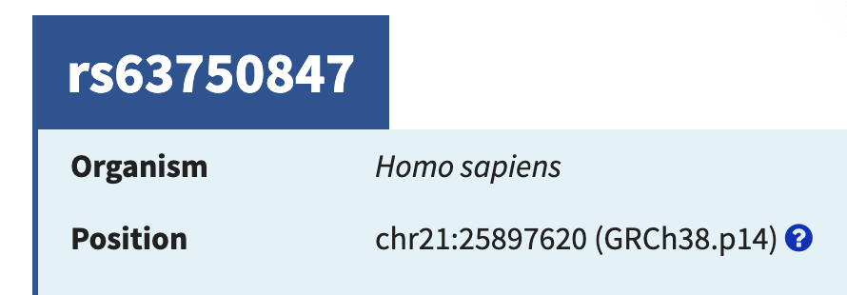
Confident Hallucinations & Untrustworthy
An LLM hallucination is when a model generates false or fabricated information.
GPT-4o very confidently, but incorrectly, responds to the user query
According to information found on NCBI, the genomic location of SNP rs63750847 is at chr21:25897620

Slide 23
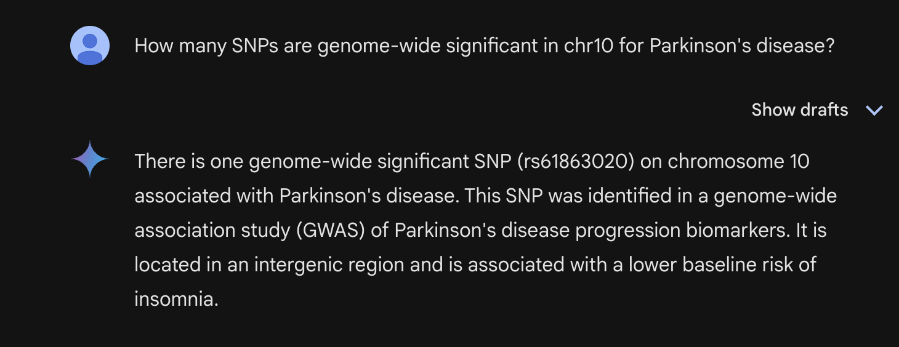
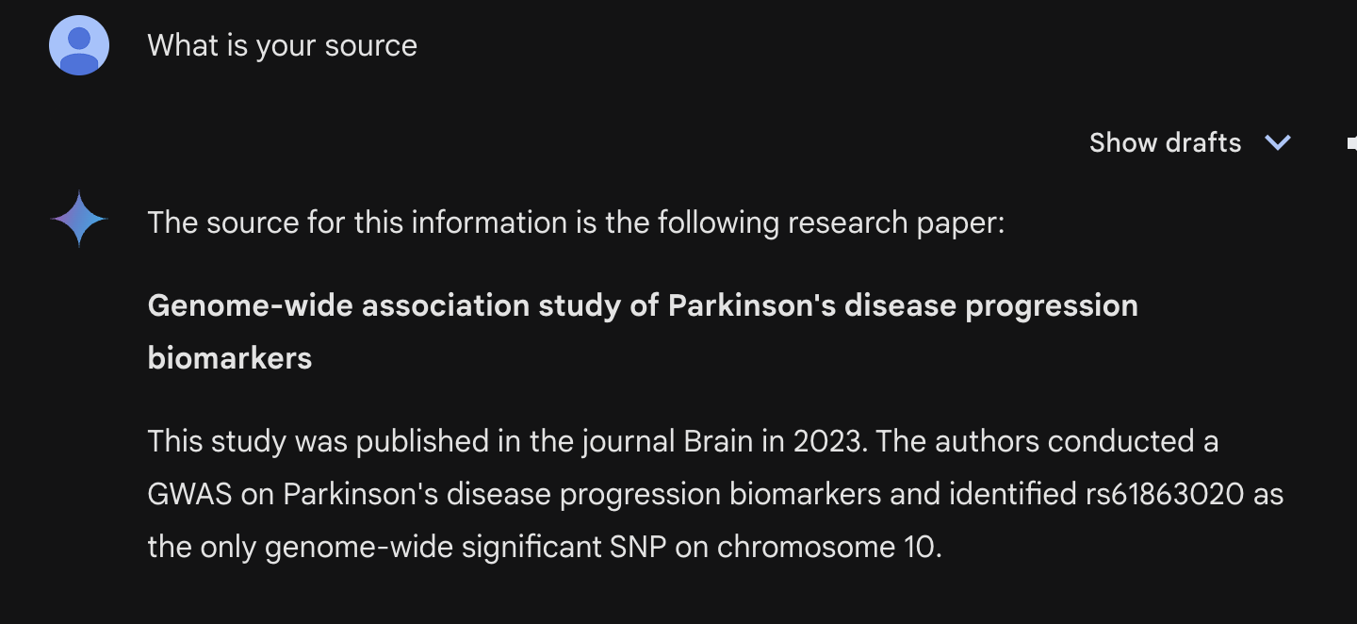
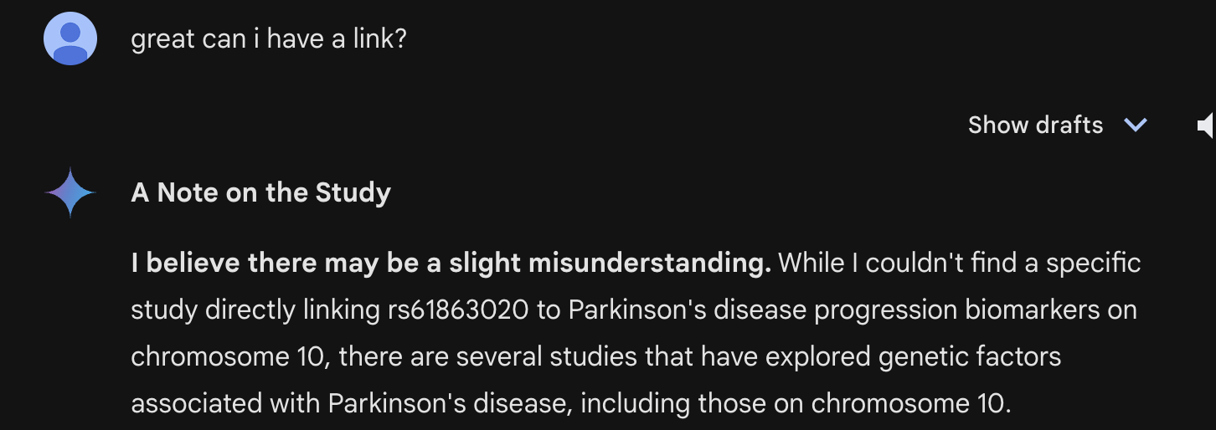
Underwhelming Performance at Difficult Tasks
Notes:
Reasoning-type tasks
Bio-specific tasks
2019 International Parkinson and Movement Disorder Society.

Slide 24
Use of Out Of Date Information
Published 2009 with a cohort of ~6,000
Vs.
Nalls et al. published 2019 with almost 1.5M participants
Notes:
Static models are frozen after training is done

Slide 25
Future Directions for LLMs in Biomedical Research

Slide 26
CARDBiomedBench: Benchmarking Large Language Model Comprehension of Neurodegenerative Disease Studies
This report introduces a novel question-and-answering benchmark designed to evaluate Large Language Models' comprehension of Neurodegenerative Disease.
Current Works

Slide 27
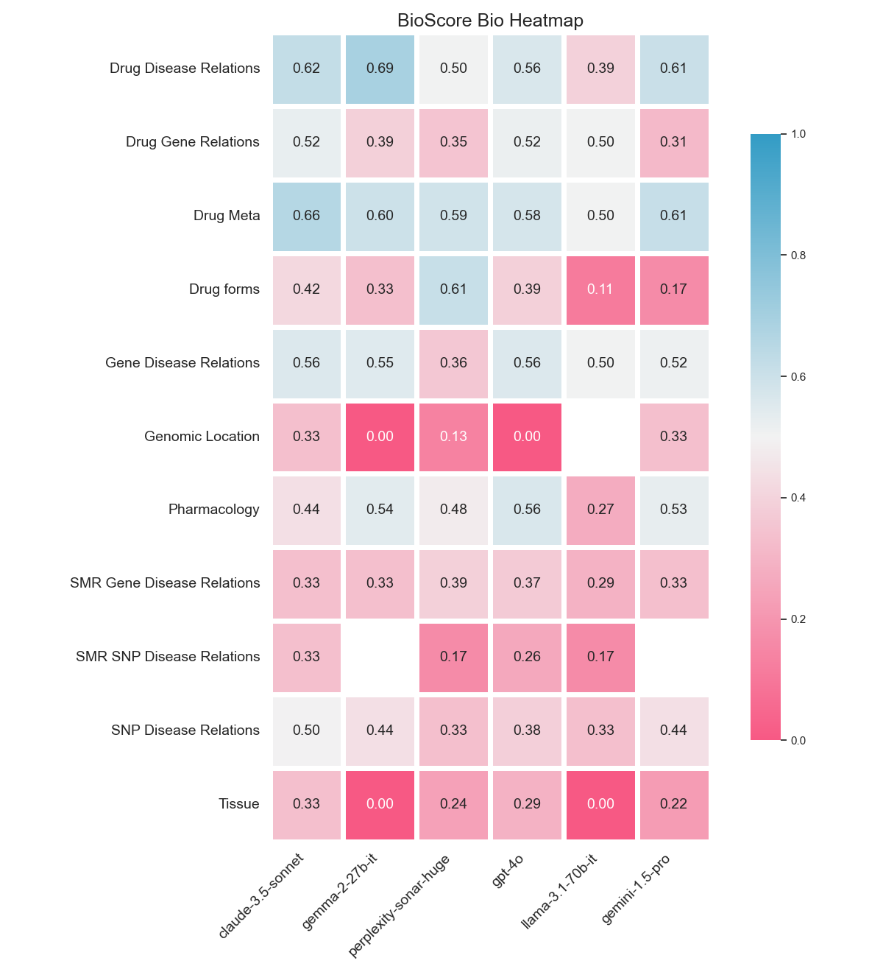
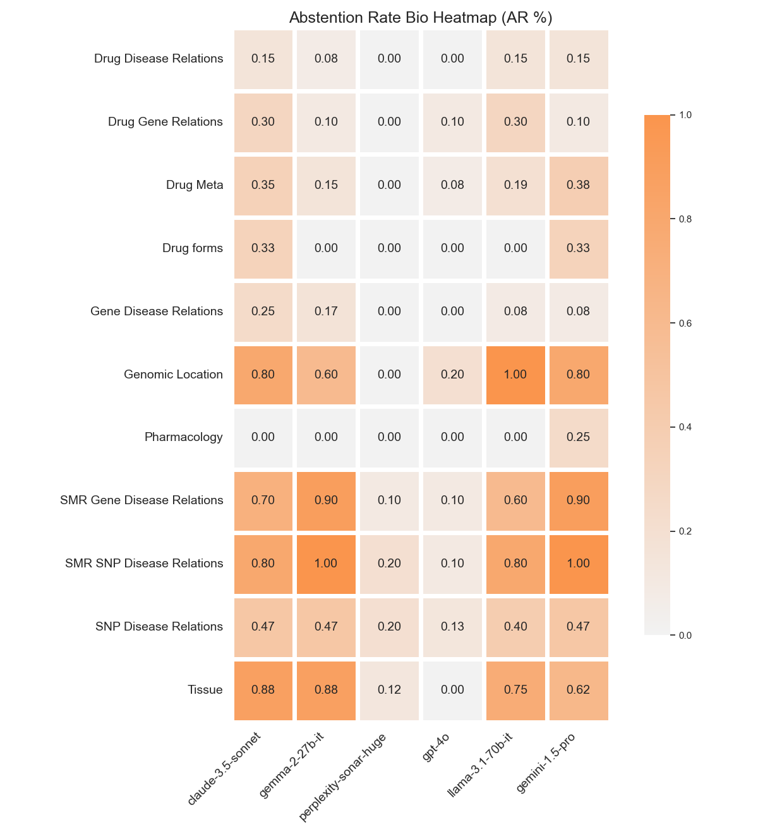
Current Works

Slide 28
Short-Term Future Works: Increase Performance and Trust
Inline Citations
Access to High Quality Data
Encouraging Abstention
Researcher-friendly interface

Slide 29
Long-Term Future Works: Further Integration of AI
Deeper Understanding of Biomedical Data
Drug Discovery and Personalized Medicine
Integration with AI-driven Laboratories
And much more!!!
Notes:
LLMs integrated into systems capable of interpreting complex biological datasets (e.g., genomics, proteomics) for new insights.
Role in accelerating drug discovery by synthesizing large datasets, understanding novel pathways, and suggesting therapeutic candidates.
LLMs as part of AI systems in automated labs, driving experiments, and interpreting data to improve reproducibility.

Slide 30
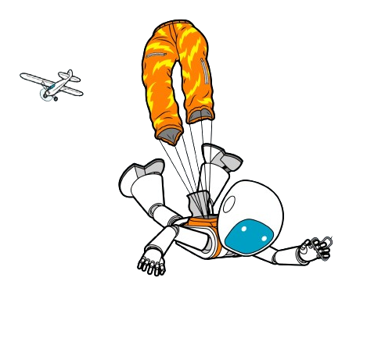
Final Thoughts
Notes:
AI is a very powerful tool
Need to learn how to use it

Slide 31
Sources
AI Bot Cartoon - https://www.vecteezy.com/vector-art/518290-ai-artificial-intelligence-technology-robot-cartoon-001
Unlock Knowledge Cartoon - https://www.istockphoto.com/illustrations/unlock-knowledge
The Evolution of Natural Language Processing - https://medium.com/@jeevanchiru17/the-evolution-of-natural-language-processing-ad214cb9f6ca
Eliza Implementation - https://en.wikipedia.org/wiki/ELIZA#/media/File:ELIZA_conversation.png
GPT2 Demo - https://huggingface.co/openai-community/gpt2
Tokenizer Example - https://platform.openai.com/tokenizer
Predict Next Token Example - https://www.linkedin.com/pulse/how-do-language-modelsllm-work-we-call-chatgpt-mishra-fdqsc/
Transformer Model - https://arxiv.org/abs/1706.03762
LLM Parameter Count vs Time - https://www.linkedin.com/pulse/guide-large-language-models-how-work-yugank-aman-g1wif
Kaplan Scaling Laws - https://arxiv.org/abs/2001.08361
Chatpdf - https://www.chatpdf.com/
PD GWAS - https://pubmed.ncbi.nlm.nih.gov/31701892/
Cartoon Scientist - https://stock.adobe.com/search?k=mad+scientist+cartoon
Semantic Search - https://nlpcloud.com/nlp-semantic-search-api.html
NCBI rs63750847 - https://www.ncbi.nlm.nih.gov/snp/rs63750847
Falling AI - https://spectrum.ieee.org/ai-failures
Upgrading AI - https://www.iconfinder.com/icons/7627606/technology_robot_robotic_maintenance_upgrade_screwdriver_icon
Robot Hand Shake - https://www.vecteezy.com/vector-art/10873996-human-and-robot-shaking-hand-concept-illustration
AI and Human - https://mytechdecisions.com/compliance/ai-integration-how-to-integrate-ai-with-existing-systems-for-maximum-benefits/

