Slide 1
Good Morning and Welcome! Morning Schedule
10 AM: Intro to Bioinformatics Resources (Amy Stonelake, NCI/CCR/BTEP)
10:25 AM: An HPC Resource for the IRP (Wolfgang Resch NIH/CIT, Biowulf)
10:50 AM: Data and Bioinformatics Resources from the NIH Library (Doug Joubert, NIH Library)
11:15 AM: Integrating NGS, AI, and Pathway Analysis: A New Era of Computational Biology (Daoud Meerzaman, NCI Center for Biomedical Informatics and Information Technology, CBIIT)
11:40 AM: The NIAID Biovisualization Lab: A Central Resource for Immersive Exploration of Data with Virtual Reality and Advanced Visualization Technologies (Meghan McCarthy, BioViz Lab at NIAID)
12:05 PM Single Cell and Spatial Genomics: An Overview of the Tools to Study Cellular Heterogeneity, Dynamics and Intracellular Signaling (Stefan Cordes, NHLBI, representing the Single Cell and Spatial Transcriptomics User's Group)

Slide 2
Afternoon Schedule
12:30 PM: Lunch – What do you want to know about Bioinformatics and Data Science?
1:00 PM: Multimodal AI to Predict Chemotherapy Response of Ovarian Cancer (Minkyu Park, CBIIT)
1:30 PM Transforming Medicine with AI: from PubMed Search to TrialGPT (Zhiyong Lu, NCBI)
2:00 PM: Translational AI Applications in Prostate Cancer (Baris Turkbey, NCI/CCR/AIR)
2:30 PM: Exploring Large Language Models: Capabilities and Limitations in Biomedical Research (Owen Bianchi and Maya Willey, CARD, Data Tecnica, LLC)

Slide 3
Any Questions?

Slide 4
Intro to Bioinformatics Resources at the Bioinformatics Community Fair NIH Research Festival 2024
Amy Stonelake, Ph.D.
BTEP Program Manager
Sept 23, 2024
Bioinformatics Training and Education Program

Slide 5
Introduction to the NCI CCR Bioinformatics Training and Education Program
Who we are
What we do
How to contact us

Slide 6
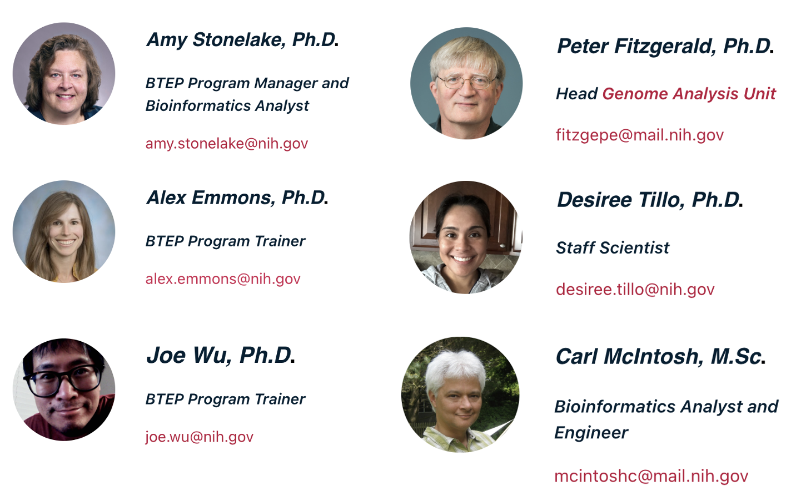
BTEP: Who we are…

Slide 7
BTEP What we do…Mission Statement
Mission statement for the NCI CCR Bioinformatics Training and Education Program (BTEP)
Enabling scientists to understand and analyze their own experimental data by providing instruction and training in bioinformatics software, databases, analyses techniques, and emerging technologies.

Slide 8
NCI CCR Bioinformatics Training and Education Program (BTEP)
In 2023, 80 classes with over 2,000 attendees
Began in 2012 to provide training in bioinformatics software

Slide 9
BTEP: What we do
NIH Bioinformatics Calendar
Training
Video Archive
Class Documentation & Resource Pages
Bioinformatics Bulletin
Office Hours - in person and virtual
Distinguished Speakers Seminar Series
Licenses to Online Learning Platforms
Monthly Coding Clubs
AI in Biomedical Research at NIH Seminar Series

Slide 10
BTEP How to contact us…
Email: ncibtep@nih.gov

Slide 11
Although we are a NCI/CCR resource…
Most of our events are open to all at NIH
Our website is open to the world
We answer questions within and outside of NIH
Video Archive is open and available
Class documentation and bioinformatics resources info are open
We advertise our events throughout NIH

Slide 12
Which of these questions can be answered on the BTEP Website?
How do I interpret Quality Control data from my sequencing project?
How do I move large data files?
I missed a class – do you have recordings? Online course documents?
Should I do my work on my local machine or get an account on Biowulf?
Are there any groups where I can learn about Single Cell RNA-Seq and Spatial Transcriptomics?
Can I get online, self-paced, on-demand training?
Where can I find out about bioinformatics and data science trainings across NIH?
How can I do my research on the cloud?

Slide 13
bioinformatics.ccr.cancer.gov/btep

Slide 14
NIH Bioinformatics Calendar maintained by BTEP

Slide 15
How to read a FastQC Report

Slide 16
How to move large files with Globus

Slide 17
Recordings of Past Events – Video Archive

Slide 18
Class Documentation

Slide 19
Why you should get to know Biowulf
Biowulf is the High Performance Cluster (HPC) at NIH.
It can hold a lot more data than your personal computer.
It has much more compute resources than your personal computer.
It can help you analyze “Big Data”.
It is available to all NIH researchers

Slide 20
Some list.nih.gov Mailing lists
Single cell (and spatial transcriptomics)
Bioinformatics SIG
Data Science SIG
Systems Biology

Slide 21
Training: Coursera licenses are available to all NIH, provided by NIH ODSS
Video lectures
Work at your own pace
Large, worldwide, online classes (MOOCS)
Courses, specializations, and guided projects
Earn certificates for your resume/CV
So many courses (thousands) available: Programming (R, Unix, Python), Genomics, Bioinformatics, Data Science, Language learning

Slide 22
NIH Cloud Resources
NCI Cancer Research Data Commons (CRDC) is a cloud-based data science infrastructure that connects data sets with analytics tools to allow users to share, integrate, analyze, and visualize cancer research data to drive scientific discovery.
Cancer Genomics Cloud (CGC/SevenBridges/ Velsera)
AnVIL NHGRI's Genomic Data Science Analysis, Visualization, and Informatics Lab-Space
The STRIDES Initiative aims to help NIH and its institutions accelerate biomedical research by reducing barriers in utilizing commercial cloud services. This initiative aims to harness the power of the cloud to accelerate biomedical discovery. NIH and NIH-funded researchers can take advantage of STRIDES benefits.

Slide 23
Email: ncibtep@nih.gov

Slide 24
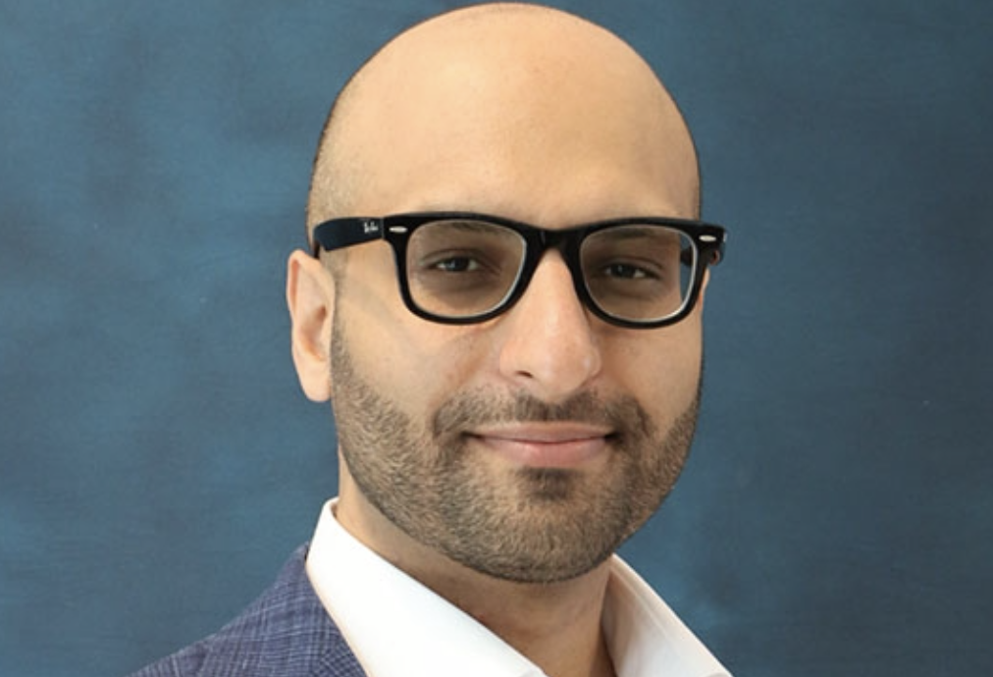
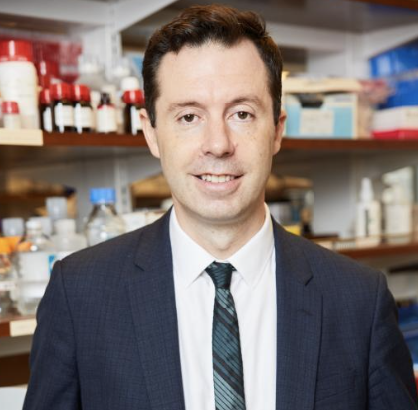
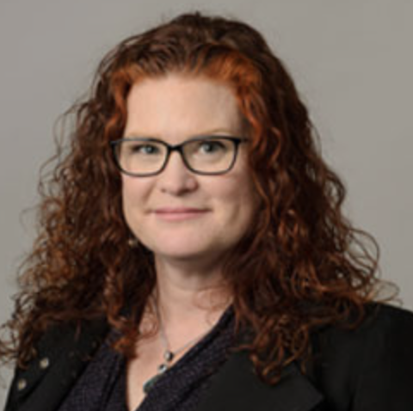
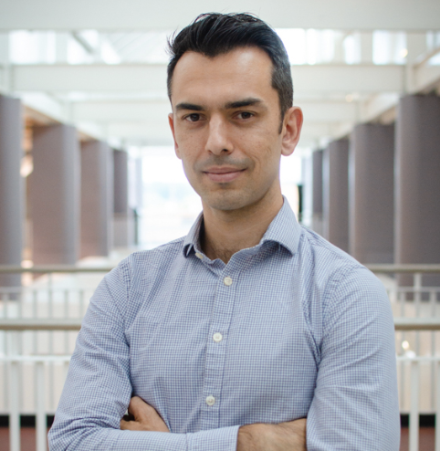
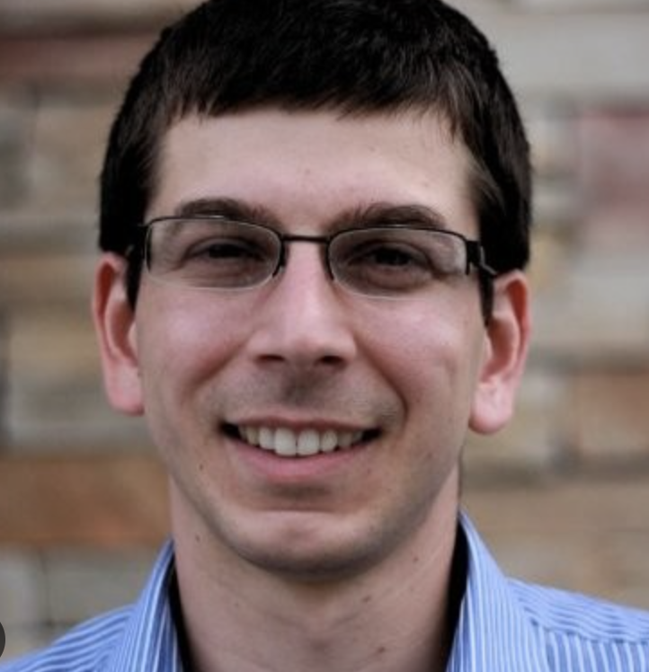
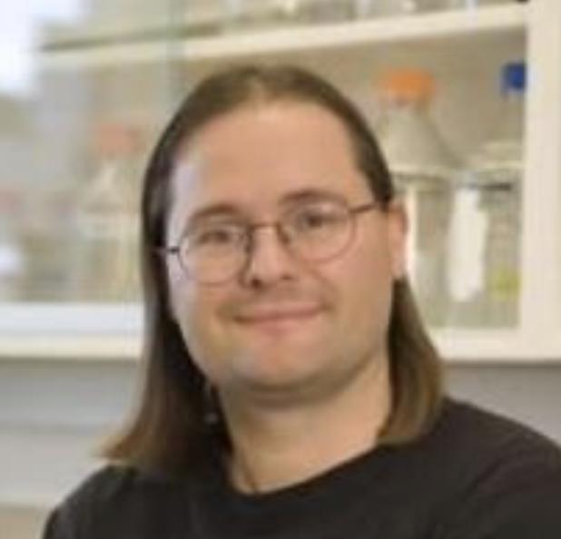
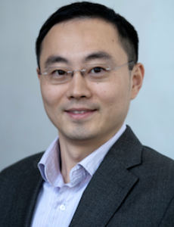
BTEP: 2024 Seminar Series

