Slide 1
Single cell and spatial genomics: An overview of the tools to study cellular heterogeneity, dynamics and intercellular signaling
Stefan F. Cordes, M.D., Ph.D.
On behalf of the Single Cell and Spatial Genomics Interest Group

Slide 2
Smoothies versus fruit salad
Fruit smoothy (bulk genomics): gives overall, blended view of populations, but masks differences between individual cells
Fruit salad (single cell genomics): allows you to see and analyze each component (cell) individually, preserving the heterogeneity and revealing details about the composition
Notes:
Since I am what’s between you and lunch, let me try to keep your attention by leading with a food based analogy
Fruit Smoothie (Bulk Genomics)
• In bulk genomics, all cells are mixed together, much like how different fruits are blended into a smoothie. Once blended, you can no longer distinguish individual fruits—everything is averaged together into one uniform mixture.
• Similarly, in bulk genomic analysis, DNA, RNA, or other molecular information from all the cells in a sample is pooled and averaged. This gives you an overall picture of the entire population, but you lose the ability to see what is happening in each individual cell.
• Example: If you blend strawberries, bananas, and blueberries into a smoothie, you know you have a mixture of these fruits, but you can’t pinpoint how much of each fruit is contributing to the flavor.
Fruit Salad (Single-Cell Genomics)
• In single-cell genomics, each cell is analyzed individually, just like how each piece of fruit in a salad remains distinct. You can see exactly which fruits are in the salad, how many of each type, and their individual characteristics.
• Similarly, single-cell genomics provides a high-resolution view, showing how each cell behaves independently. You can distinguish between different cell types and identify rare cells that might be hidden in a bulk approach.
• Example: In a fruit salad, you can count and describe the strawberries, bananas, and blueberries separately. If there are only a few blueberries, you’ll notice them, unlike in a smoothie where they’d be blended in and hard to detect.

Slide 3
Single Cell versus Bulk Genomics
Advantages of Bulk Genomics:
Cost-effectiveness
Simpler data analysis
Sensitivity
Total tissue/population overview
Low input material
Established protocols and benchmarks
Advantages of Single Cell Genomics:
Cellular heterogeneity
Rare cell populations
Variation in gene expressopm
Developmental and differentiation pathways
Clonal evolution
Spatial context

Slide 4
Approaches to single cell RNA-seq
Physical isolation of cells:
Well-based
SMART-seq: Full length
Microwell-seq/ Seq-well : High thoughput with lower cost
Droplet-based
Drop-seq
inDrop
10X Chromium: Higher throughput
Combinatoric Indexing:
sci-RNA-seq
scifi-RNA-seq: Very high throughput
SPLIT-seq
Microfluidic approaches: isolate single cells in droplets along with beads containing primers and reagents for reverse transcription.

Slide 5
Labeling mRNA from individual cells uniquely
Physical isolation of cells:
Segregate a single cell with primers for reverse transcription
All primers for a given cell contain the same DNA cell index (barcode)
All cDNA prepared from a given cell will contain this index
Many approaches also contain an additional random sequence, Unique Molecular Identifier (UMI) to mitigate double counting duplicates arising from amplification steps
Combinatoric Indexing:
Individual cells are never physically isolated
Composite index is constructed over several rounds
Splitting: cells are partitioned into smaller groups and unique index applied to all members of group
Pooling: labeled cells are mixed together again
Splitting: cells partitions into smaller groups and unique index is added to all members if group
Pooling: labeled cells are mixed together again
Etc.
cDNA library elements after first round of split/pooling:
Cell 1
Cell 2
Cell 3
Cell 4
Cell 5
Poly-dT complementary to poly-A tail on 3’ end of mature mRNA
Cell 6
Etc.

Slide 6
Preparing the (cDNA) sequencing libraries
Physical isolation of cells:
Segregate a single cell with primers for reverse transcription
All primers for a given cell contain the same DNA cell index (barcode)
All cDNA prepared from a given cell will contain this index
Many approaches also contain an additional random sequence, Unique Molecular Identifier (UMI) to mitigate double counting duplicates arising from amplification steps
Combinatoric Indexing:
Individual cells are never physically isolated
Composite index is constructed over several rounds
Splitting: cells are partitioned into smaller groups and unique index applied to all members of group
Pooling: labeled cells are mixed together again
Splitting: cells partitions into smaller groups and unique index is added to all members if group
Pooling: labeled cells are mixed together again
Etc.
cDNA library elements after second round of split/pooling:
Cell 1
Cell 2
Cell 3
Cell 4
Cell 5
Cell 6
Diversity of index grows with each round of split/pooling
Etc.

Slide 7
Preparing the (cDNA) sequencing libraries
Physical isolation of cells:
Segregate a single cell with primers for reverse transcription
All primers for a given cell contain the same DNA cell index (barcode)
All cDNA prepared from a given cell will contain this index
Many approaches also contain an additional random sequence, Unique Molecular Identifier (UMI) to mitigate double counting duplicates arising from amplification steps
Combinatoric Indexing:
Individual cells are never physically isolated
Composite index is constructed over several rounds
Splitting: cells are partitioned into smaller groups and unique index applied to all members of group
Pooling: labeled cells are mixed together again
Splitting: cells partitions into smaller groups and unique index is added to all members if group
Pooling: labeled cells are mixed together again
Etc.
cDNA library elements after third round of split/pooling:
Cell 1
Cell 2
Cell 3
Cell 4
Cell 5
Cell 6
Diversity of index grows with each round of split/pooling
Etc.

Slide 8
Preparing the (cDNA) sequencing libraries
Physical isolation of cells:
Segregate a single cell with primers for reverse transcription
All primers for a given cell contain the same DNA cell index (barcode)
All cDNA prepared from a given cell will contain this index
Many approaches also contain an additional random sequence, Unique Molecular Identifier (UMI) to mitigate double counting duplicates arising from amplification steps
Combinatoric Indexing:
Individual cells are never physically isolated
Composite index is constructed over several rounds
Splitting: cells are partitioned into smaller groups and unique index applied to all members of group
Pooling: labeled cells are mixed together again
Splitting: cells partitions into smaller groups and unique index is added to all members if group
Pooling: labeled cells are mixed together again
Etc.
cDNA library elements after fourth round of split/pooling:
Cell 1
Cell 2
Cell 3
Cell 4
Cell 5
Cell 6
Cells have essentially unique indices
Etc.

Slide 9
Embellishments to scRNA-seq
scRNA-seq may be embellished in lots of ways:
T cell or B cell receptor sequencing (TCR-seq or BCR-seq): Track clonal diversity of T or B cells
Lineage tracing:
Immutable lineage tracing indices (lentivirally) integrated into progenitor cells: Track clonal descendants
Lineage tracing indices that change over time (‘gene scarring’): Track sub-clonal lineages
CRISPR screening: capture sgRNA in CRISPR screening experiments to identify the effect of [d]Cas9-targeted perturbations
Metabolic labeling: Study cellular dynamics by altering the medium in which cells are grown over time
Other aspects of cellular states can be measured (individually or simultaneously):
CITE-seq: cell surface protein abundance
scATAC-seq: chromatin accessibility
scCUT&RUN: protein-gDNA interactions
scHi-C: gDNA-gDNA interactions

Slide 10
Sensitivity and noise in scRNA-seq
scRNA-seq samples only a fraction of a cell’s mRNA:
Typical mammalian cell contains 200k – 300k mRNA molecules
Usually 10k – 20k unique mRNA transcripts
scRNA-seq experiments typically capture between 5% - 15% of a cell’s mRNA
Sampling to this degree is inherently noisy
Other factors (method, experimentalist, environmental factors) add technical noise
Insight after local averaging/global comparison

Slide 11
Visualization and understanding cell type
Cells in multi-cellular organisms share the same genome, but differentiate into different ‘cell types’
Variety of methods from machine learning are used to ‘cluster’ similar cells (putative cells types)
Graph-based clustering: Louvain or Leiden algorithms
Older: k-means, hierarchical, density-based, model-based, etc.
All methods have (at least) one free parameter, loosely interpreted as ‘resolution’
Can detect populations as small as ~ 50 cells in sample of 5k – 10k cells (0.5- 1%)
Project into low dimensional (2 or 3 dimensional) space that preserves similarity in gene expression
tSNE: preserves local but not global relationships between cells
UMAP: ‘preserves’ both local and global relationships
Machine learning methods (including knowledge transfer) can be used to automatically annotate cells
Azimuth, singleR, cellTypist, scANVI, etc: automatically annotate cell type

Slide 12
Comparisons between clusters
Expression levels of genes important to NK cells.
Note: local variations in gene expression
Sampling is noisy
Don’t compare individual cells
Compare populations of cells in different clusters (putative ‘cell types’)
Caution: some cells may be differentiating between different cell types

Slide 13
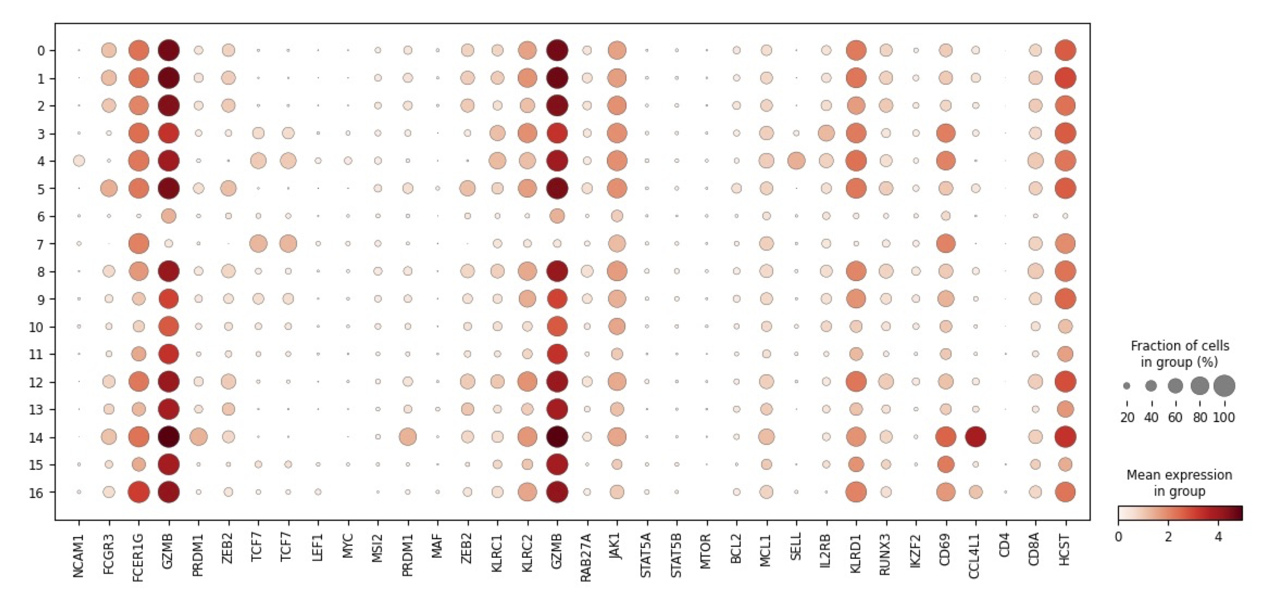
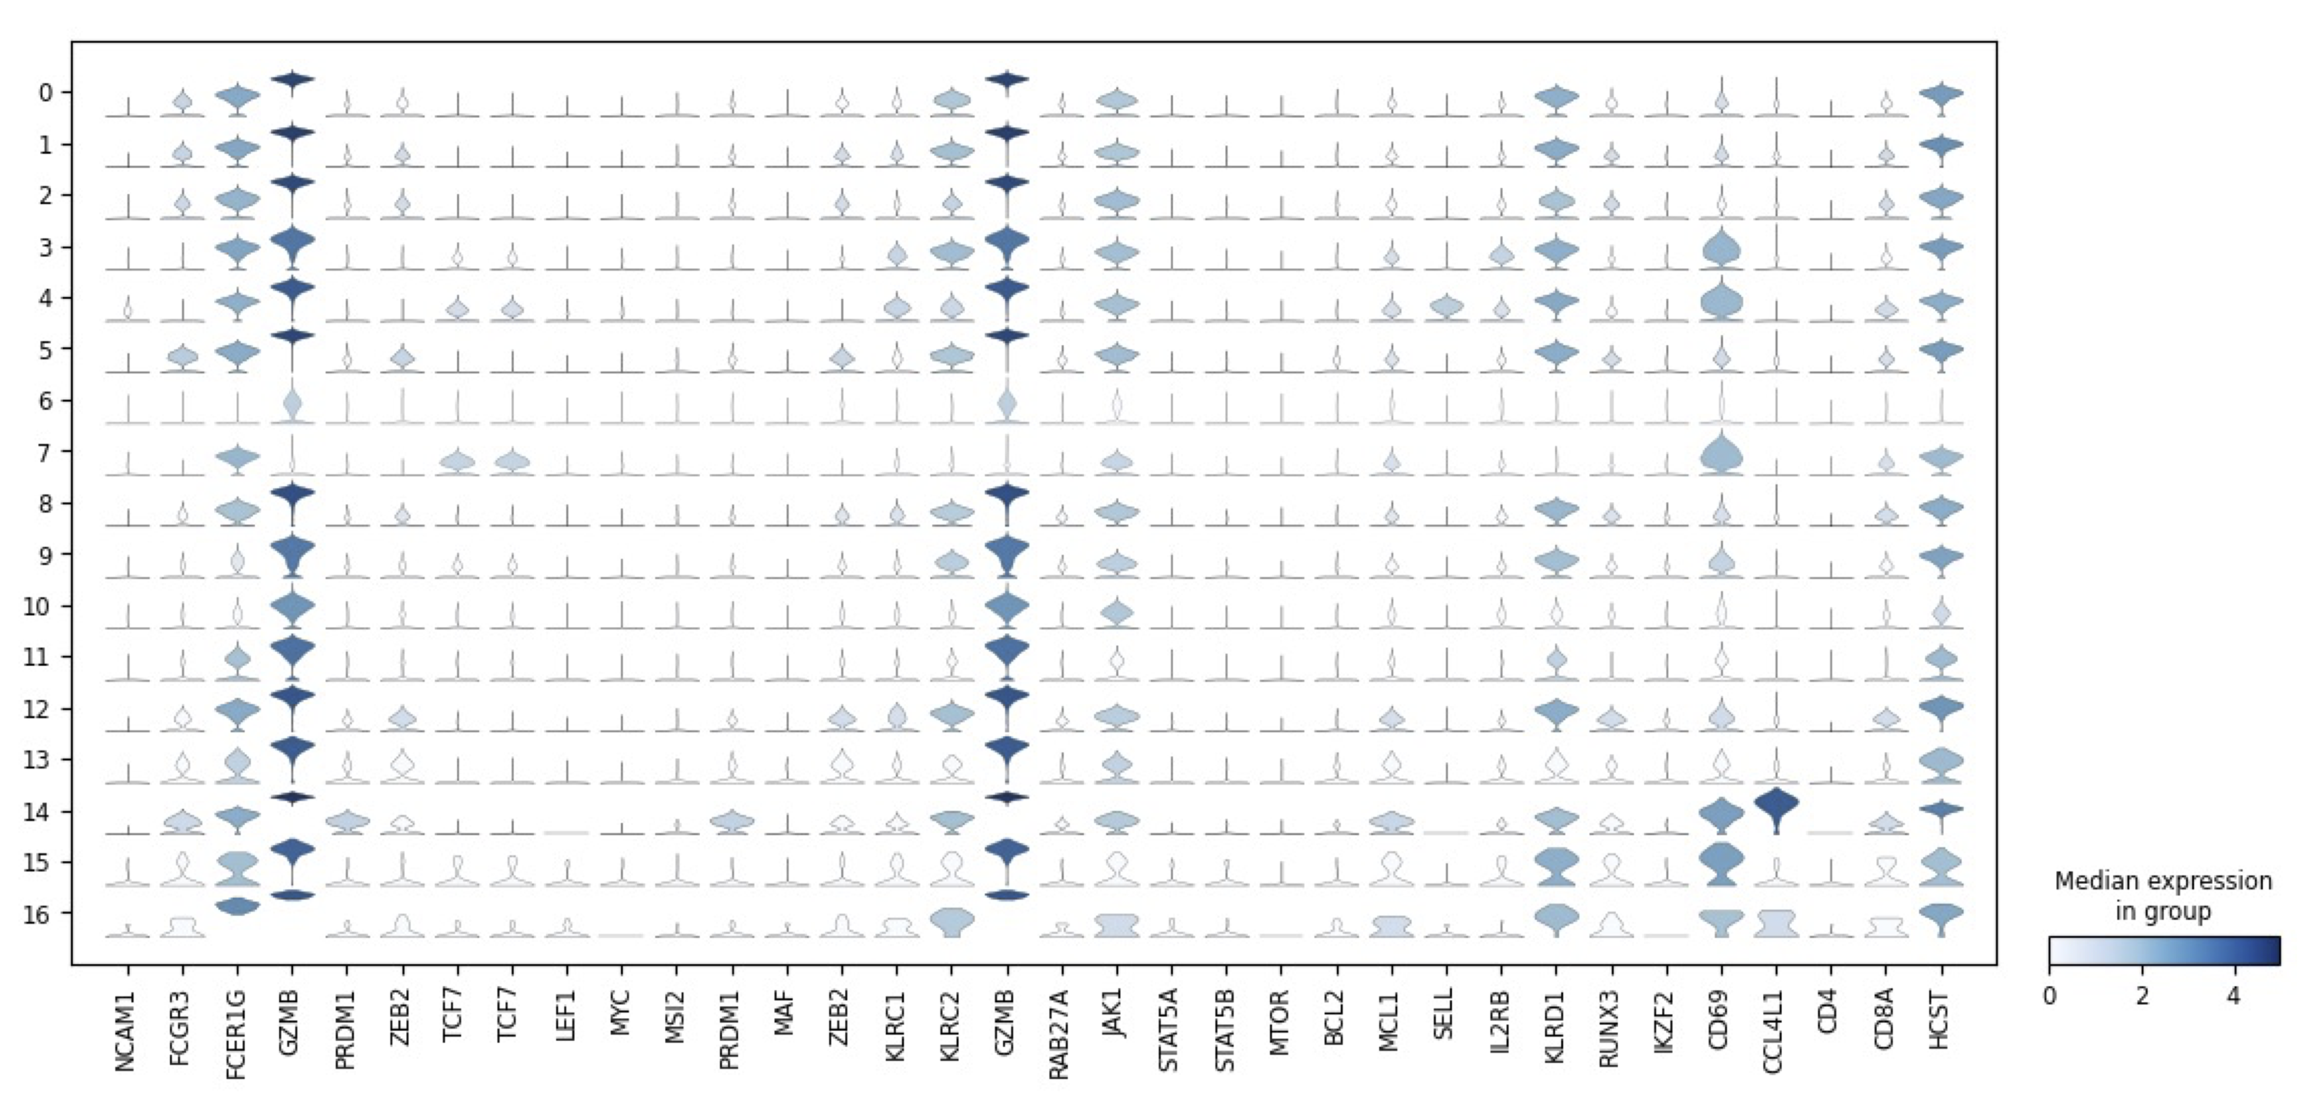
Comparisons between clusters
Statistically rigorous comparisons between clusters
Variety of ways to express the results
Dot plots:
Clusters label rows; selected genes label columns
Circle size: fraction of cells expressing the gene
Circle color: mean expression level
Violin plots:
Clusters label rows; selected genes label columns
Violin depicts distribution of expression levels in cluster
Violin color depicts median expression level in cluster

Slide 14
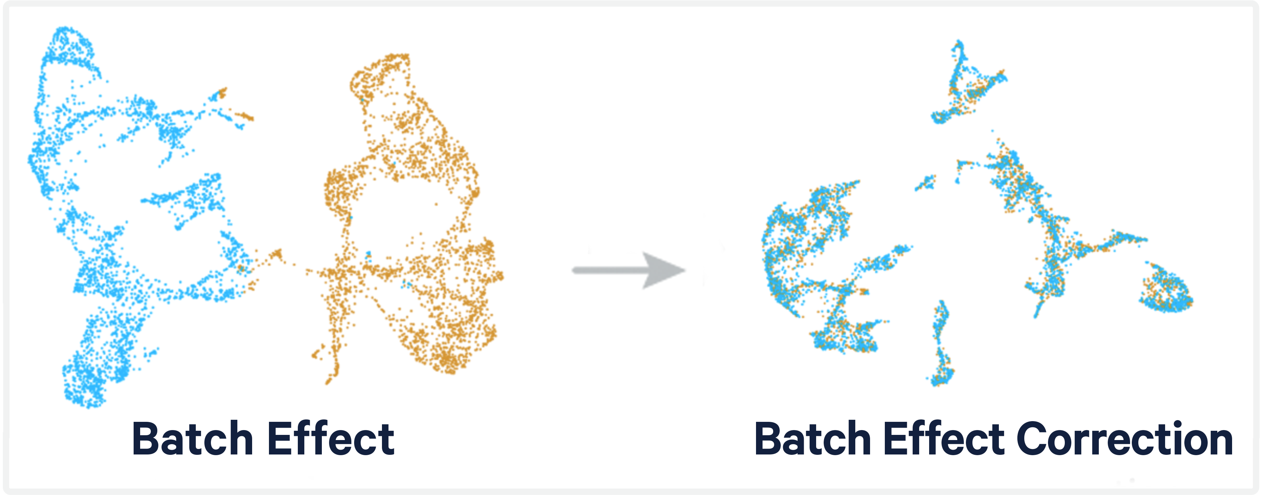
Finer points
Technical noise (‘batch effects’) between different samples
Complicate the extraction of biological signals
Many different approaches developed
SCTransform (Seurat): regresses out unwanted variation and stabilizes variance
Harmony: Works in PCA space to adjust principal components
fastMNN: Uses mutual nearest neighbors to align cells
Deep generative approaches (scVI, TOTALVI): uses variational autoencoders to map cellular states into a common low-dimensional ‘latent space’

Slide 15
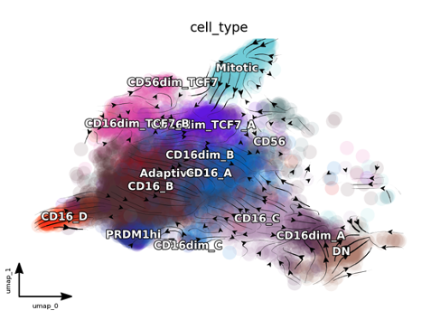
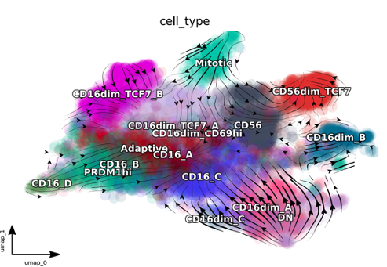
Understanding dynamics
RNA velocity in NK cells after primary CMV infection
RNA velocity in NK cells after CD16 depletion
Dynamical information can be extracted from single cell data in variety of ways
Pseudotemporal inference: assigns ‘pseudotime’ on basis of best path through cells that captures gradual transitions in gene expression (monocle)
RNA velocity: predicts future cell states based on the relative abundance of unspliced and spliced mRNA (velocyto, scvelo, dynamo and recent machine learning approaches)
Lineage tracing: tracks lineage tracing indices that have been integrated into genomes of cells
Time-course single cell experiments: collects cells at different time points
Many other: including multiomics, gene regulatory network inference, etc.

Slide 16
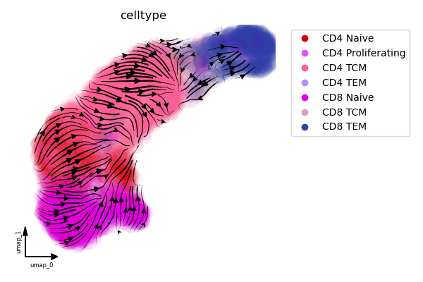
Understanding perturbations
RNA velocity in primary T cells
RNA velocity in T cells after conditional TCF7 knock down
RNA velocity can be extended to an analytic vector field
Dynamo: learns sparse vector field to represent vector field in analytic form
LatentVelo: unsupervised learning in low-dimensional latent space to find generative model of gene expression
MultiDynamo: expands dynamo to multiomic data
Analytic vector field can be used to predict changes in cellular dynamics resulting from targeted perturbations

Slide 17
Chromatin-state aware RNA velocity
Chromatin State Dynamics
Transcriptional Dynamics
Splicing and Degradation
Dynamics
CRE
[Unobserved]
Requisite TF
Open CRE
Intron
CRE
AAAAA
Closing
Opening
TF_{i}
AAAAA
0
AAAAA
TF_{i}
RPII
Primary transcript
AAAAA
AAAAA
Closed CRE
Promoter
Gene Body
mRNA
Genomic DNA
Histone
$$\frac{de_{i}(t)}{dt}=k_{i}ω_{i}−ω_{i}e_{i}(t)$$
e_{i}(t) = chromatin accessibility at i^{th} enhancer
$ω_{i}$ = opening or closing rate
$k_{i}$ = 1 for chromatin opening; 0 otherwise
$$\frac{du(t)}{dt}=\sum_{i=1}^{N_{CRE}}{α_{i} e_{i}\left(t\right)− β u(t)}$$
$u\left(t\right)$ = [unspliced] primary transcript
$α_{i}$ = impact of i^{th} CRE on transcription rate
$β$ = splicing rate
Note: Presence or absence of requisite TF_{i} is captured by $α_{i}$
$$\frac{ds(t)}{dt}=β u\left(t\right)− γ s(t)$$
s$\left(t\right)$ = [spliced] mRNA
$β$ = splicing rate
$γ$ = degradation rate
Notes:
Existing approaches <CLICK> infer dynamics from quantitative measurements of unspliced and spliced RNA .
Nascent (unspliced) and mature (spliced) RNA have different dynamics within cells: nascent are typically short-lived, while mature are generally longer lived.
The ratio of unspliced to spliced transcripts provides information about genes that were recently turned on or off: a higher ratio of unspliced to spliced transcripts indicates a gene that was recently turned on – the cell’s splicing machinery needs to catch up, while a lower ratio indicates a recently turned off gene – the production of nascent unspliced RNA has stopped.
Incorporating chromatin state dynamics adds a mechanistic description <CLICK> to how gene transcription is regulated. We describe the activity of CRE though their chromatin state <CLICK>. Activity of a particular CRE is indicated by a state variable e which takes values between 0 and 1 that vary over time. The aggregate activities of neighboring CRE <CLICK> determine gene transcription.

Slide 18
Understanding perturbations to CRE
RNA velocity in primary T cells
RNA velocity in T cells after conditional TCF7 knock down
With multiomic extension can predict the effects of perturbations to regulatory elements
Chr8:101,790,788-101,791,270 is an enhancer in the vicinity of KLF10 an important modulator balancing regulation and tolerance
Conditional knockdown of an enhancer on chr8 stabilizes naïve T cell states
Analytic vector field can be used to predict changes in cellular dynamics resulting from targeted perturbations to both cis- and trans-acting factors

Slide 19
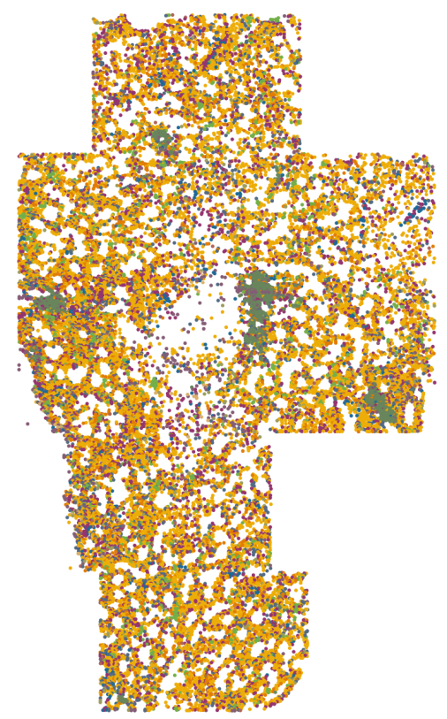
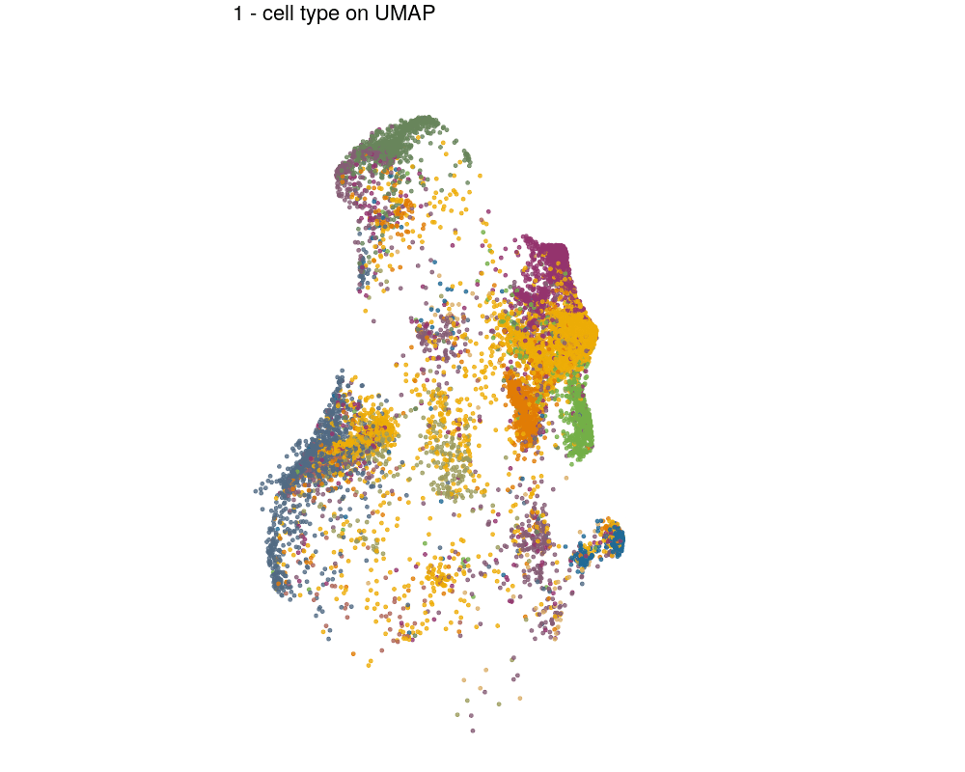
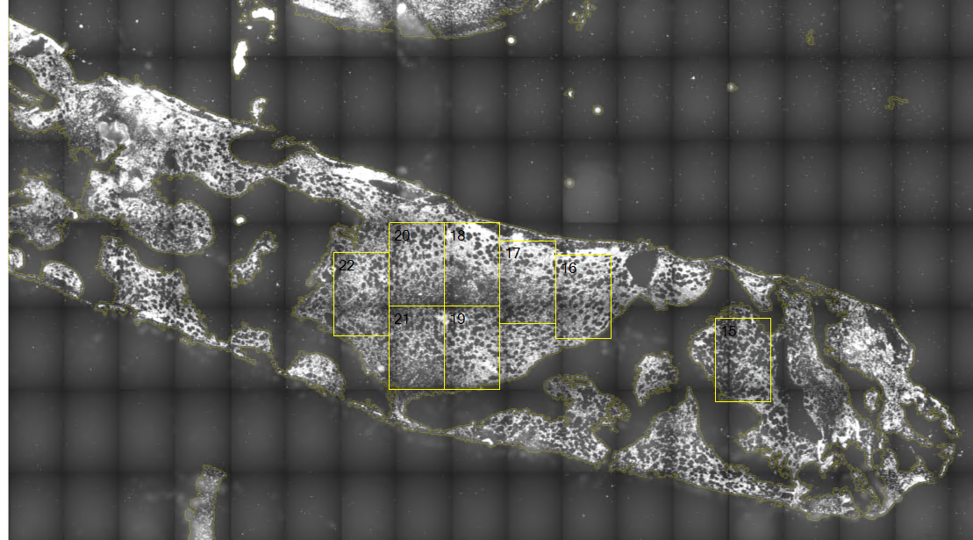
Spatial genomics example: leukemic BM
Slide Credit: Chen Zhao, M.D.
Transcriptome characterizes cell type/state (indicated by color)

Slide 20
Resources
Experimental resources
Single Cell Analysis Facility (SCAF): Michael Kelly, Ph.D.
Center for Human Immunology: Jim Cherry, Ph.D.
NHLBI DNA sequencing core: Yuesheng Li, Ph.D.
Bioinformatics resources
BTEP: Amy Stonelake,
NIAID/Integrated Data Sciences Section: Jack Collins, Ph.D., Justin Lack, Ph.D.
Single Cell and Spatial Genomics Interest Group: Mark Cookson, Ph.D. and others
Spatial Genomics Interest Group: Chen Zhao, M.D. and Lichun Ma, Ph.D.
Systems Biology Interest Group: Gregoire Altan-Bonnet, Ph.D. and others

