Slide 1
Germline and Somatic Mutation Analysis: Experimental Design and Best Practices
Justin Lack
NIAID Collaborative Bioinformatics Resource (NCBR)
June 30, 2022

Slide 2
Germline vs Somatic Variation
Germline Variant Analysis
  Heritable genetic variation
  Large cohort analysis -> GWAS/Burden testing (quantitative)
  Small cohort analysis -> Candidate gene identification (qualitative)
  Pedigree analysis -> variant/disease co-segregation
Somatic Variant Analysis
  Non-heritable genetic variation arising in non-germ cells
  Tumor/Normal or tumor-only analysis
  Somatic mosaicism (e.g., Neurofibromatosis)
Very different expectations in terms of allele frequency distribution

Slide 3
Germline vs Somatic Variant Calling
Potentially very different allele frequency expectations
Germline - ~0.5 read proportions
Somatic - ~0.3 read proportions

Slide 4
Germline vs Somatic Variant Calling
Potentially very different allele frequency expectations

Slide 5
Germline vs Somatic Variant Calling
Within-sample germline allele frequency variance is driven by sample quality and sequencing quality
  Amount of sample input
  Sequencing depth
  Read/base quality
Somatic allele frequency variance is driven by MANY more factors:
  Sample quality and sequencing quality
  Subclonality/heterogeneity
  Copy number variation
  Tumor purity

Slide 6
Germline Design Considerations - Depth
~30X target for genome data (below)
~50X target for exome, due to increased depth variance
Telenti et al., 2016 PNAS
Notes:
On the left plot, blue dots show the proportion of the genome >=10X

Slide 7
Germline Design Considerations - Depth
~30X target for genome data (below)
~50X target for exome, due to increased depth variance
Belkadi et al., 2015 PNAS

Slide 8
Germline Design Considerations - WES vs WGS
Depth variance MUCH higher for exome
~2-fold more variants with GQ < 20 for exome
Read ratio for heterozygous variants significantly skewed for exome
  Especially pronounced for INDELs
Belkadi et al., 2015 PNAS

Slide 9
Germline Design Considerations - WES vs WGS
Significant capture and enrichment biases for different kits
Illustrates issue with combining samples from multiple kits
For germline-only analysis, WGS strongly preferred
Meienberg et al., 2015 Nucleic Acids Research

Slide 10
Germline Design Considerations - WES vs WGS
Sure, there’s bias in WES introduced due to capture, but does it significantly affect variant calling?
Genome in a bottle (GIAB) truth sample (NA12878)
  50X WES and 30 WGS available from exact same sample
  Processed both WES and WGS through identical pipelines
  Compared both variant sets to GIAB truth set
  Used only exonic sites targeted in WES capture for performance assessment

Slide 11
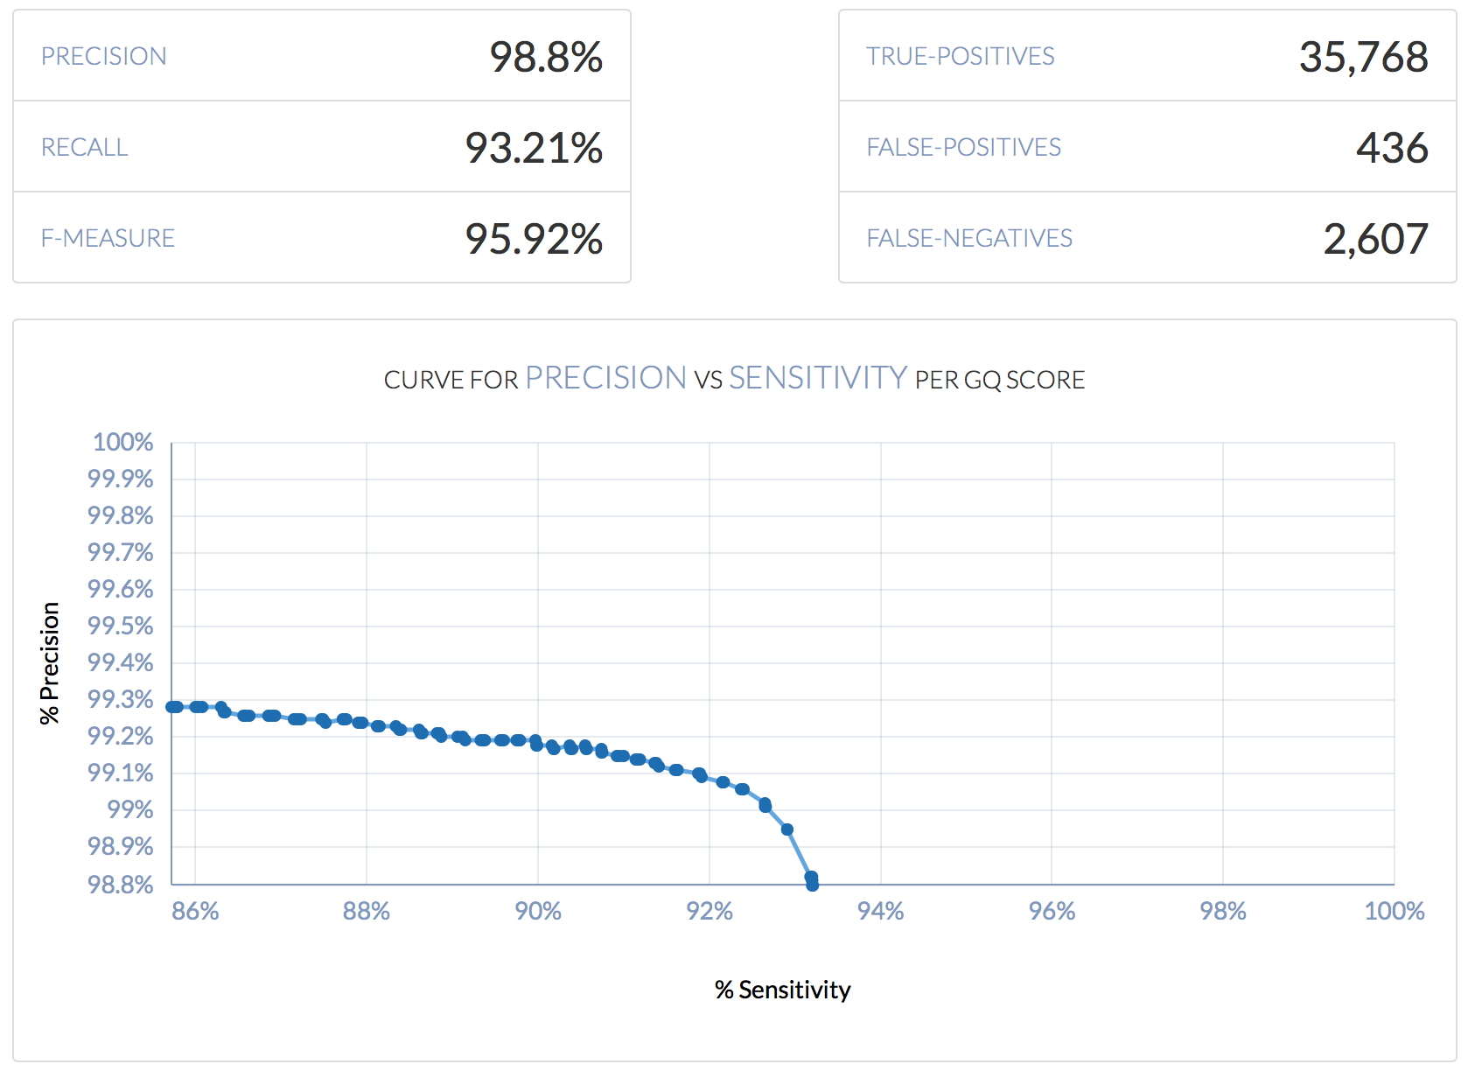
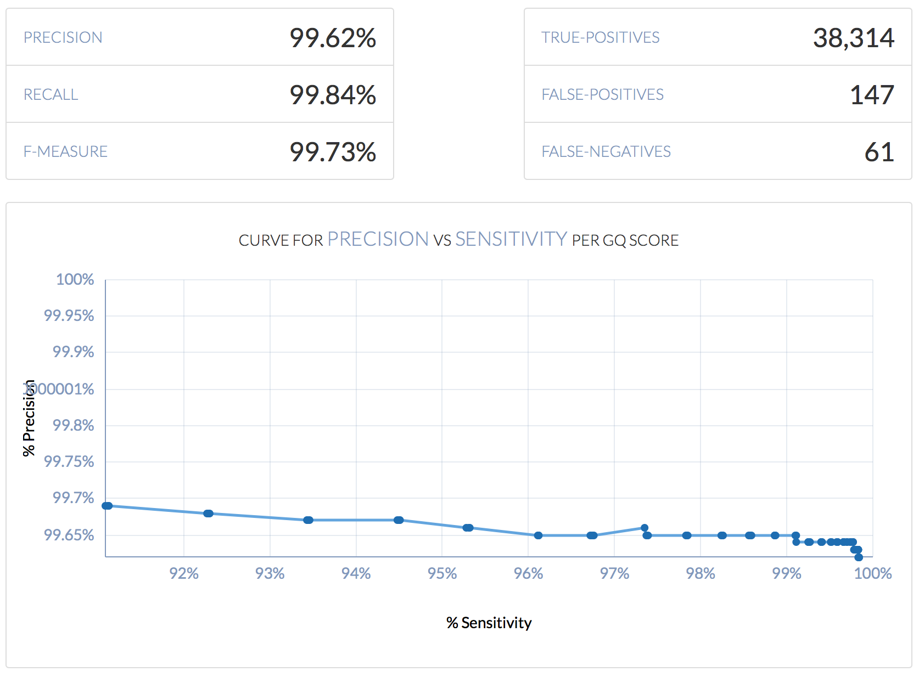
Germline Design Considerations - WES vs WGS
  3X higher False Positive rate, and >40X higher False Negative rate for exome!!!
 | False Negative Rate | False Positive Rate
50X Whole Exome | 0.067934853 | 0.011361564
30X Genome (Exome Sites) | 0.001589577 | 0.003830619
Exome (50X WES)
Genome (30X WGS)

Slide 12
Germline Design Considerations - WES vs WGS
  3X higher False Positive rate, and >40X higher False Negative rate for exome!!!
 | False Negative Rate | False Positive Rate
50X Whole Exome | 0.067934853 | 0.011361564
30X Genome (Exome Sites) | 0.001589577 | 0.003830619
Exome (50X WES)
Genome (30X WGS)

Slide 13
Germline Design Considerations – Short vs Long reads
Illumina short read technology has certainly cornered the market on NGS
  Cheap, high throughput, highly accurate
  Typical read lengths ~150 bp, paired-end
  Low input requirements
But long read technologies have recently become affordable and reliable enough to compete
  More expensive to achieve comparable coverage to Illumina
  Higher error rate (sort of)
  Read lengths >>10 kb
  High input requirements (micrograms, HMW)
Other technologies coming
  Illumina Infinity
  TELL-Seq

Slide 14
Germline Design Considerations - WES vs WGS
Exome Sequencing
  Covers ~5% of genome (depending on capture kit)
  Allows for high depth targeting
  Cheaper than WGS
  Suffers from high depth variance
  Poor copy number/structural variant calling
Genome Sequencing
  Confidently call >85% of reference genome (hg38)
  More confidently call copy number/structural variation due to even coverage of entire genome
  Significantly more accurate variant (SNP/INDEL) calling
  More expensive, but price gradually decreasing

Slide 15
Germline Design Considerations – Structural Variation

Slide 16
Somatic Design Considerations

Slide 17
Somatic Design Considerations
An excellent resource for Somatic Variation Best Practices comes from the Somatic Mutation Working Group of the SEQCII Consortium
Generated 12 sequencing replicates to assess repeatability
Developed somatic truth-set

Slide 18
Depth Effects - Somatic
WGS
WES

Slide 19
Depth Effects - Somatic
As with germline, variance in general is increased for WES relative to WGS
WES
WGS

Slide 20
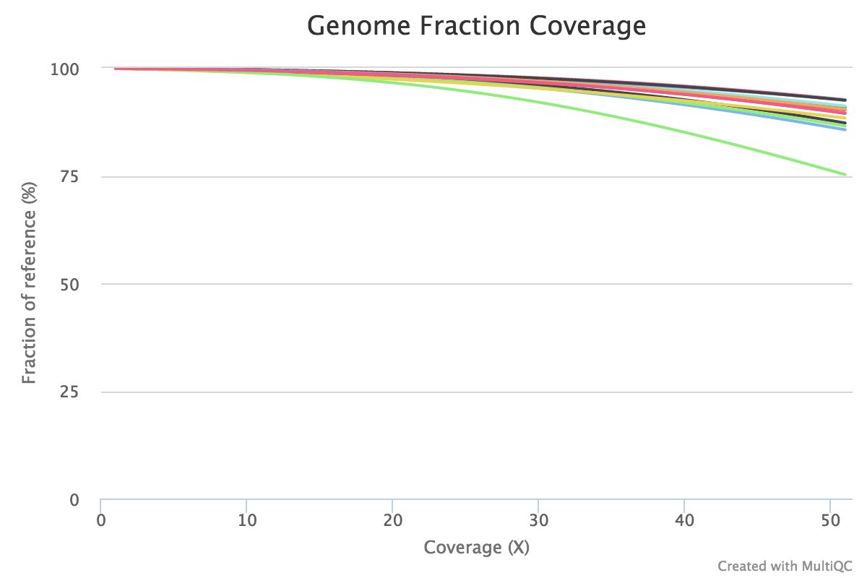
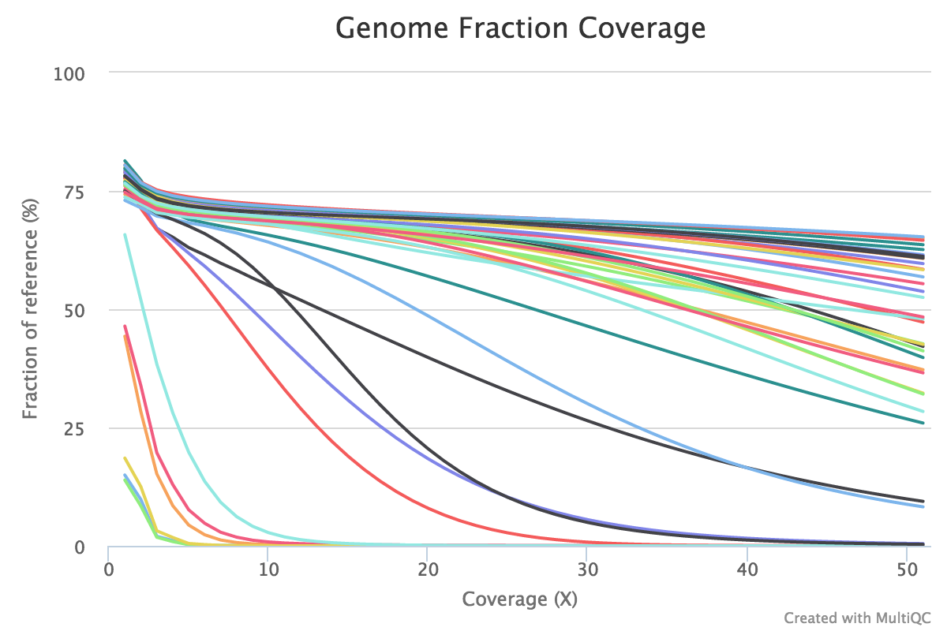
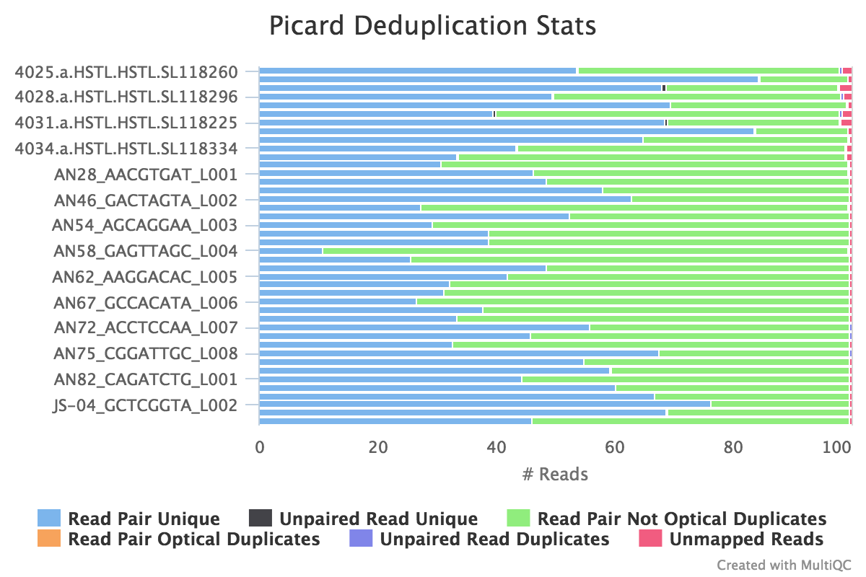
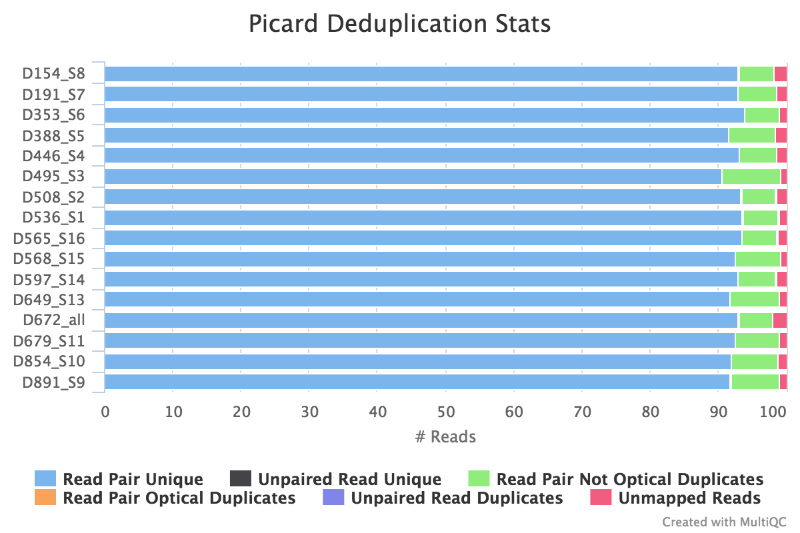
FFPE vs Fresh/Frozen Tissue – 50X target depth
Fresh/Frozen
FFPE

Slide 21
FFPE vs Fresh/Frozen Tissue – 50X target depth
DNA Damage Estimation
Variant Call Accuracy
Elevated ratio of G>T / A>C resulted in ~10% reductions in precision and recall

Slide 22
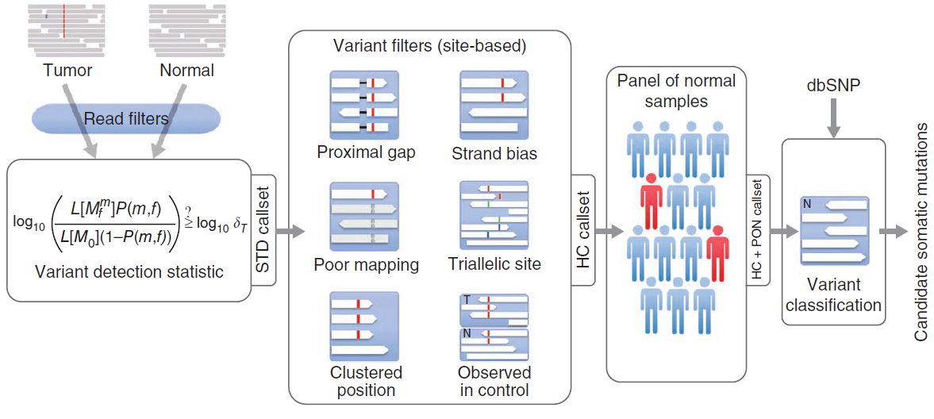
Paired Tumor/Normal vs Tumor-only Somatic Variant Calling

Slide 23
Paired Tumor/Normal vs Tumor-only Somatic Variant Calling
For tumor/normal calling, strong prior on variant evidence in germline sample

Slide 24
Paired Tumor/Normal vs Tumor-only Somatic Variant Calling
For tumor-only calling, germline contamination removed via a panel of normal (PON)
X

Slide 25
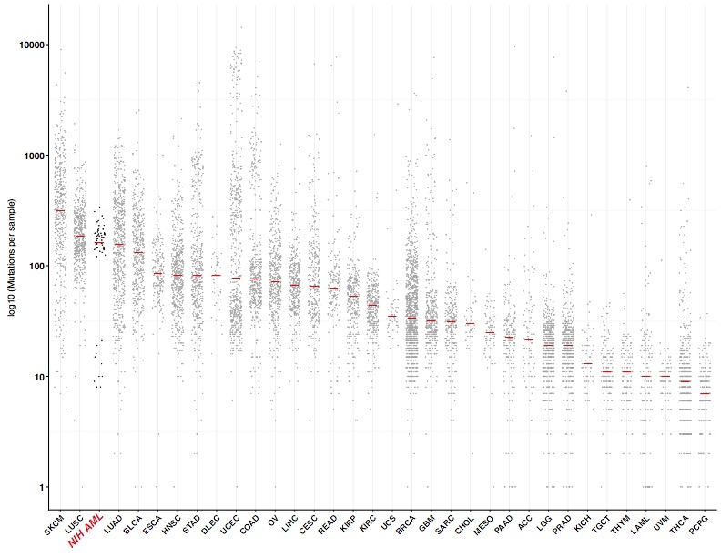
Paired Tumor/Normal vs Tumor-only Somatic Variant Calling
Even with a PON, false positive rate will be significantly higher for tumor-only relative to tumor/normal calling

Slide 26
Paired Tumor/Normal vs Tumor-only Somatic Variant Calling
TCGA AML
Even with a PON, false positive rate will be significantly higher for tumor-only relative to tumor/normal calling
Tumor-only
Tumor/Normal

Slide 27
Panel of Normals (PON)
Collection of individuals assumed to be “normal”
Used to augment population frequency databases (e.g., ExAC, GnomAD)
  Population databases are highly filtered and curated
  Many segregating germline variants are missing from population databases because they occur in challenging portions of the genome to call genotypes
Also useful for removing systematic sequencing and mapping artifacts…

Slide 28
Panel of Normals (PON)
This is a tumor/normal cohort of adrenocortical carcinoma (ACC)
Most common driver gene for ACC is CTNNB1
Somatic variant analysis for our cohort suggests RFPL4AL1 is the most frequently mutated gene
WE’RE GONNA BE FAMOUS! WOOHOO!

Slide 29
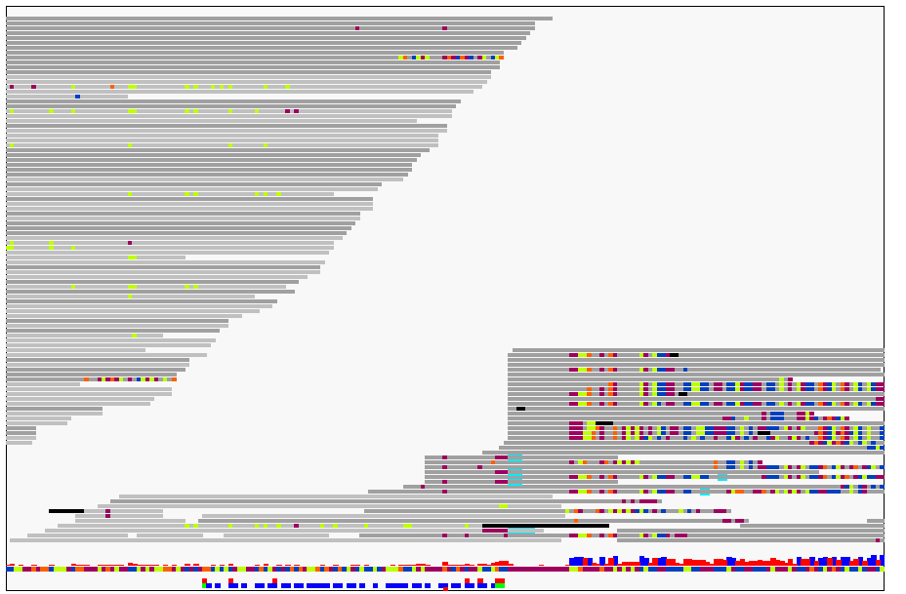
Panel of Normals (PON)
This is a tumor/normal cohort of adrenocortical carcinoma (ACC)
Most common driver gene for ACC is CTNNB1
Somatic variant analysis for our cohort suggests RFPL4AL1 is the most frequently mutated gene

Slide 30
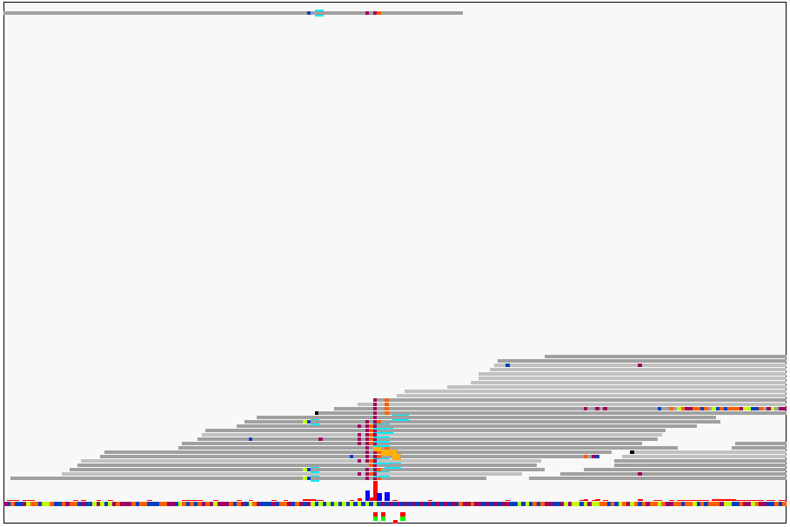
Panel of Normals (PON)

Slide 31
PON Performance
No PON
With PON
X
X
X
X

Slide 32
Panel of Normals (PON)
Collection of individuals assumed to be “normal”
Used to augment population frequency databases (e.g., GnomAD)
  Population databases are highly filtered and curated
  Many segregating germline variants are missing from population databases because they occur in challenging portions of the genome to call genotypes
Even with matched germline, these artifacts will be prevalent, and because they are systematic, they can be widespread
PON that was processed in (approximately) the same way as the case samples can remove many of these artifacts

Slide 33
Tumor Heterogeneity/Subclonality

Slide 34
Tumor Heterogeneity/Subclonality
For identification of subclones, certain conditions required:
  High tumor purity****
  High depth/coverage (sky’s the limit!)
  Paired tumor-normal
  WGS has significantly higher sensitivity and accuracy
  WES alone performs poorly for copy number segmentation, inflates VAF variability, can be too few mutational events per subclone

Slide 35
Tumor Heterogeneity/Subclonality
For identification of subclones, certain conditions required:
  High tumor purity****
  High depth/coverage (sky’s the limit!)
  Paired tumor-normal
  WGS has significantly higher sensitivity and accuracy
  WES alone can perform poorly for copy number segmentation, inflate VAF variability, and generate too few mutational events per subclone
150X WES
80X WGS

Slide 36
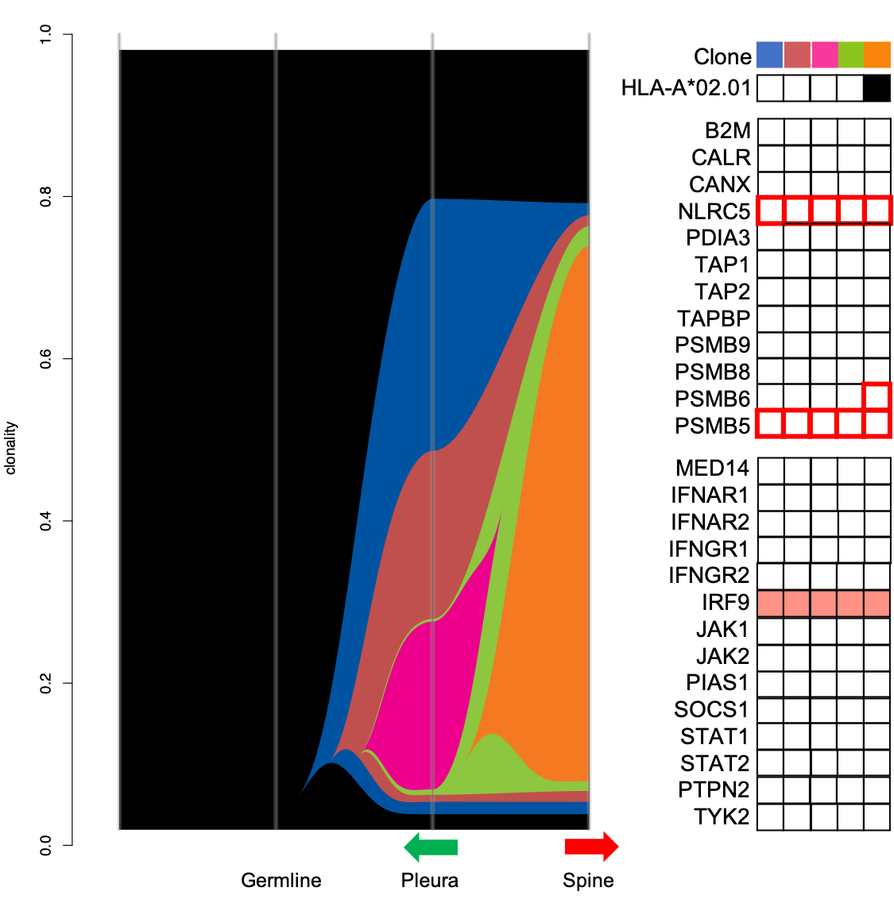
Tumor Heterogeneity/Subclonality
With paired tumor/normal and at least 150X WES we can accurately detect subclones as low as 10%

Slide 37
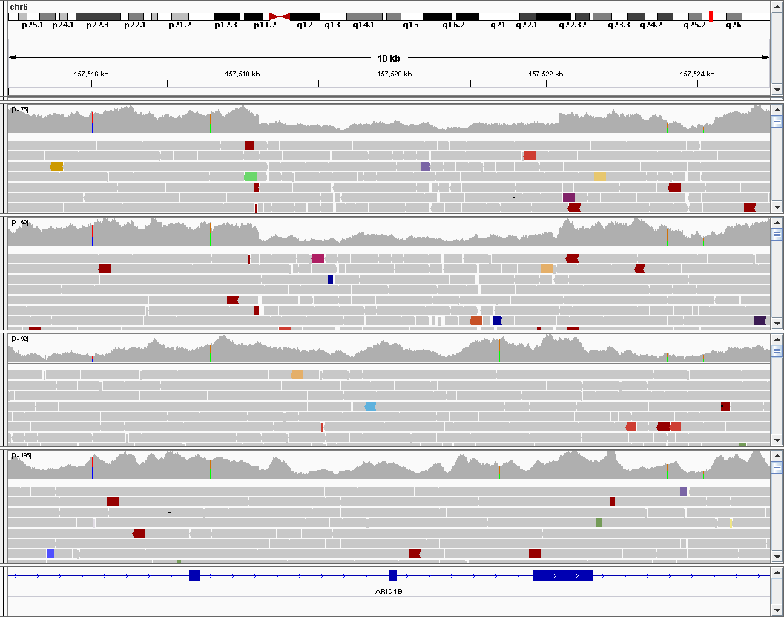
Variant Analysis in Cell Lines
Can never assume your cell lines are homogenous!
This cell line had a subclone with an ARID1B loss
Another subclone had lost the Y chromosome
Replicates of a single-cell established line
Replicates of the parental cell line

Slide 38
Variant Analysis in Animal Models
Mice have retained significant levels of heterozygosity
Vary considerably in regional gene expression

Slide 39
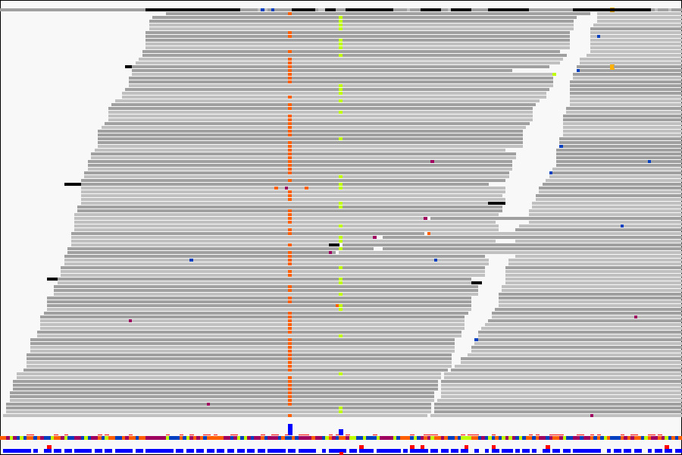
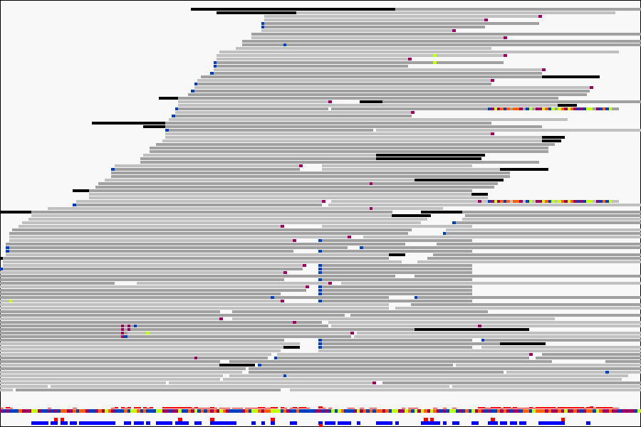
Always Visualize Significant Variants
ABSOLUTELY CRUCIAL!!
ALVIEW (https://github.com/NCIP/alview)
  Internally-developed tool for BAM/SAM visualization (Richard Finney)
True Positive
False Positive
Notes:
Also, SnpEff annotated VCF, and Oncotator somatic annotations followed by MutSigCV mutation analysis for somatic variants

Slide 40
Somatic Variant Calling – Best Practices
STRONGLY favor paired tumor/normal design
For non-human samples (e.g., mouse models) without paired somatic/germline
  >=2 control/”germline” samples
>=100X/50X mean depth for tumor/normal samples
Significantly higher target depth for FFPE samples
Tumor purity >50% (ideally, >60%) for variant calling
MUST visually verify any somatic variant of “significance”
Subclone analysis favors WGS, high purity, and high depth

Slide 41
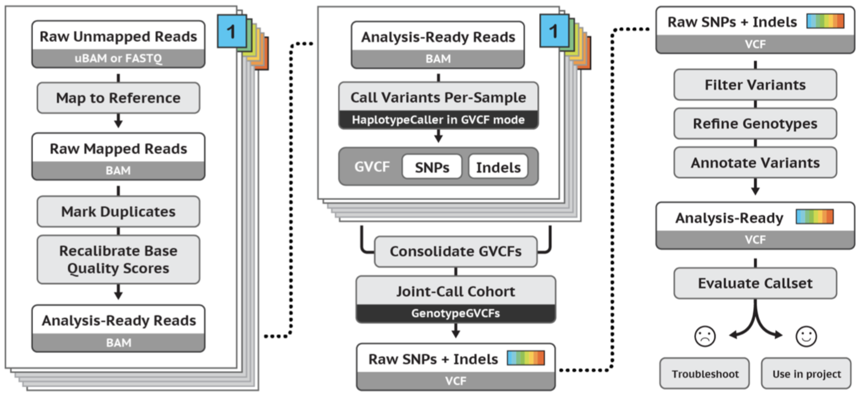
WGS/WES Workflow Development
GATK3/4 Best Practices is probably the most widely used

Slide 42

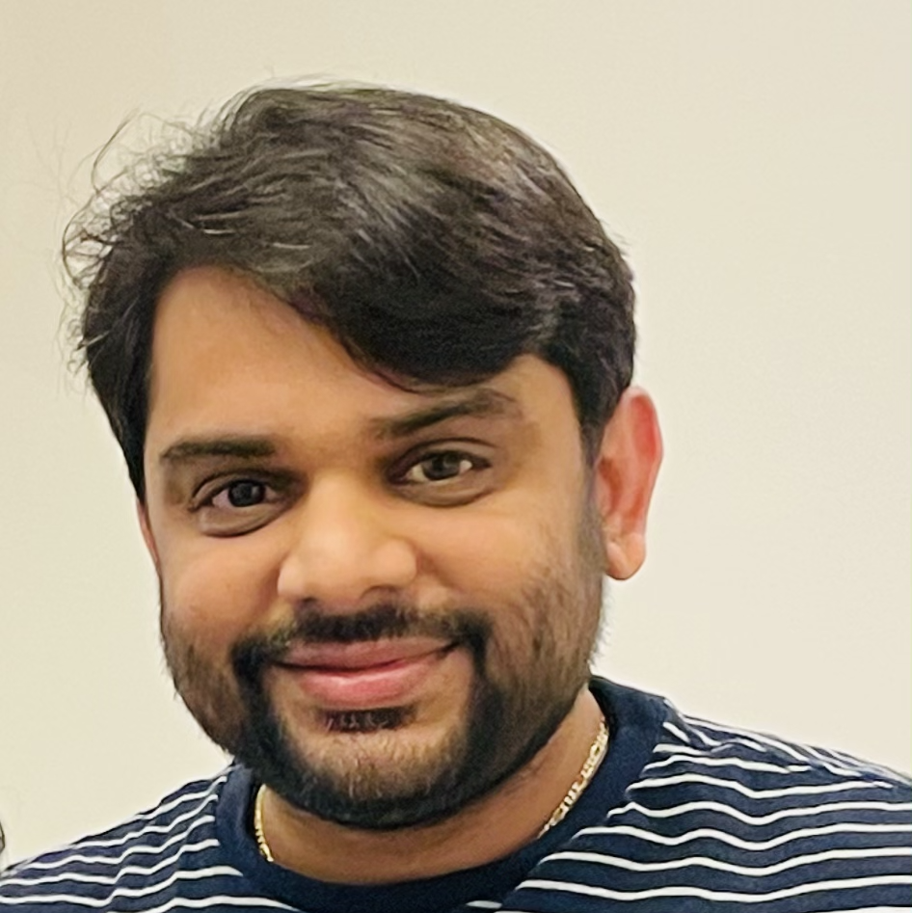
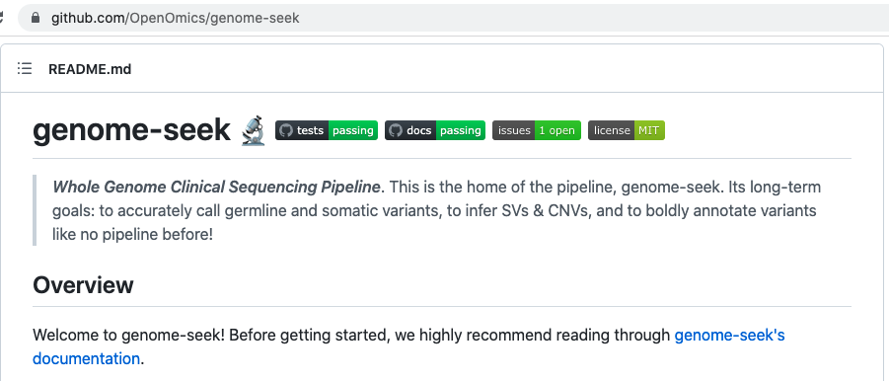
WGS/WES Workflow Development
Fastp - trimming
Skyler Kuhn
Keyur Talsania
Bwamem2/Samblaster – mapping, dedup, rehead, sort
Based on the benchmarking you’ve seen today, we are developing genome-seek
50 WGS samples at 30X median coverage process in ~10 hours, from raw reads to analysis-ready VCF
https://github.com/OpenOmics/genome-seek
DeepVariant v1.4 – sample-level VCF/gVCF
Analysis-ready
VCF
GLNexus v1.4.1 – joint genotyping
OpenCravat v1.4.1 – Extensive annotation, filtering, variant prioritization

Slide 43
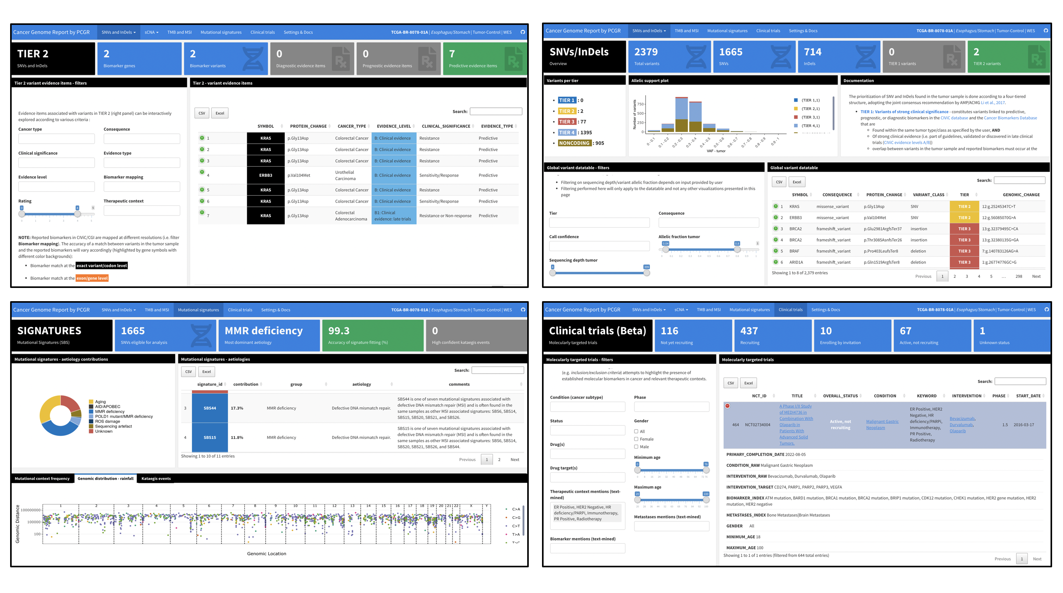
WGS/WES Workflow Development
Fastp - trimming
Skyler Kuhn
Keyur Talsania
Bwamem2/Samblaster – mapping, dedup, rehead, sort
Based on the benchmarking you’ve seen today, we are developing genome-seek pipeline
Somatic branch under development now
Somatic Branch
PCGR – Personal Cancer Genome Reporter
DeepVariant v1.4 – sample-level VCF/gVCF
Tumor-only
Octopus
MuTect2
Sage
Tumor/Normal
Octopus
MuTect2
Strelka2
Muse
GLNexus v1.4.1 – joint genotyping
Superfreq subclonality analysis
OpenCravat v1.4.1 – Extensive annotation, filtering, variant prioritization
CNV/SV Calling
Purple
Canvas
Manta

Slide 44
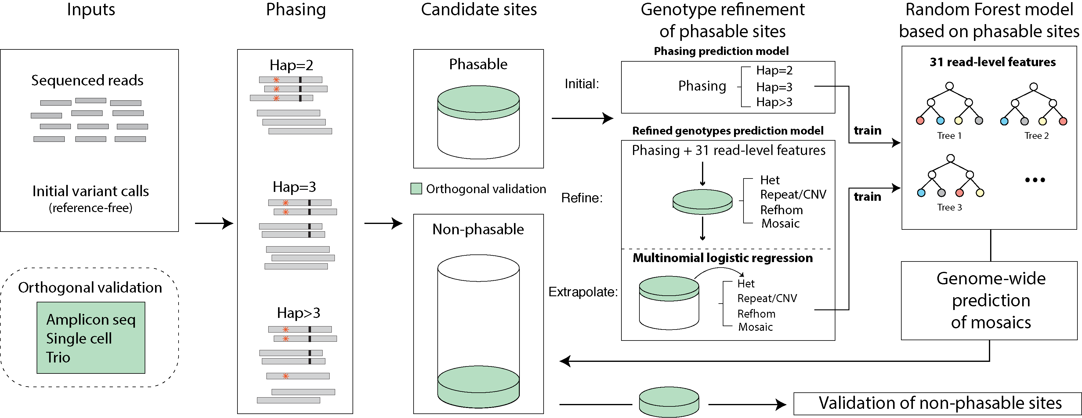
Somatic Mosaicism
MosaicForecast

