Slide 1
NIH Research Festival
Proteogenomic Integrative data analysis
Dr. Daoud Meerzaman
Computational Genomics and Bioinformatics Branch (CGBB)
NCI Center for Biomedical Informatics and IT
September 23, 2024

Slide 2

Center for Biomedical Informatics and Information Technology
(CBIIT) NCI/Shady Grove Campus
P

Slide 3



Computational Genomics & Bioinformatics Branch (GCBB)
Provide state-of-art data analysis on a variety of multifaceted cancer-related research projects including proteogenomic, AI, and clinical high-throughput data.
Computational Genomics & Bioinformatics Branch
NGS and Integrated analysis of proteogenomic data for Intramural NCI and moonshot projects (APOLLO, CIMAC-CIDC and SeQC2).
Multimodal AI and ML approaches for patient outcome prediction. Deep learning algorithms, CNNs.
Computational Genomics & AI
Generate and implement a web-based workflow in CRDC (CGC) and OmicCircos and (MOGSA)
Widely used tools for NGS analyses and Visualization tools
ITCR Scientific software
CBIIT Summer Internship Program
Scientific & Tools Consulting and training
Notes:
CGBB – Advancing Data Insights
CGBB’s data scientists provide state-of-art data analysis, consulting, and training on a variety of multifaceted cancer-related research projects including proteogenomic, AI, and clinical high-throughput data. Access to these skills, tools, and resources empowers cancer researchers, including non-data scientist and bioinformaticians, to collaborate and reduce the time it takes to turn data into insights.
Multimodal AI and ML approaches for patient outcome prediction.
Using multi-omic data and radiology images to build deep learning model, followed by building a classifier to integrate these features and predict patient survival, treatment response and clinical subtyping.

Slide 4
Genomic Medicine and Bioinformatics Applications
https://www.slideshare.net/TWilckens/symbiotic-innovation-082015

Slide 5
Proteogenomic Integrative data analysis
Dr. Daoud Meerzaman
Computational Genomics and Bioinformatics Branch (CGBB)
NCI Center for Biomedical Informatics and IT
September 23, 2024

Slide 6
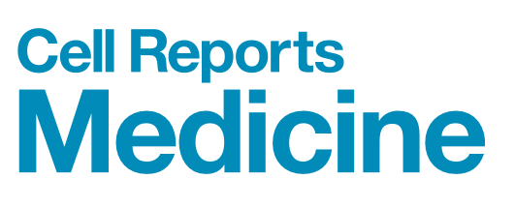
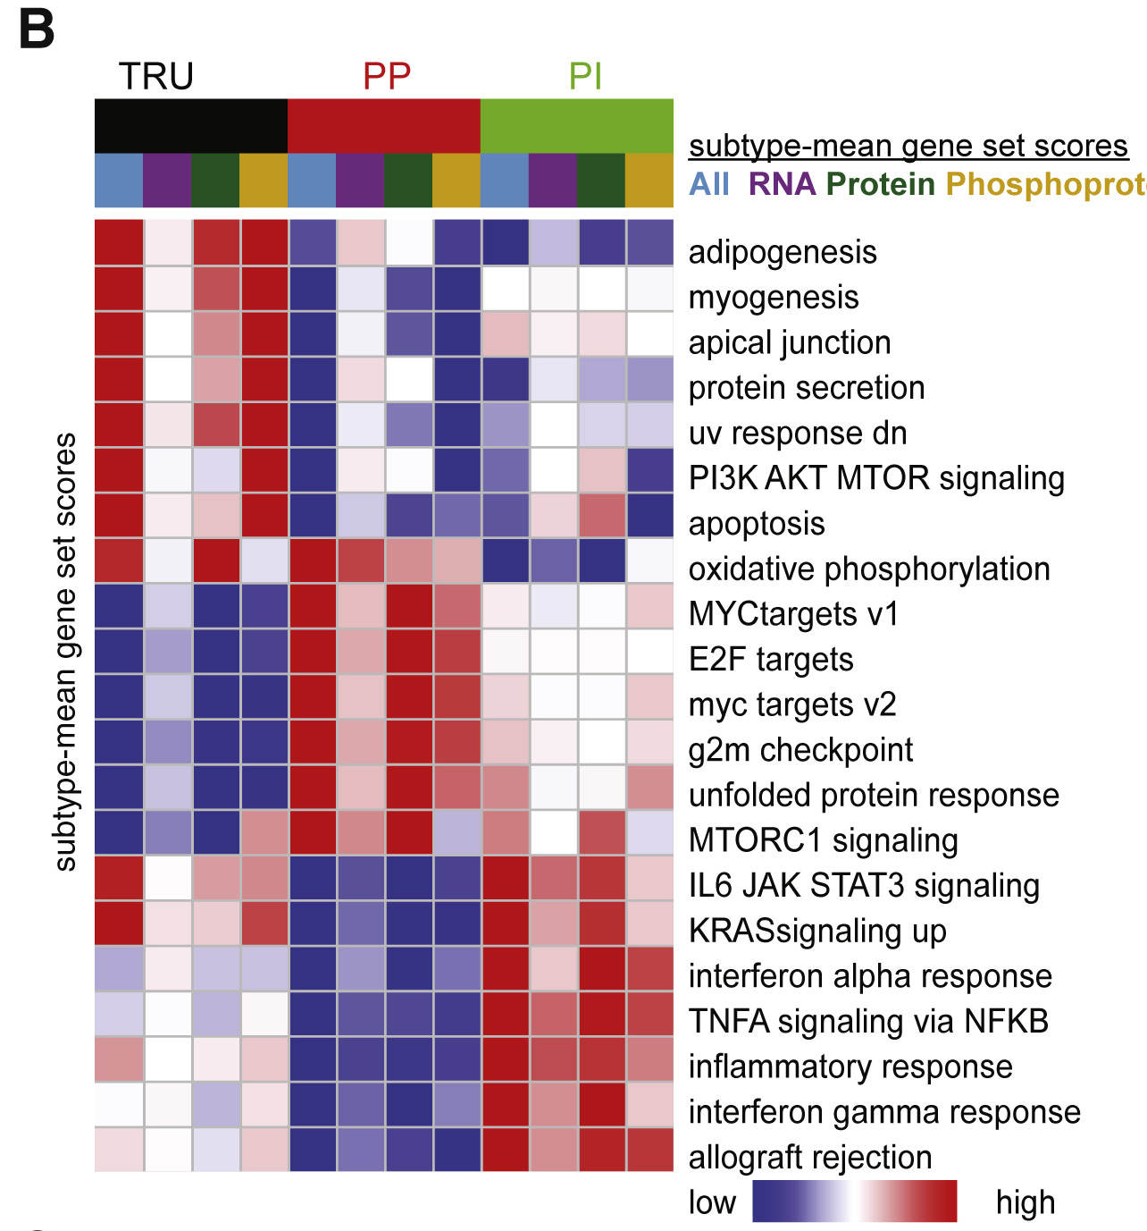
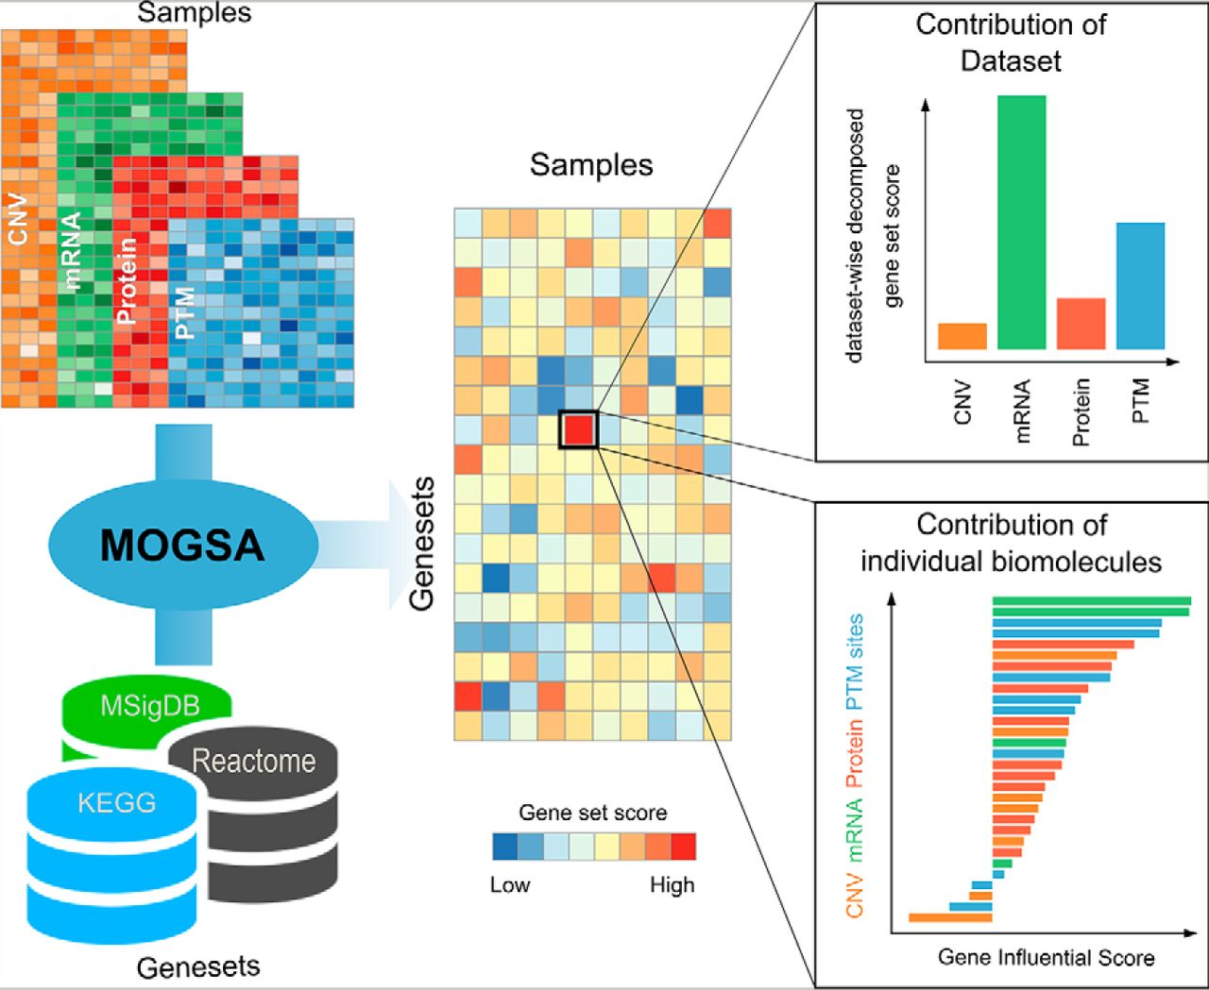
Proteogenomic analysis of lung adenocarcinoma
reveals tumor heterogeneity, survival determinants,
and therapeutically relevant pathways
Multi-omics gene-set analysis (MOGSA)
Chen Meng et al. Mol Cell Proteomics 2019;18:S153-S168
Soltis et al., 2022, Cell Reports Medicine 3, 100819

Slide 7
Single cell and CyToF analysis
Dr. Daoud Meerzaman
Computational Genomics and Bioinformatics Branch (CGBB)
NCI Center for Biomedical Informatics and IT
September 23, 2024

Slide 8
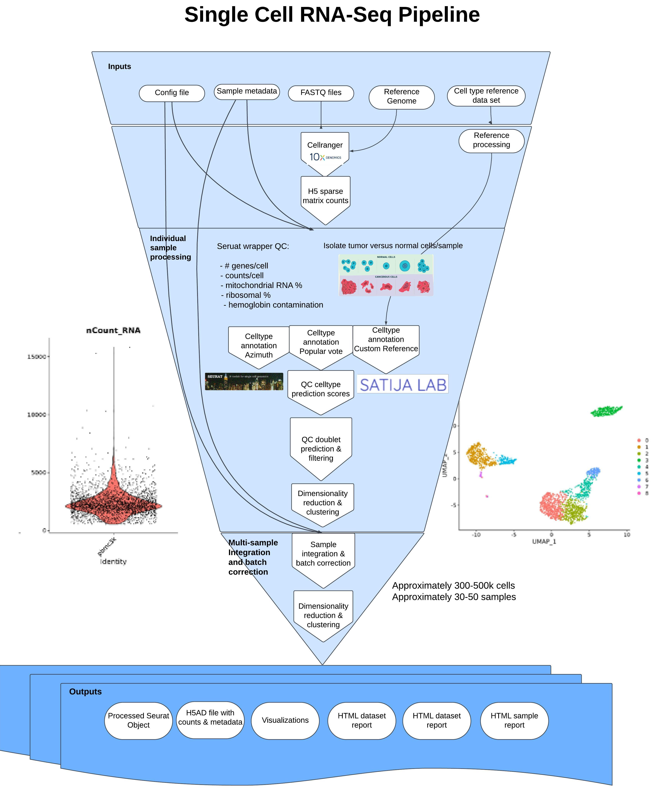
Single Cell RNA Seq Pipeline

Slide 9
CyTOF (cyttools pipeline)
Raw FCS
Annotated FCS
Arcsinh transform
Automated gating
Default cofactor is 0.25 with option for VST optimization
Assignments
Extract/Tabulate
Profiles
For all tabulations, counts, frequencies, and other summary statistics are generated (such as median intensity)
Annotated FCS files contain numeric encoded FlowSOM nodes and gating assignments, allowing for human interaction in FlowJo/FCS express
Compartments

Slide 10
Bridging the Gap: Bioinformatics Pipelines for Non-Bioinformaticians
Dr. Daoud Meerzaman
NCI Center for Biomedical Informatics and IT
September 23, 2024

Slide 11
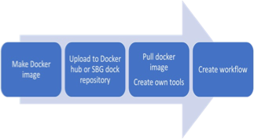
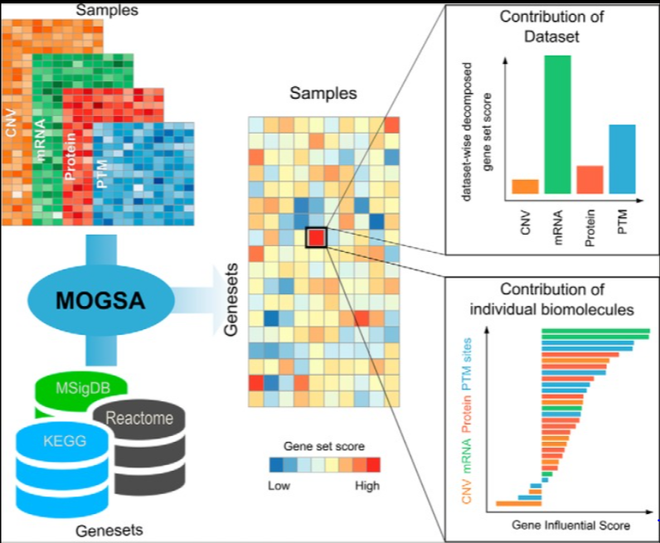
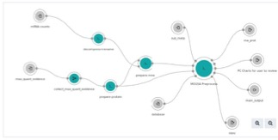
Bridging the gap between data scientist, clinicians and biologists using CRDC
Perform MOGSA Analysis in 3 Steps

Slide 12
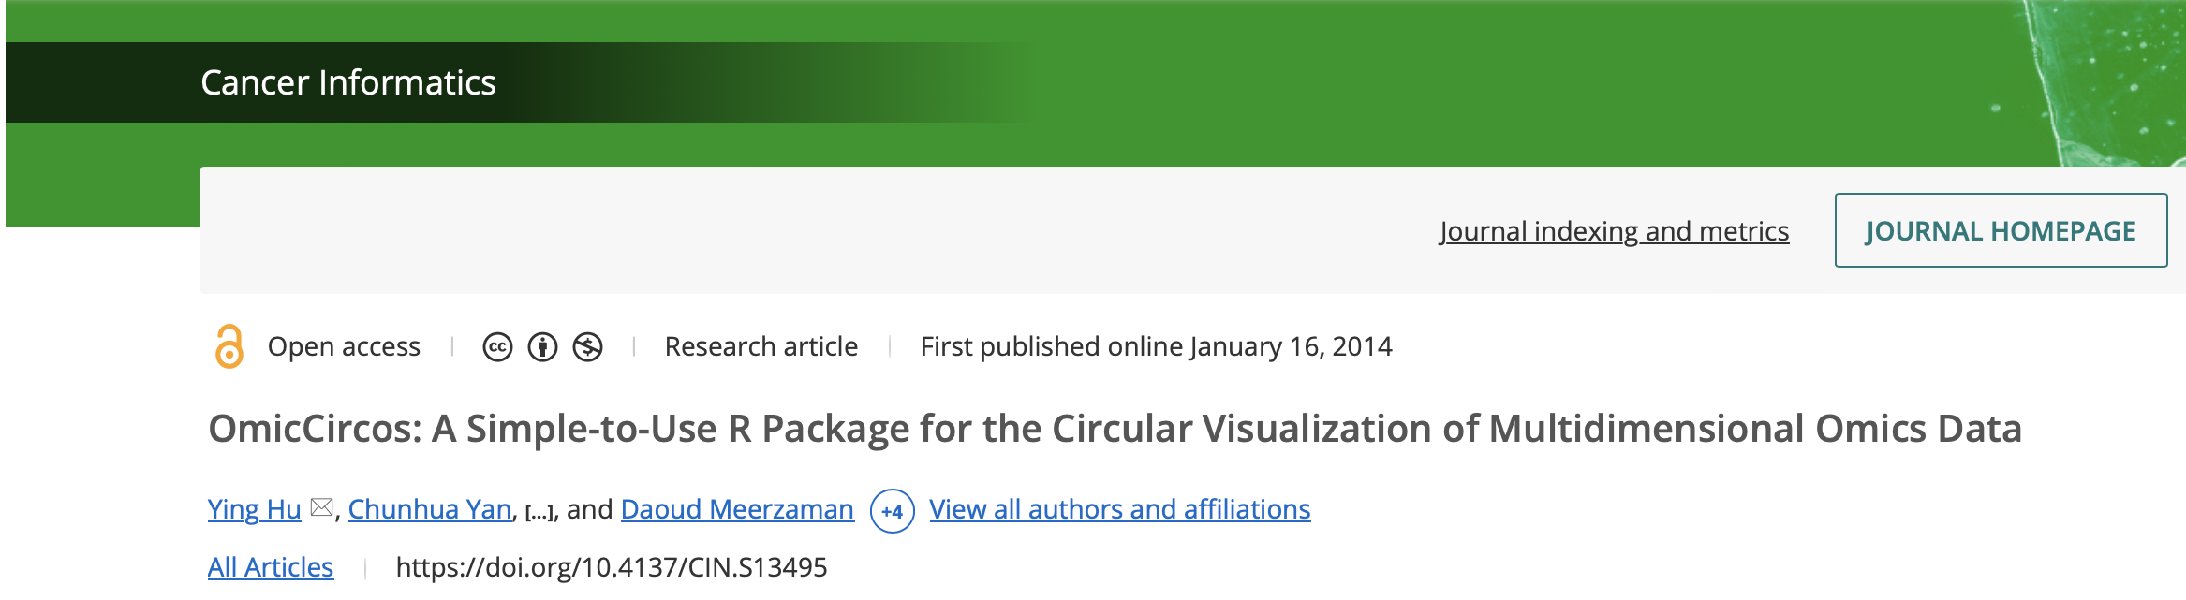
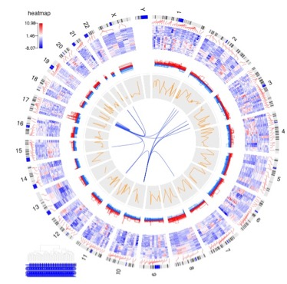
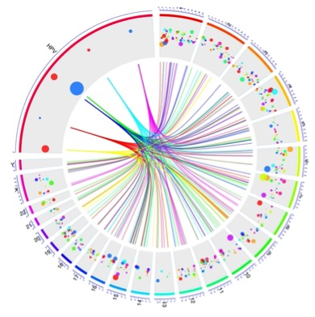
OmicCircos
Since December 2013
Sited over by 160 articles
Total views and downloads of this article: 4323
Total downloads of the tool more than 43000

Slide 13
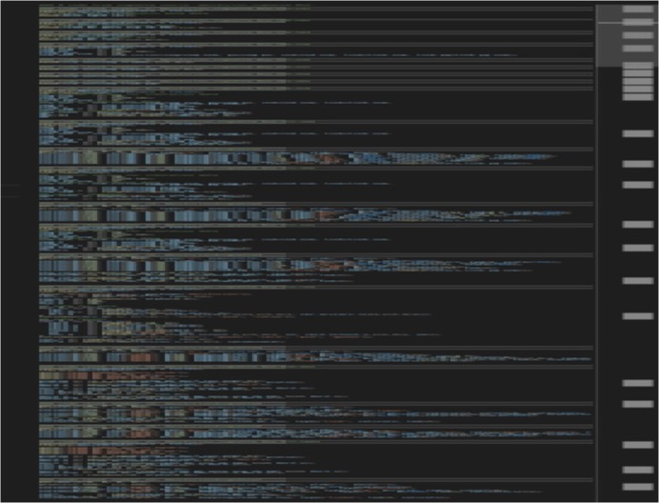
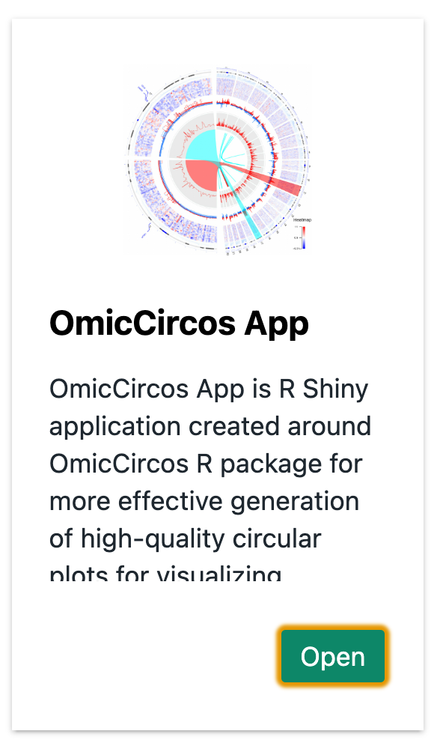
Implementation of OmicCircos on CRDC-CGC
Bioconductor R package into an R shiny application named OmicCircos App. This App requires no coding experience.

Slide 14
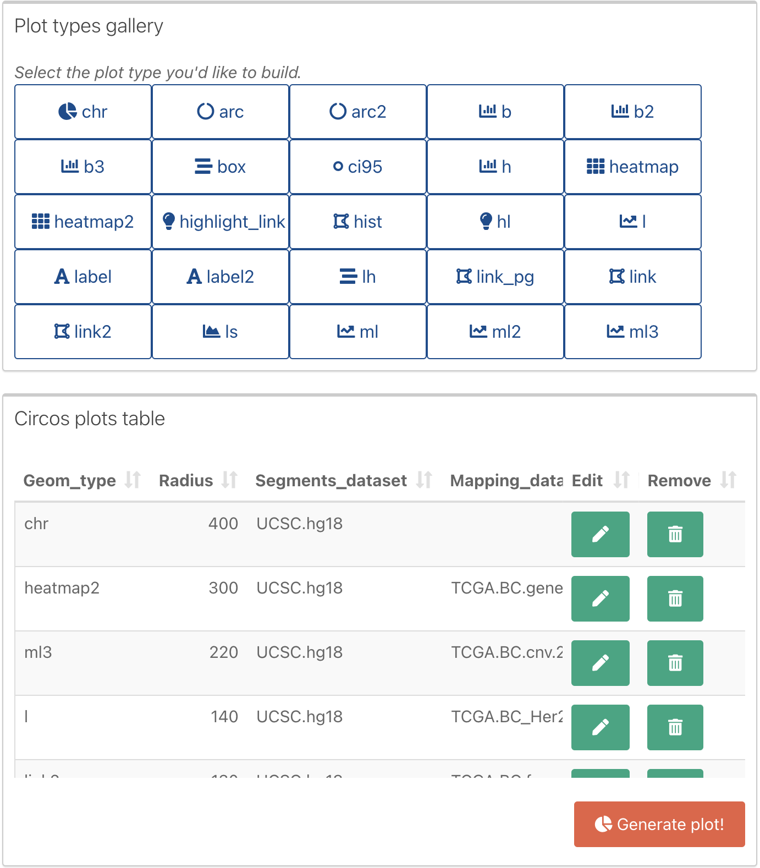
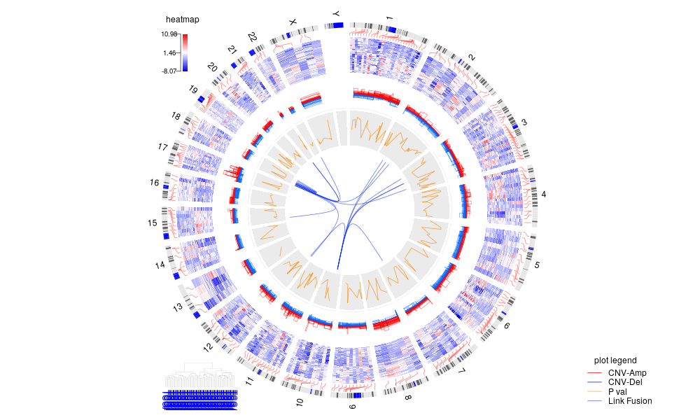
Tool Integration and Data Usability
Graphical User Interface- OmicCircos App
Notes:
CNV and gene expression came from the case: TCGA-A2-A04W.01A
Gene fusion: came from multiple cases.
CNV and gene expression association came from multiple cases.

Slide 15
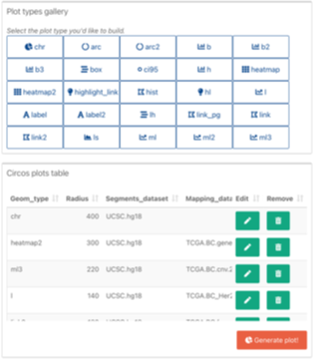
Genomic variations for Basal subtype of BCR

Slide 16
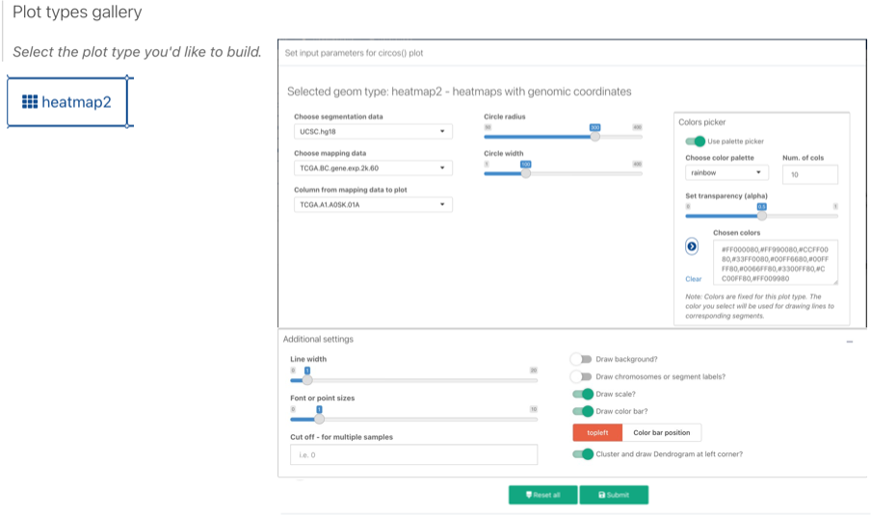
Gene Expression for Basal subtype of BCR

Slide 17
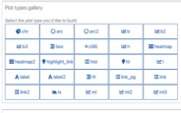
Copy Number variation for Basal subtype of BCR

Slide 18
CNV and expression correlation for Basal subtype of BCR

Slide 19
Gene fusion for Basal subtype of BCR

Slide 20
Zooming on chromosome 11 and 17 for Basal subtype
of BCR
Chromosomes
Expression Heat
map
Copy number
variations
Correlation between
CNV and Expression
Fusion

Slide 21
Zooming on chromosome 11 and 17
ERBB2 (Her2)
P53

Slide 22
OmicCircos capabilities

Slide 23
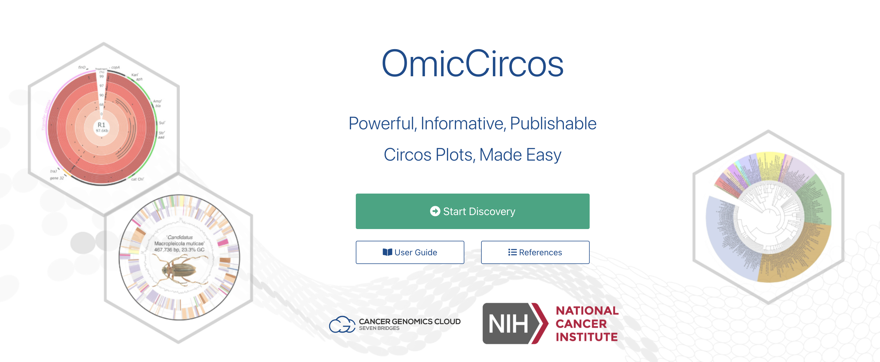
Demo
https://cgc.sbgenomics.com/webapps

Slide 24
What role does 3DVizSNP play?
Visualizing the effect of SNPs on protein structure using iCn3D
Collaboration with Philippe Youkharibache and Jiyao Wang,
Cancer Data Science Laboratory and NCBI

Slide 25
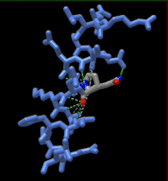
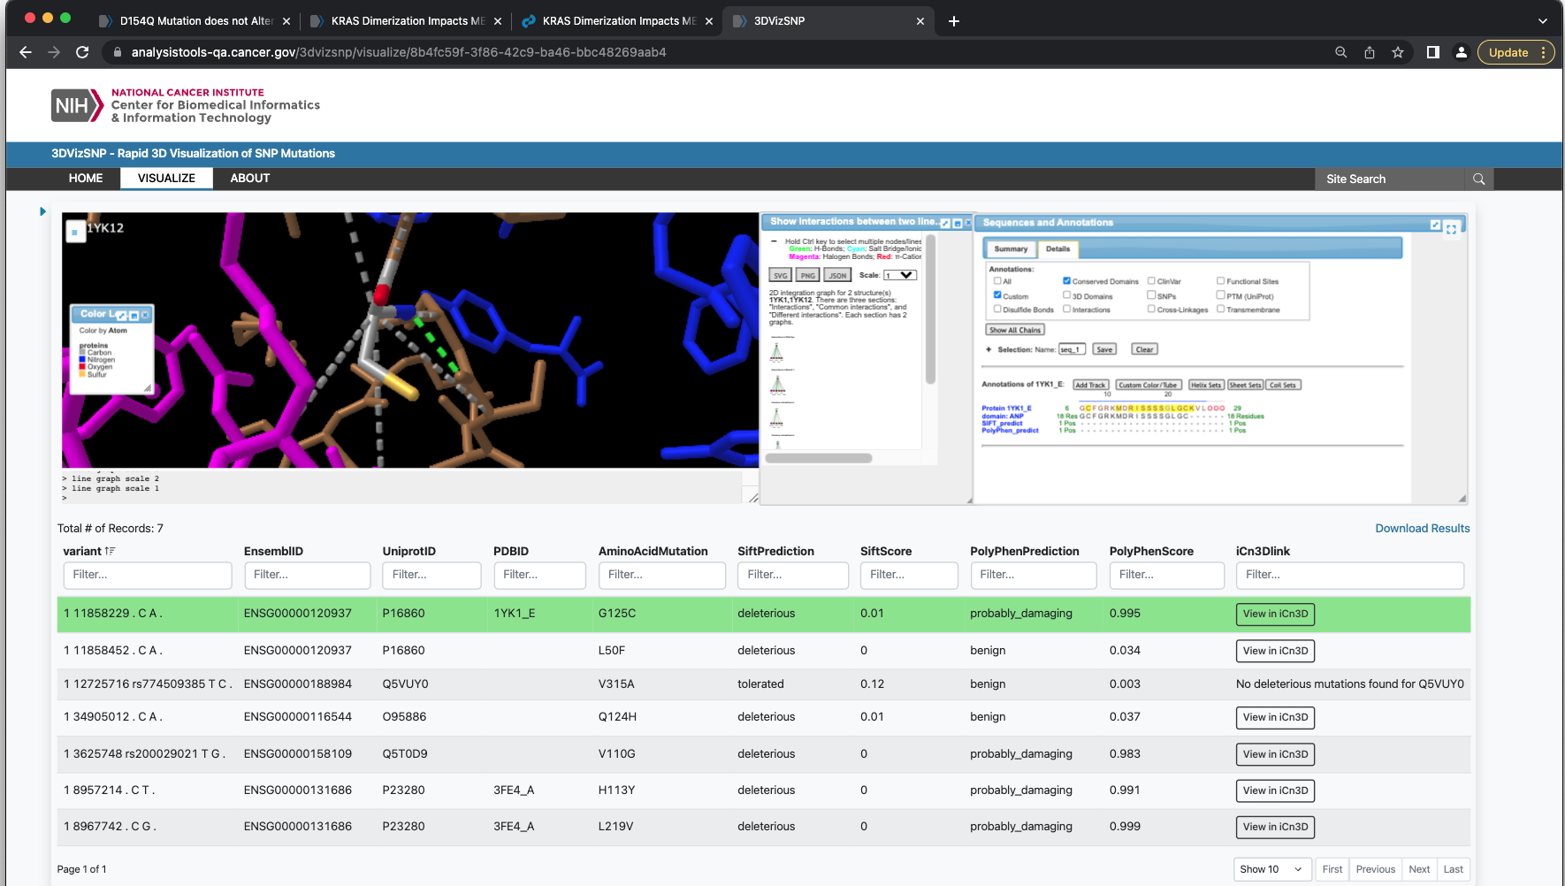
What role does 3DVizSNP play?
Website: https://analysistools.cancer.gov/3dvizsnp

Slide 26
AI related project

Slide 27
Computational Genomics and Bioinformatics Branch: Training Resources
CGBB Training
Computational Genomics and Bioinformatics Mini-courses
Scientific Software Webinars
ITCR is a trans-NCI program supporting investigator-initiated,
Short-term (Summer) Internship Opportunities

Slide 28
Next-Generation Sequencing (NGS) training classes
  Bioinformatics 101
  whole-genome sequencing (WGS)
  whole exome sequencing (WES)
  RNA-seq (Transcriptomics)
  Epigenomic sequencing (Chip-Seq)
  Pathway Analysis
  NGS data Visualization Tool (OmicCircos)
Training topics

Slide 29
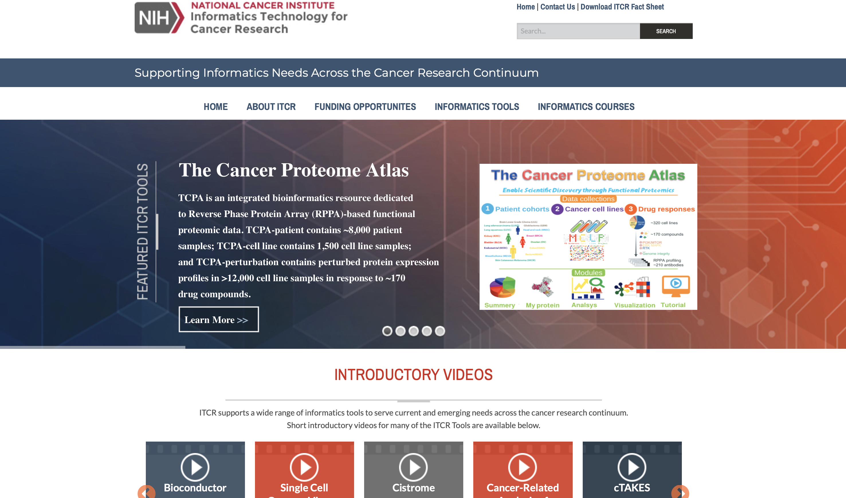
Scientific Software Portfolio and Informatic Technology for Cancer Research ITCR

Slide 30
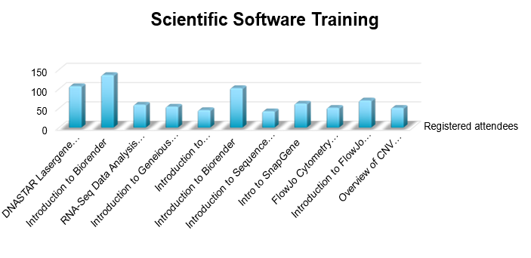
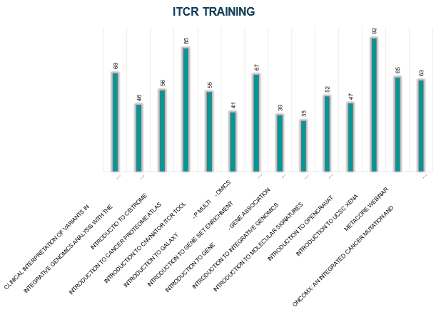
Training classes
Notes:
29 total trainings held in 2020
2,010 people registered for our trainings in 2020

Slide 31


