Slide 1
Transforming Medicine with AI: from PubMed Search to TrialGPT
Zhiyong Lu, PhD FACMI FIAHSI
Senior Investigator, NLM, NIH
NIH Research Festival – Bioinformatics Community Fair
September 23, 2024

Slide 2
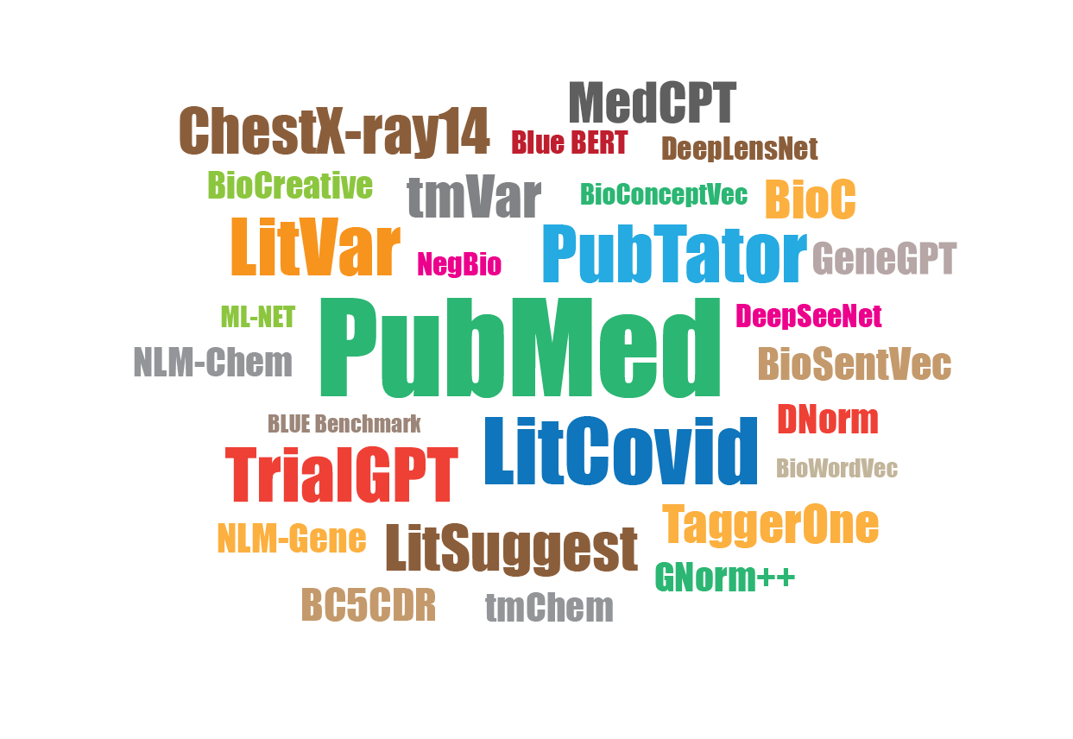
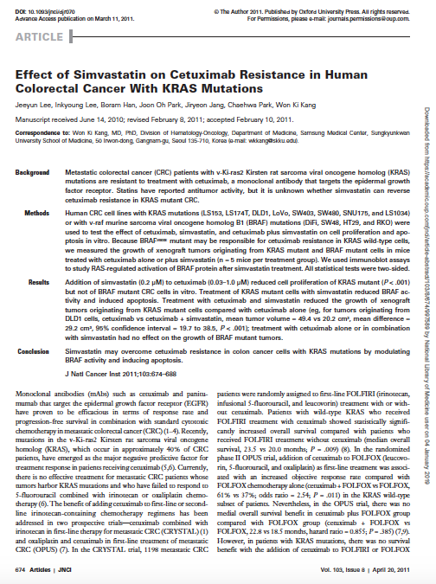
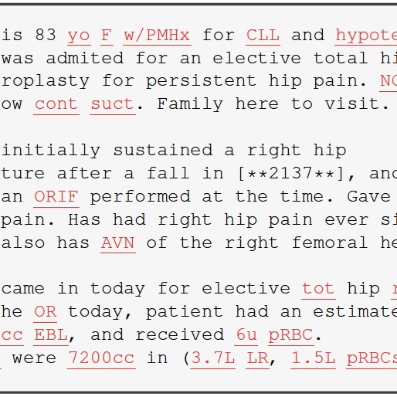
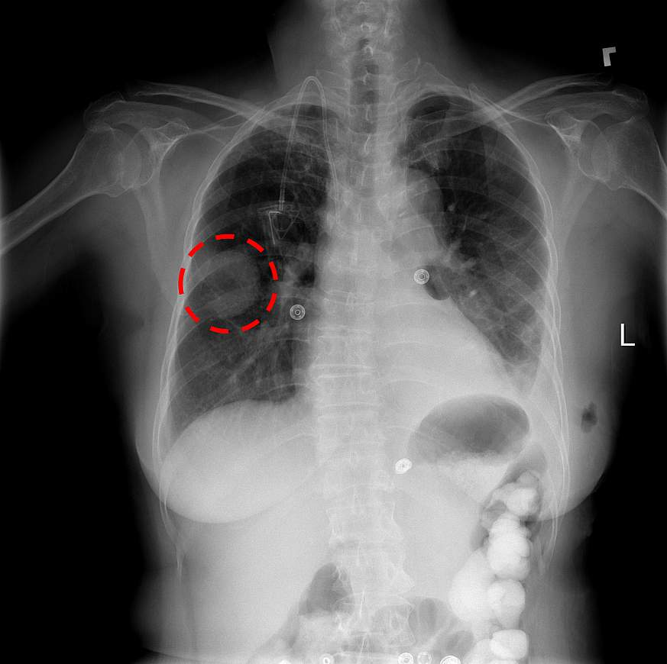
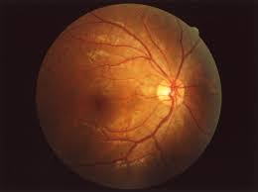
Our research at NLM IRP
Research Areas
AI & Machine Learning, LLMs
Natural Language Processing (NLP)
Medical Image Analysis
Text & Image data
Biomedical Literature
Clinical notes, EHRs
CT, CXR & retinal images
Application areas:
Literature Retrieval (e.g., PubMed Search; LitCovid)
Information Extraction/Curation (e.g., LitVar, PubTator)
AI/LLMs in Healthcare (e.g., diagnosis/prognosis; TrialGPT)

Slide 3
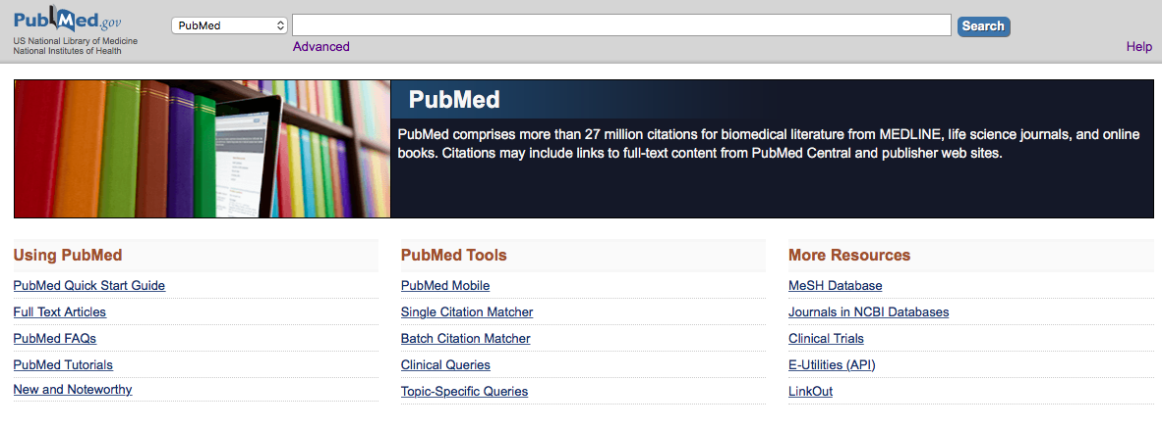
PubMed Daily Usage
~36+ million articles
2.5 million users daily
~ 3 million searches
9 million page views

Slide 4
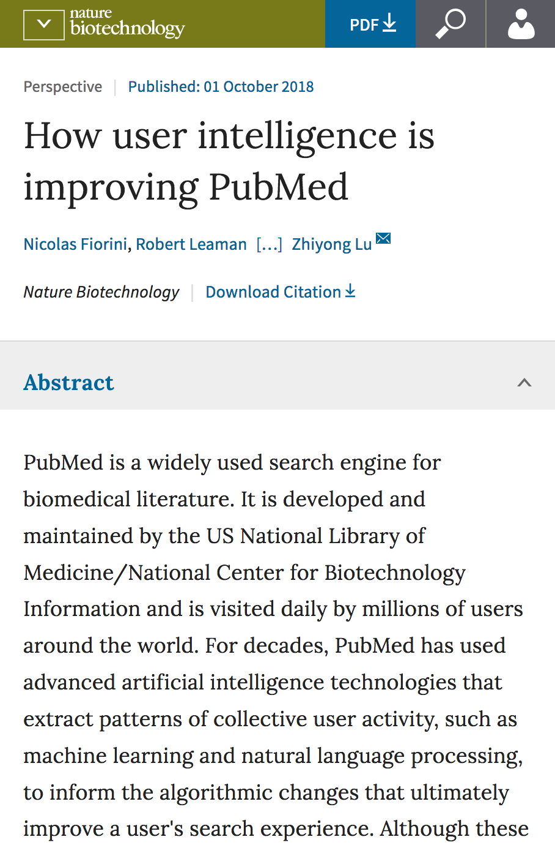
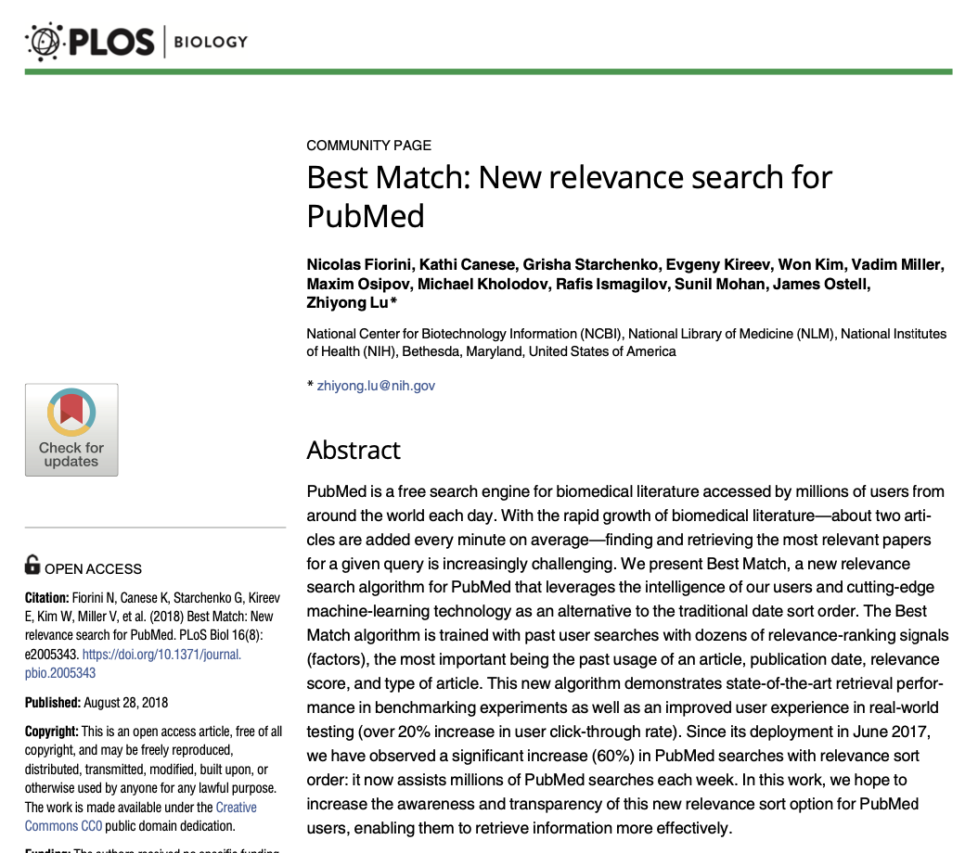
AI/ML in PubMed
Related articles
Spell checker
Query autosuggest
Semantic query understanding
Citation sensor
Author name disambiguation
Query expansion
Best Match: Sort by Relevance
…

Slide 5
Unknown pneumonia
2019 nCov infection
Novel coronavirus pneumonia
Coronavirus disease 2019
COVID-19
Wuhan coronavirus pneumonia
CoV 19 infection
SARS-CoV-2 associated ADRS
Coronavirus 2 syndrome
2019 nCoV
SARS COVID 2
Novel coronavirus
SARS-CoV-2
New Cov 19
HCoV-019
SC2
WH-human 1’ coronavirus
New CoV
Severe acute respiratory syndrome coronavirus 2

Slide 6
LitCovid: Research matters (est. 02/2020)
Chen et al., Keep up with the latest coronavirus research.
Nature. 2020, NAR 2021, 2023
“First thing in the morning, right after brushing your teeth, you click on LitCovid”
Qingyu Chen
“My favorite site for following the latest #covid19 literature is NLM LitCovid. Organized, comprehensive and user friendly.”
“I just wanted to say thank you for the LitCovid tool!
It is an amazing resource. "
“I just wanted to thank you for organising this informative information. I am incredibly grateful for your efforts. ”
“Thank you for putting together such a wonderful resource.”

Slide 7
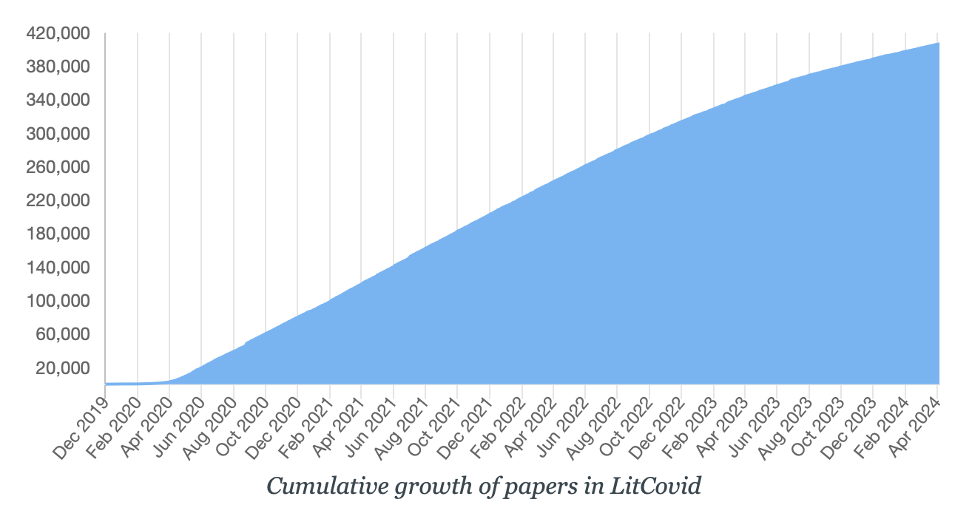
AI + Curator > Curator
LongCovid collection
Total usage: Over 60 million hits
Machine
curation
AI-driven data curation
100%
manual
AI-assisted
Lilly Xu, 2022 summer intern
AMIA 2022 High School Scholar
Harvard, Class of 2027
Leaman et al. Comprehensively identifying Long Covid articles with human-in-the-loop machine learning.” Patterns, 2023
Chen et al. LitMC-BERT: Transformer-Based Multi-Label Classification of COVID-19 Literature. IEEE/ACM TCBB, 2022

Slide 8
Information Extraction for Discovery
1
2
3
1. Articles
4
2. Entities
3. Relations
4. Integration
Rzhetsky A et al., (2009) Getting Started in Text Mining: Part Two. PLoS Comput Biol 5(7):

Slide 9
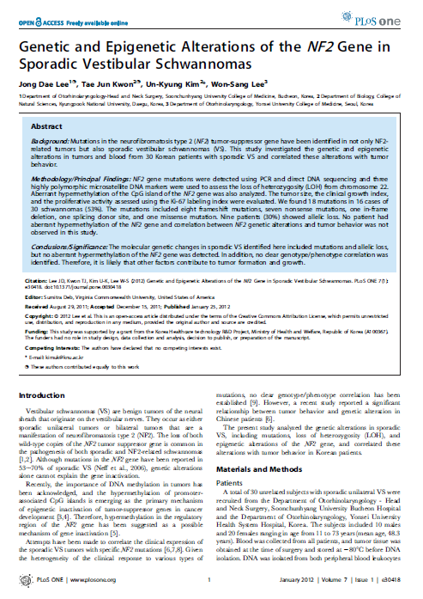
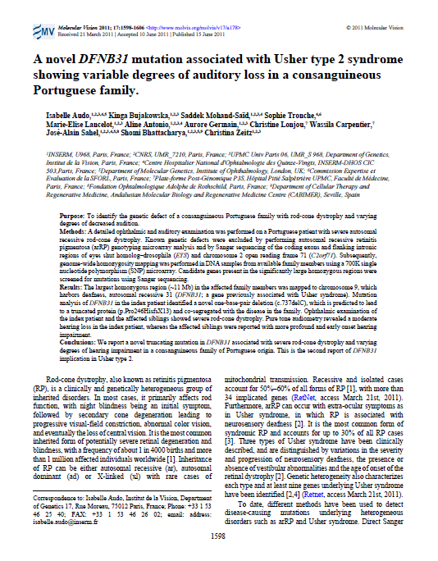
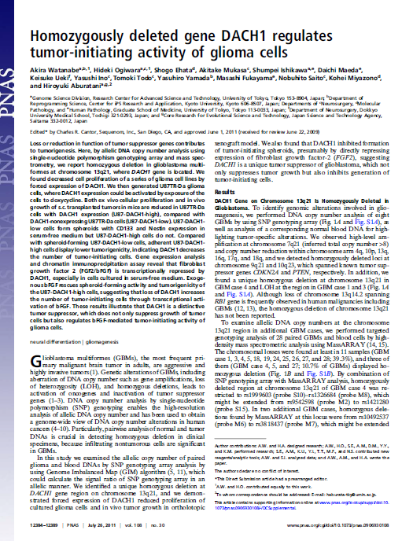
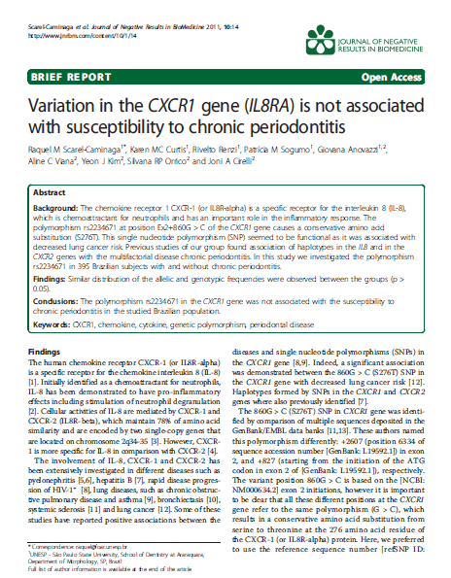
Extracting gene-disease-variant relations from free text
Disease
Gene
Variant
J Alzheimers Dis. 2012;32(2):397-415. doi: 10.3233/JAD-2012-121129.
Highly pathogenic Alzheimer's disease presenilin 1 P117R mutation causes a specific increase in p53 and p21 protein levels and cell cycle dysregulation in human lymphocytes.
Bialopiotrowicz E¹, Szybinska A, Kuzniewska B, Buizza L, Uberti D, Kuznicki J, Wojda U.
Rank | Gene or Protein ID | Gene SYM | WTAA | MTAA | POS | Disease | PMIDs
1 | Q13131 | PRKAA1 | Q | R | 16 | Breast cancer | 16959974
2 | P31749 | AKT1 | E | K | 17 | Breast cancer | 17611497 18954143 19713527 21793738
3 | P10275 | AR | H | Y | 874 | Prostate cancer | 17591767
 | ….. | …. | …. | …. | …. | …. | …..

Slide 10
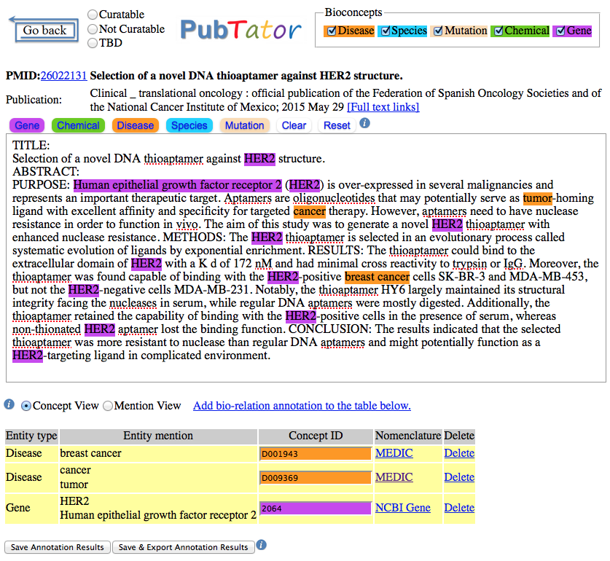
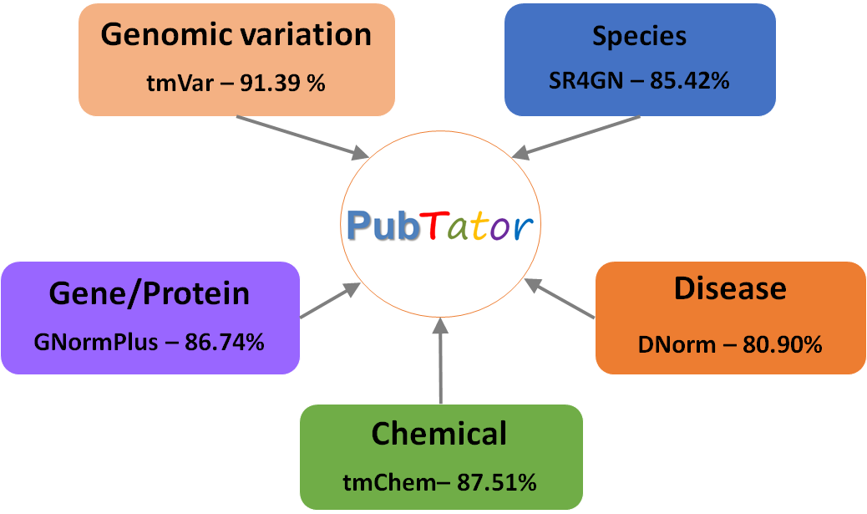
PubTator (est. 2012): integrating text-mined results at PubMed scale
Wei, Kao, & Lu: PubTator: a Web-based text-mining tool for assisting biocuration, Nucleic Acids Research, 2013

Slide 11
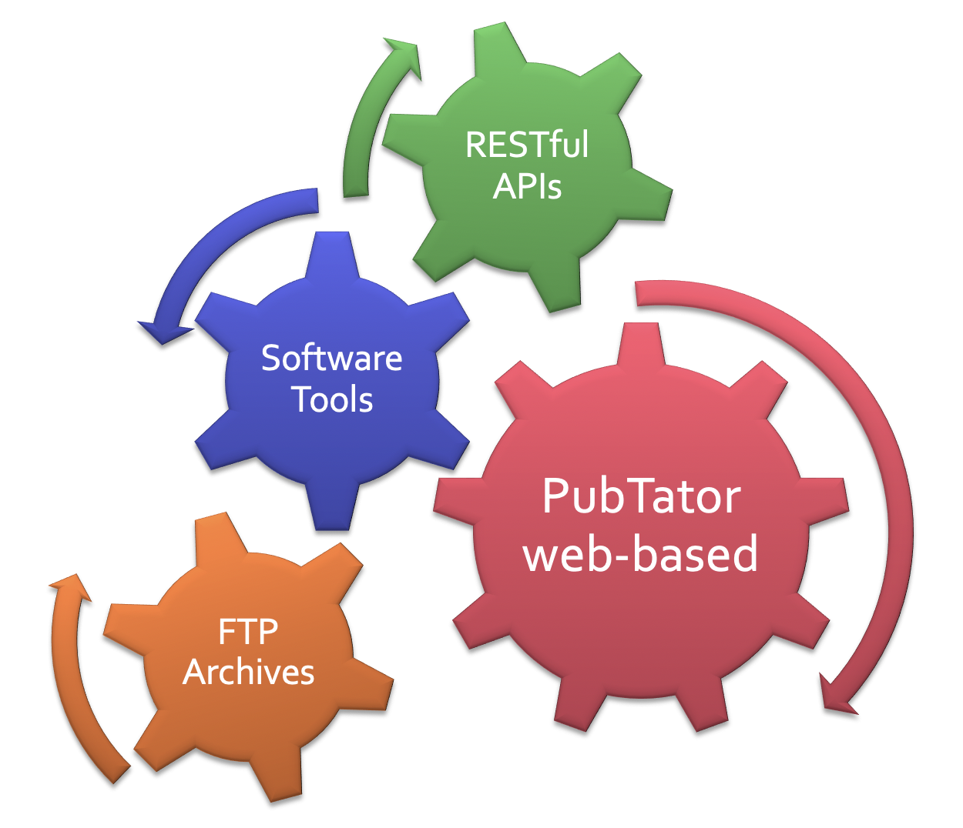
PubTator milestones
2019
2024
Deep Learning for improved results
Relation annotations (PubTator 3.0)
2018
2016
Full-text PMC articles added (PubTator 2.0)
Bulk download available via FTP
2015
APIs released
2012
PubTator first launched

Slide 12
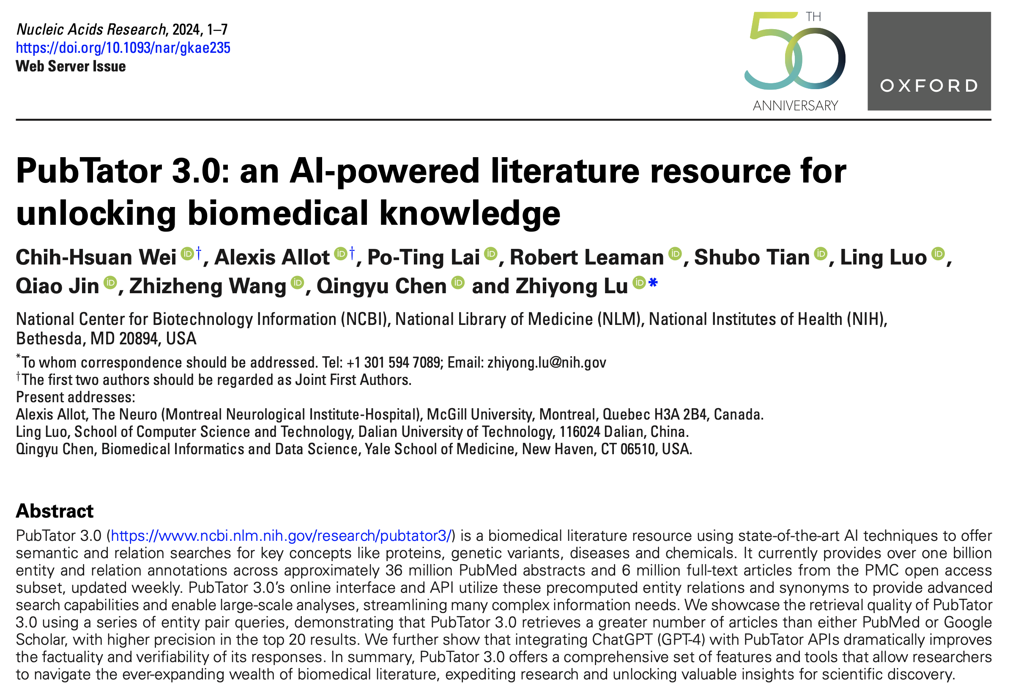
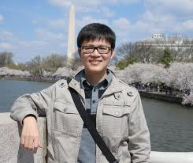
Staff Scientists: C. Wei, R. Leaman

Slide 13
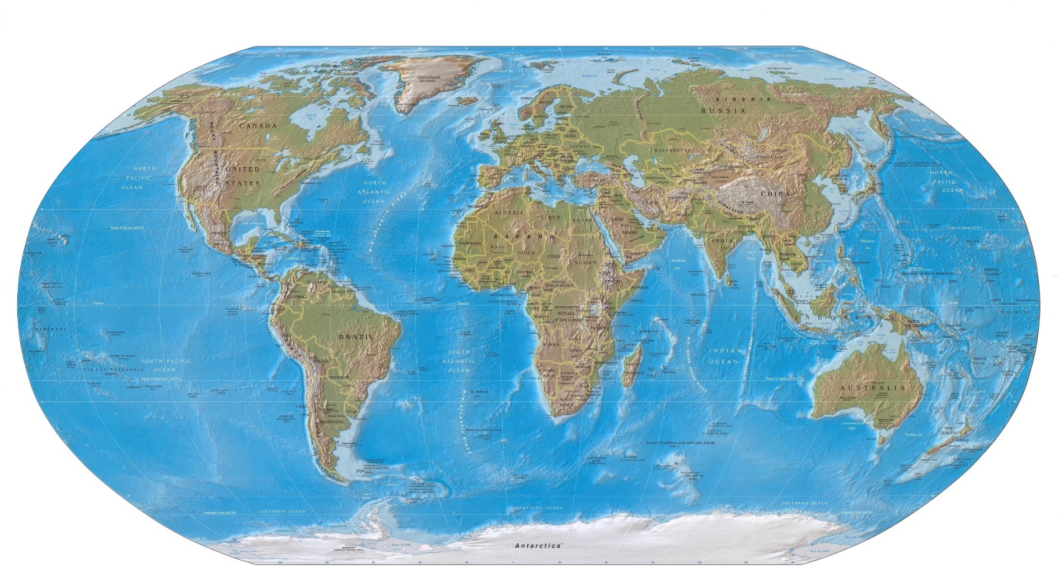
API usage: over 1 billion requests

Slide 14
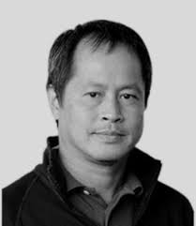
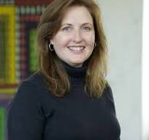
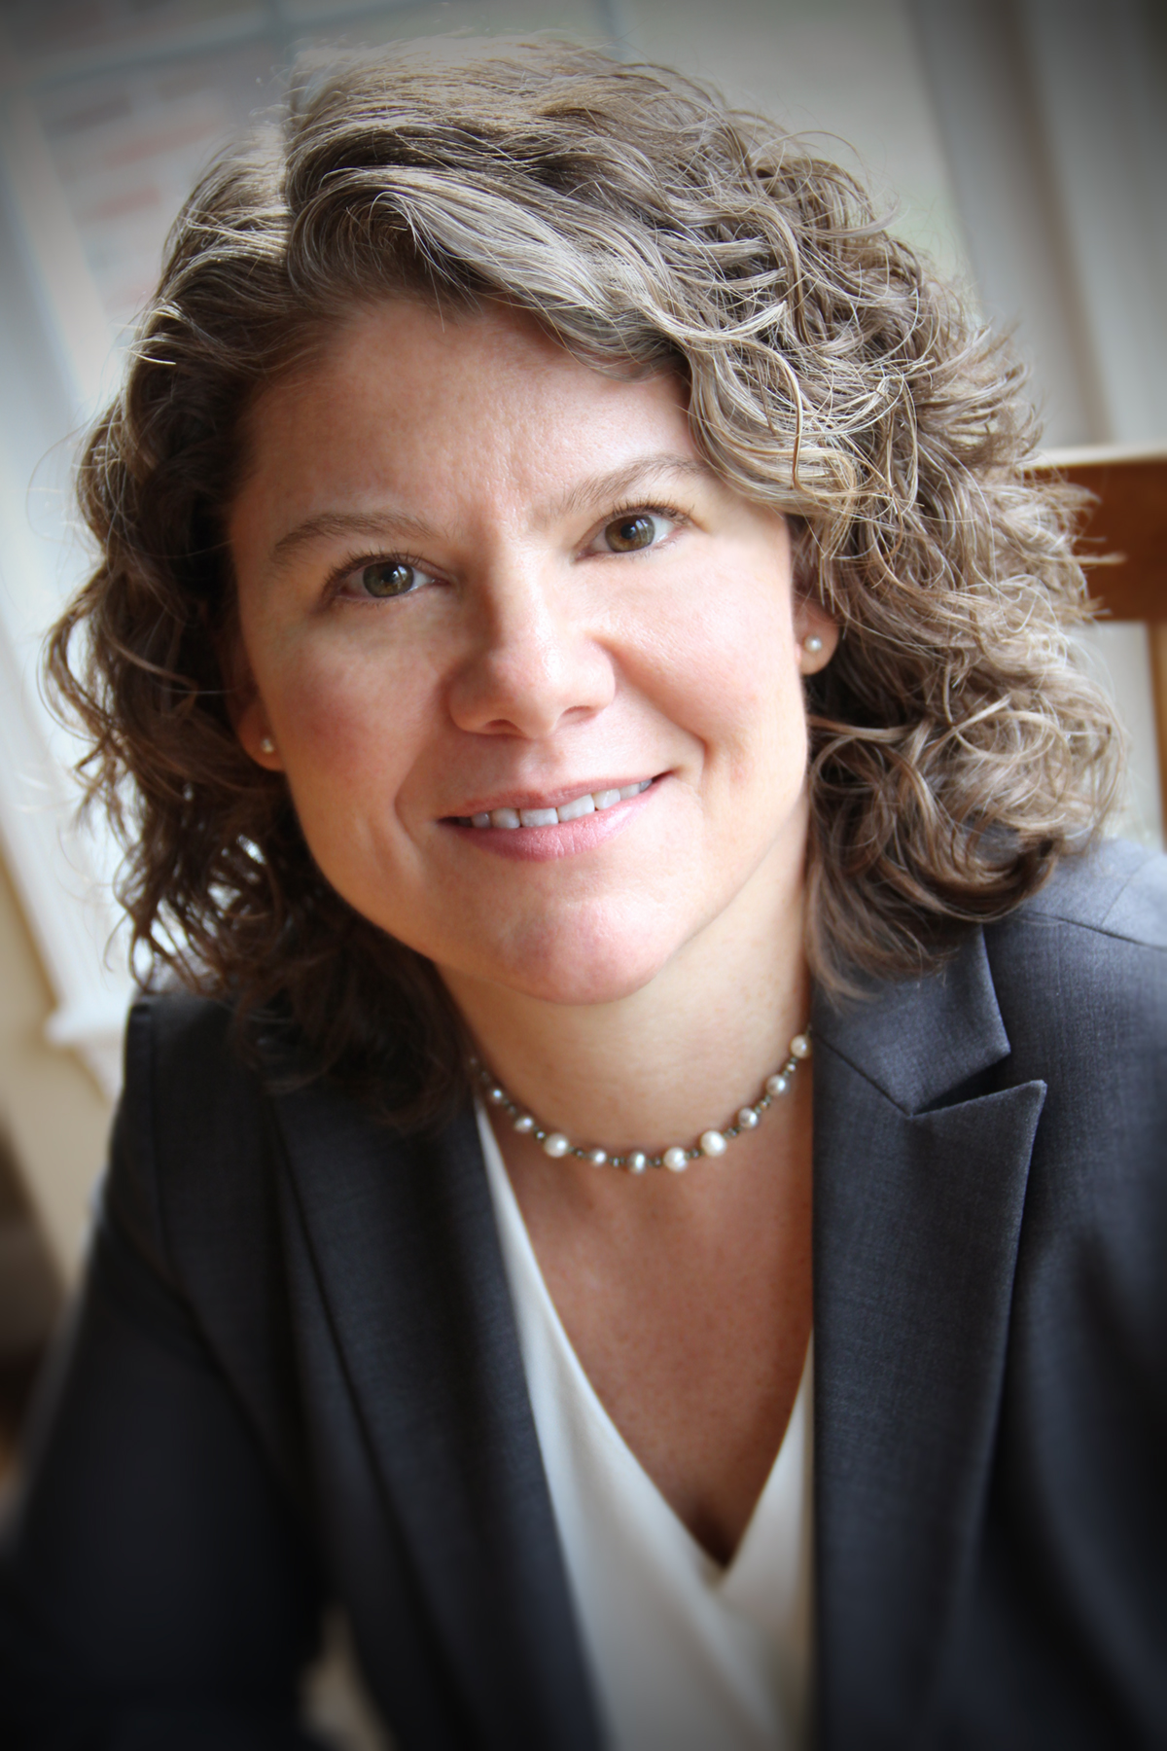
Tracking genetics variants in literature
Lon Phan, dbSNP
Melissa Landrum, ClinVar
Heidi Rehm, Broad
Allot et al., Tracking genetic variants in the biomedical literature using LitVar 2.0. Nat Genet. 2023

Slide 15
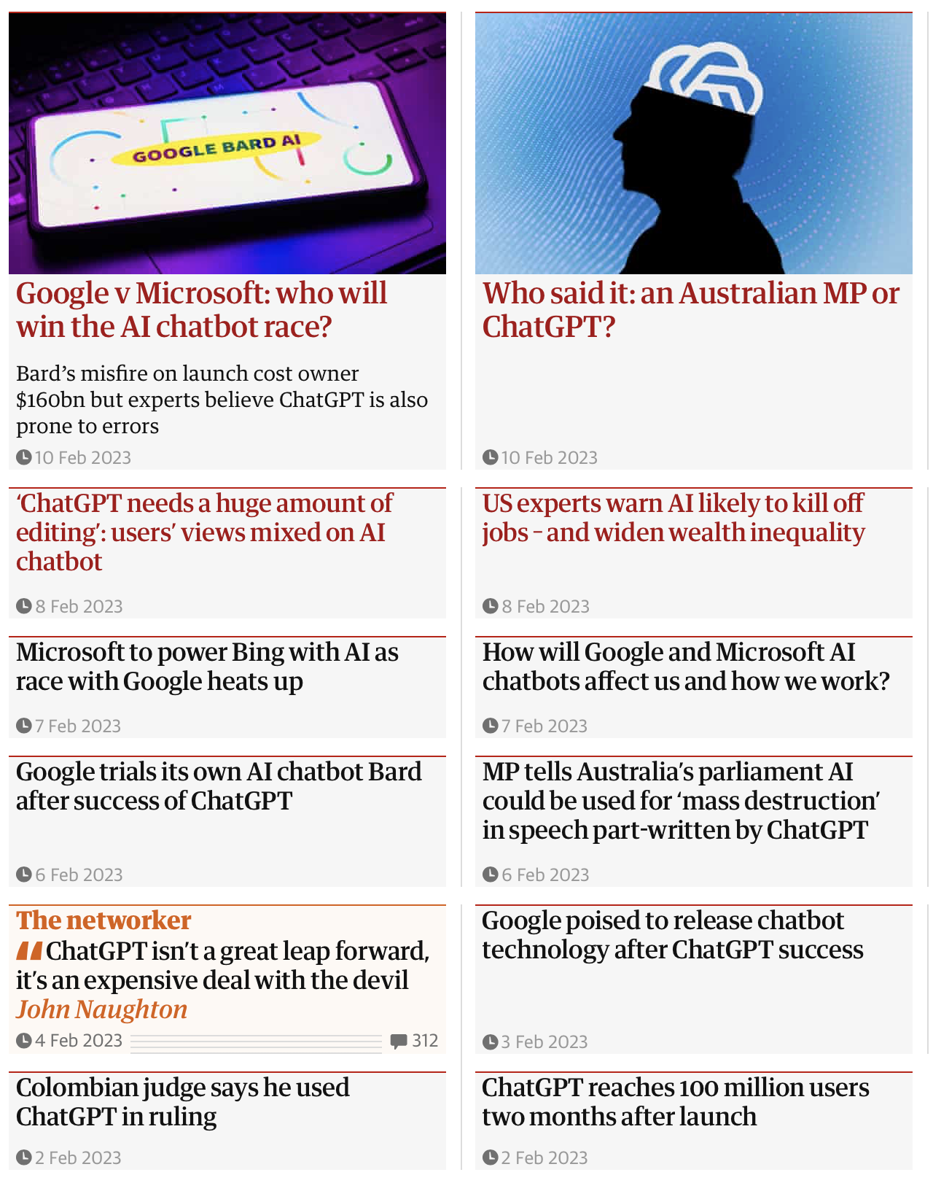
ChatGPT: revolution or hype?

Slide 16
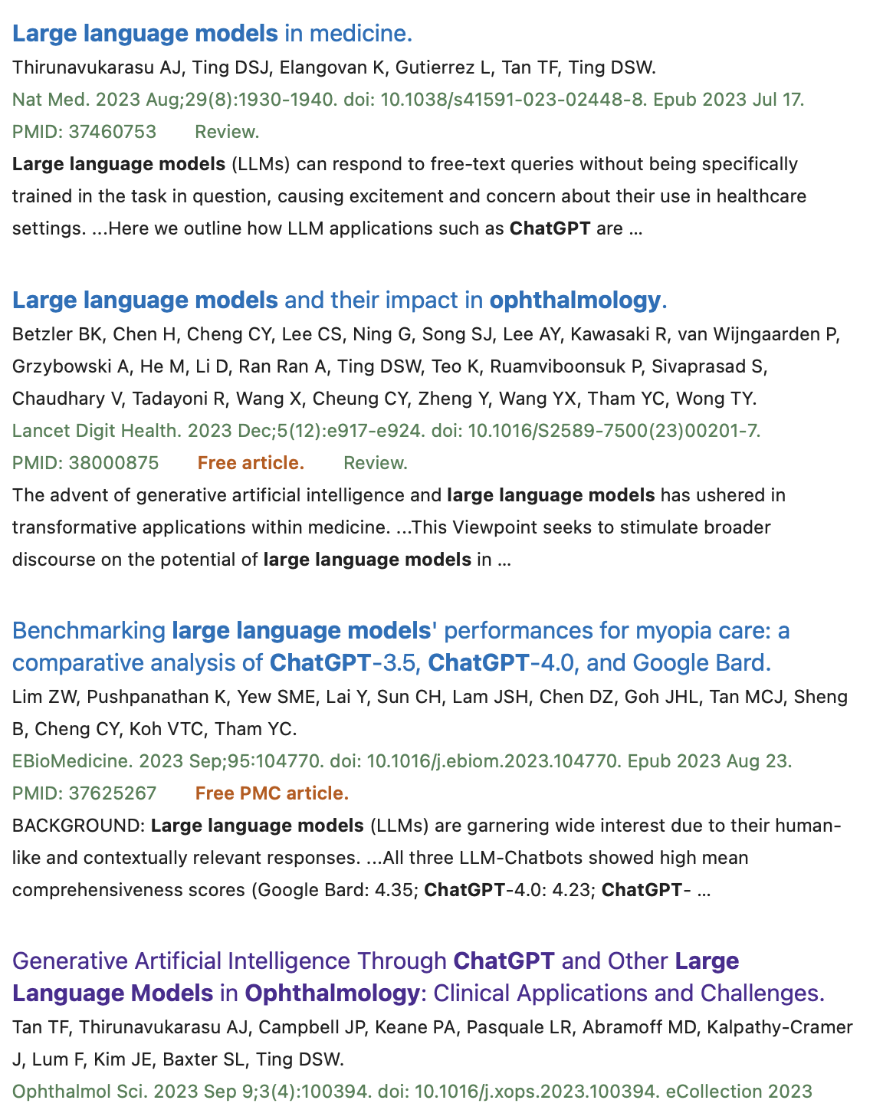
LLMs for Biomedicine
PubMed: “large language models” OR chatgpt
Over 1,000 journals
~170 in ophthalmology

Slide 17
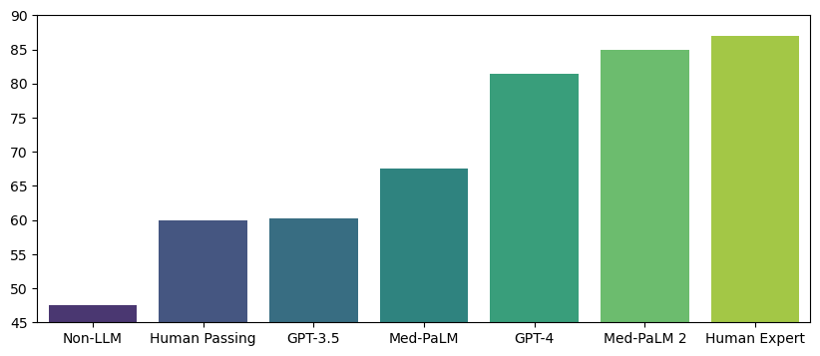
LLMs for Biomedical QA: USMLE Performance
👩🏾‍⚕
< 0.5 year
👨🏻‍🎓
(Tian et al. arXiv:2306.10070)

Slide 18
https://rb.gy/tueqe7

Slide 19
Hallucination in LLMs

Slide 20
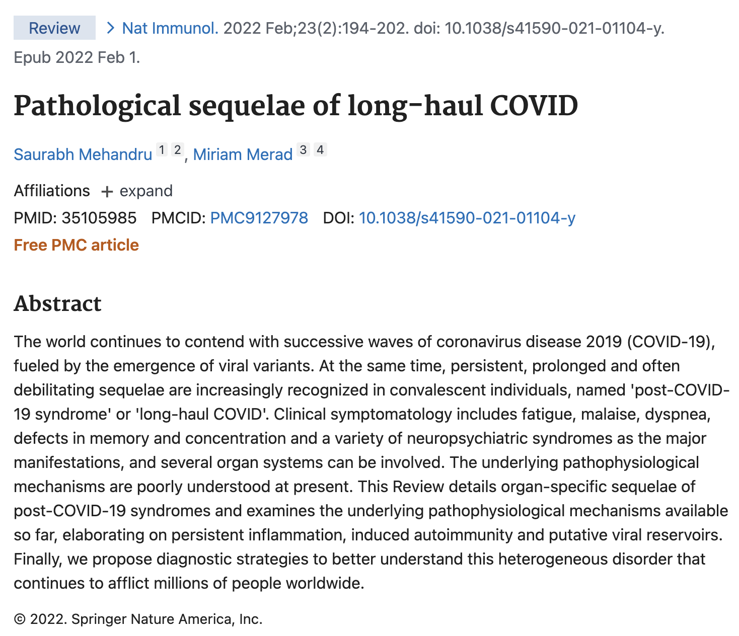
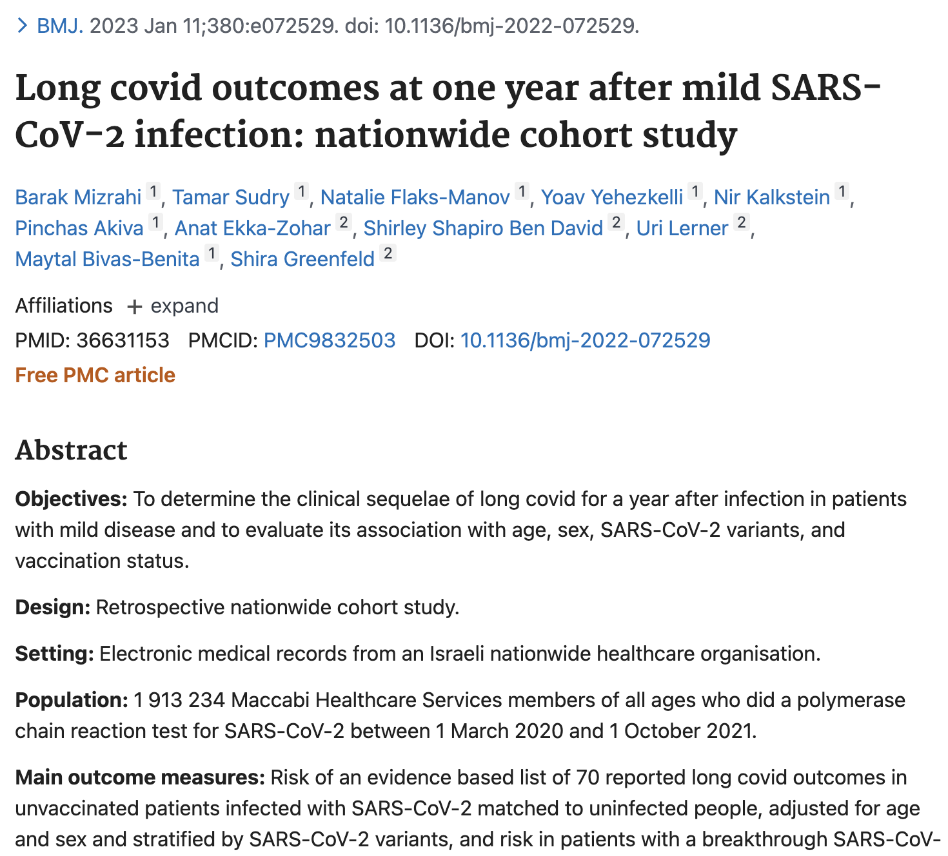
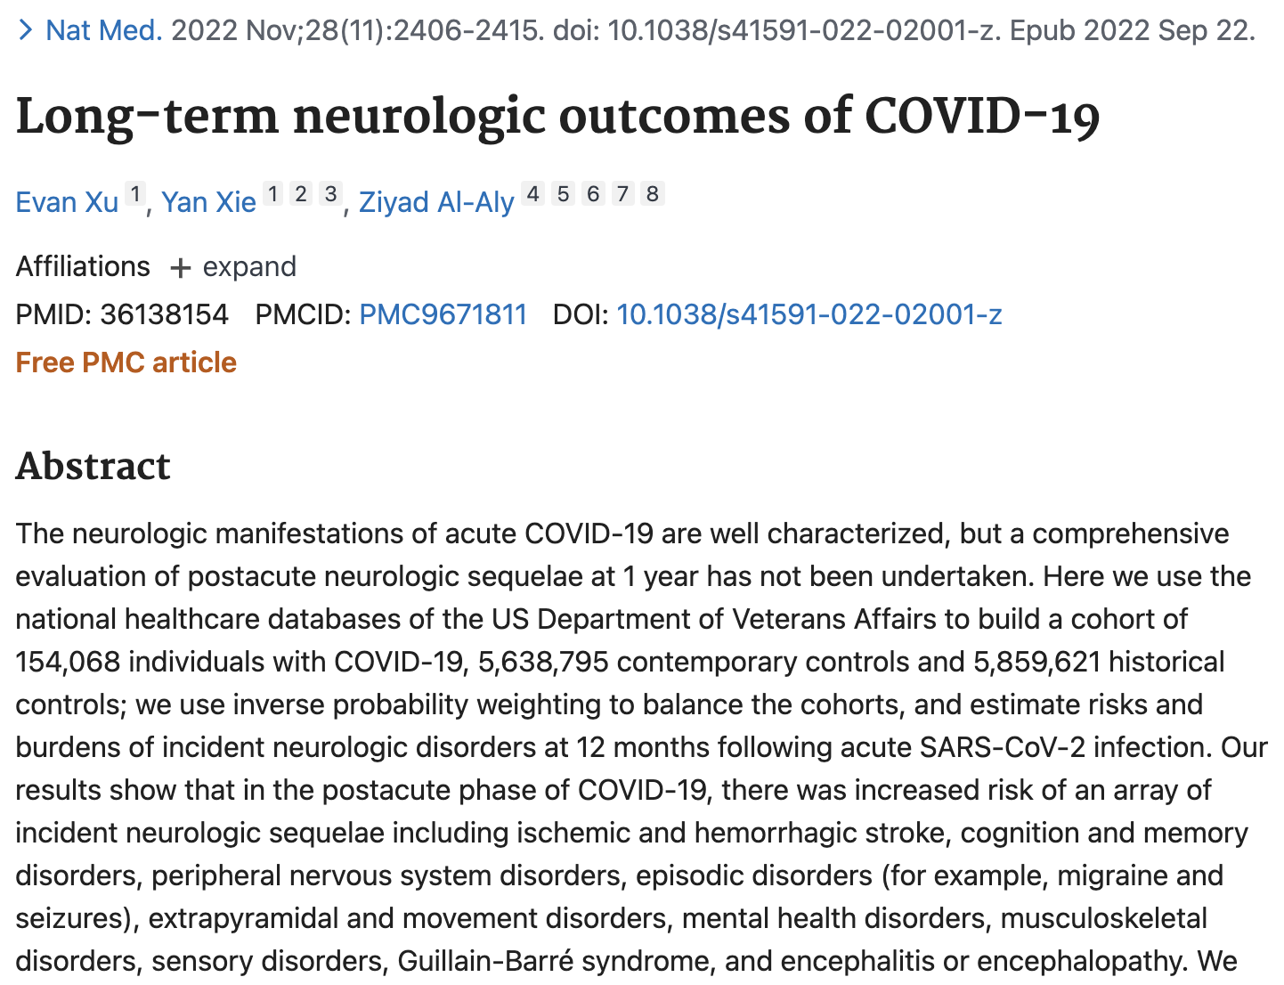
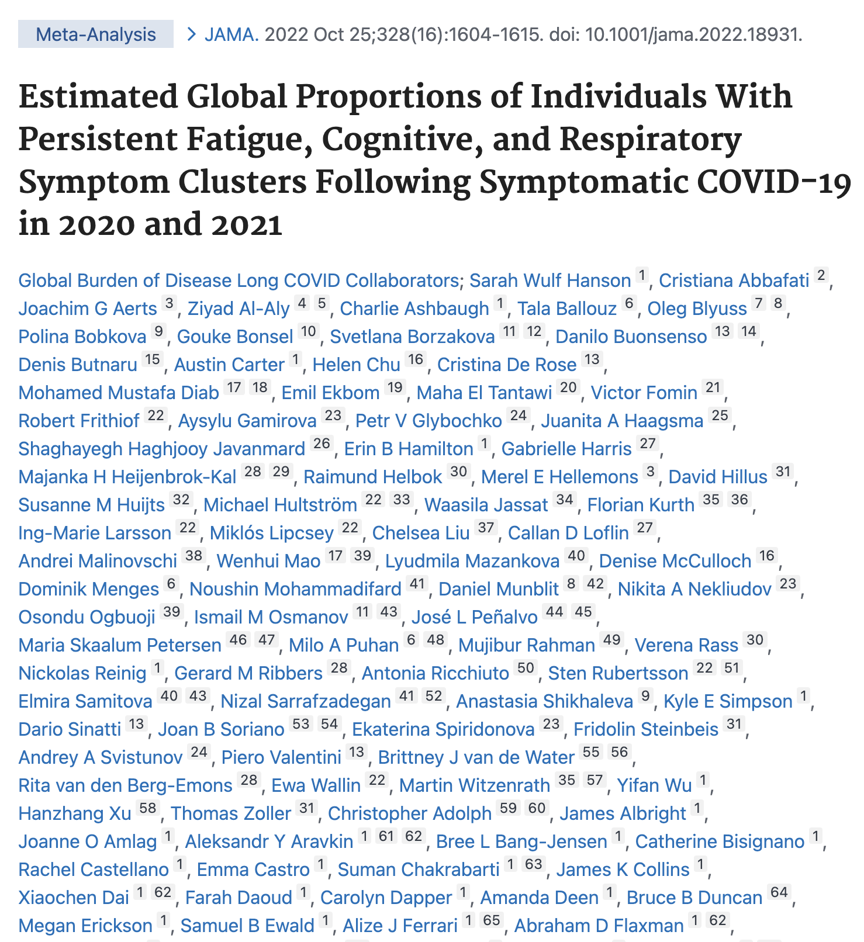
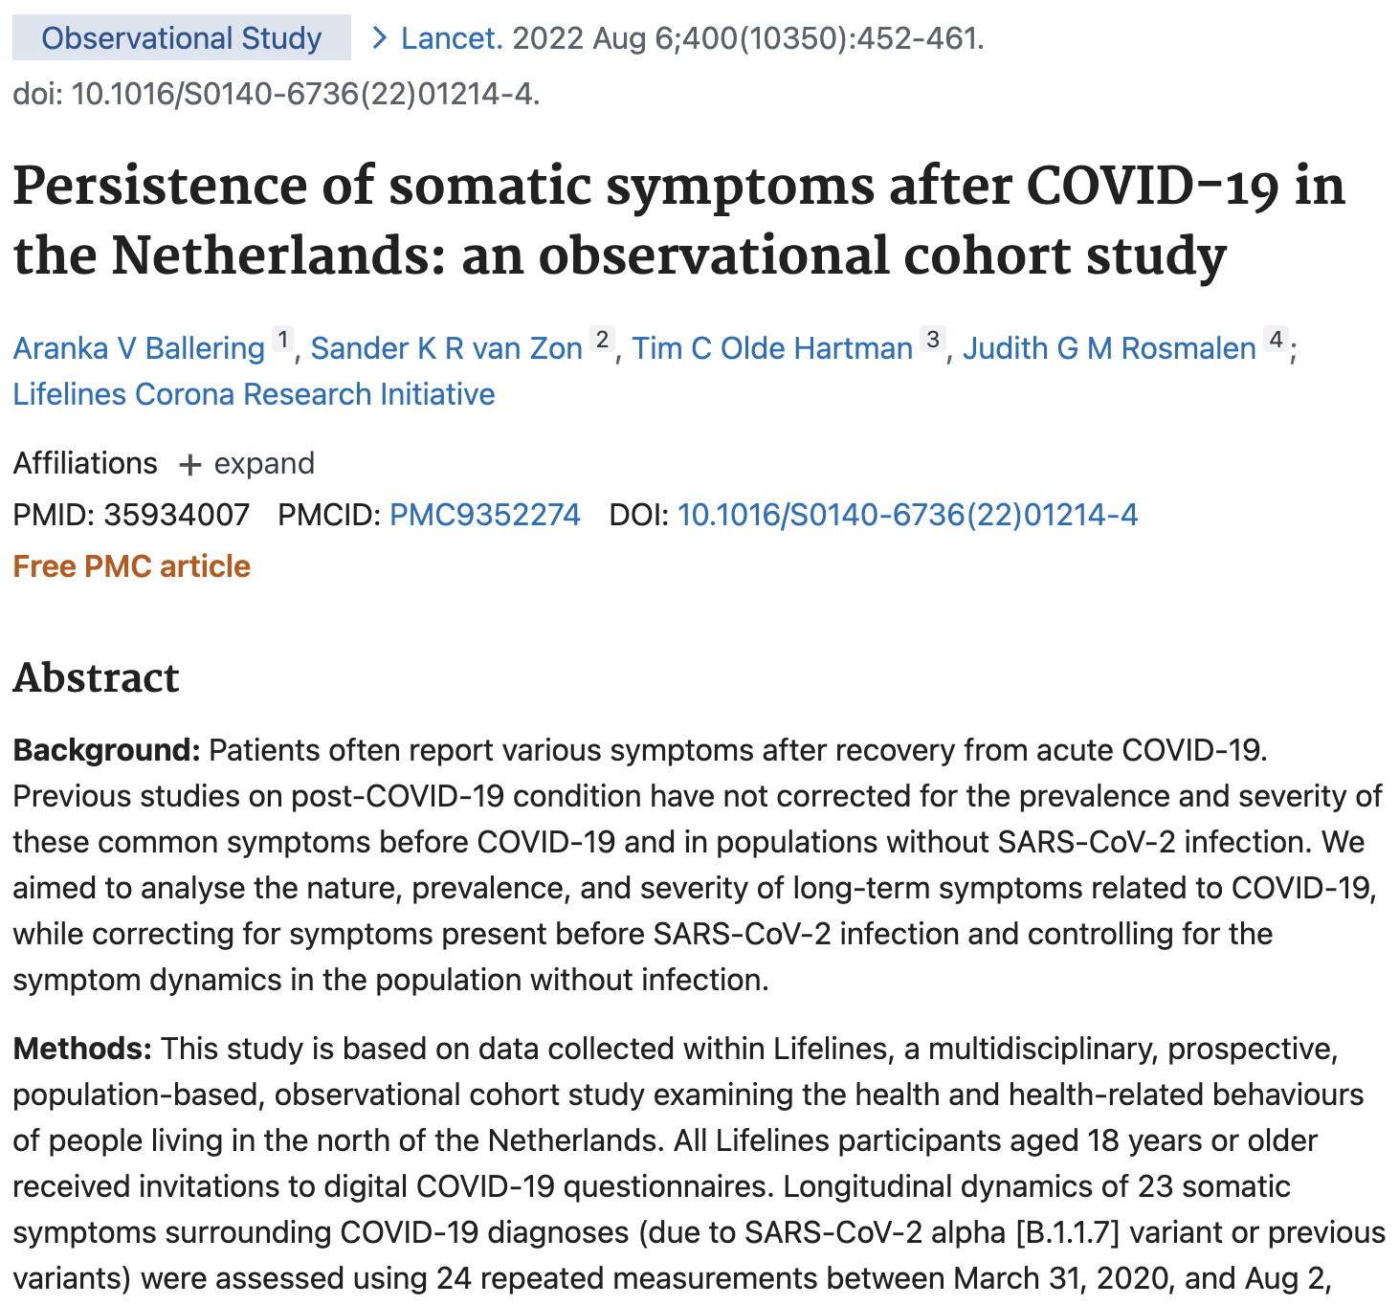
Retrieval Augmented Generation
Providing relevant articles to ChatGPT

Slide 21
Retrieval → Summarization → Verification
😲 But there are still problems
Jin Q, Leaman R, Lu Z. Retrieve, Summarize, and Verify: How Will ChatGPT Affect Information Seeking from the Medical Literature? JASN, 2023

Slide 22
Our work on medical LLMs
Overview of LLMs in Medicine
Tian et al. Opportunities and Challenges for ChatGPT and Large Language Models in Biomedicine and Health. Briefings in Bioinformatics, 2024.
Lu et al., JAMIA Focus Issue on Large Language Models in Biomedicine and Health, Journal of the American Medical Informatics Association, 2024.
Evaluating LLMs on medical benchmarks
Medical literature search (Journal of the American Society of Nephrology, 2023)
BioNLP tasks (Nature Communications, to appear)
MedCal-Bench: evaluating LLMs for medical calculations (NeurIPS, under review)
Enhancing standard LLMs
Retrieval augmented generation (MedRAG, ACL 2024; i-MedRag, PSB 2025)
Tool learning (GeneGPT, bioinformatics, 2024)
Novel applications/AI agents
GeneAgent: Gene set analysis (under revision)
TrialGPT: patient-trial matching (Nature Communications, to appear)
AgentMD: medical risk calculation (manuscript under review, preprint available)
AI Safety
Hidden flaws in multi-modal GPT4V (npj Digital Medicine, 2024)
Trustworthiness in clinical evidence synthesis (J Biomed Inform, 2024)
Bias & fairness (Nature Communications, 2023, Communications Medicine, 2024)
Adversarial attacks & risks (under review; preprint available)

Slide 23
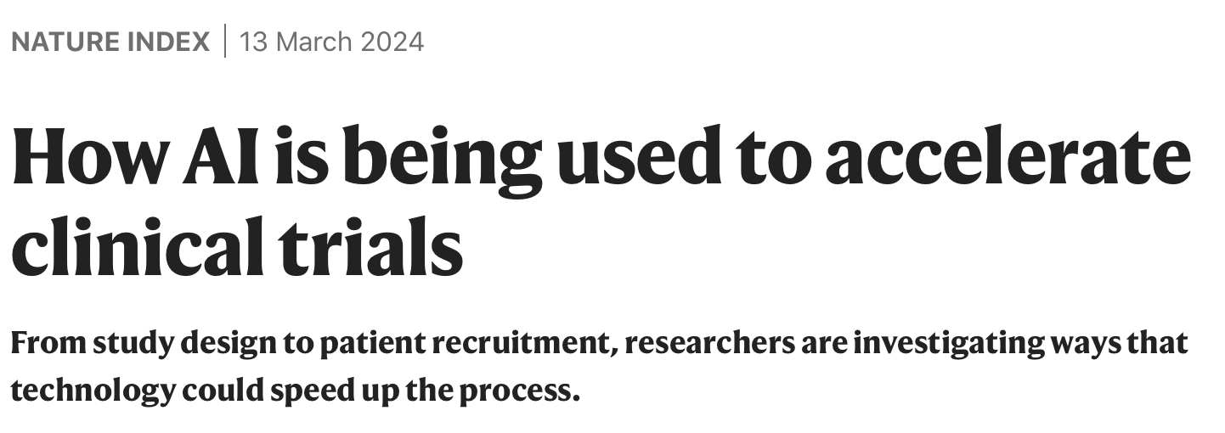
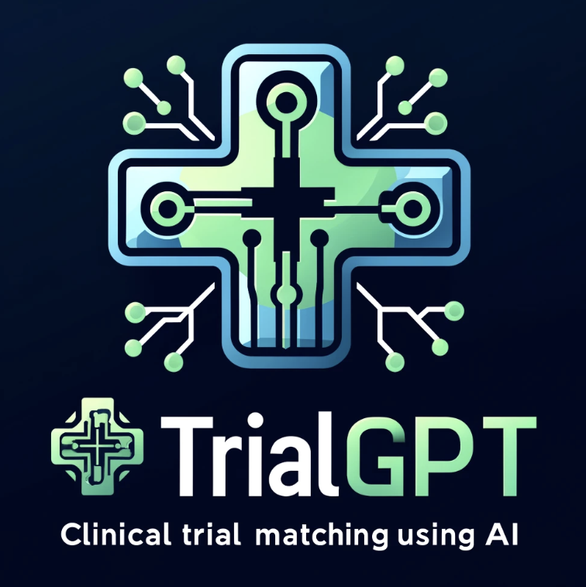
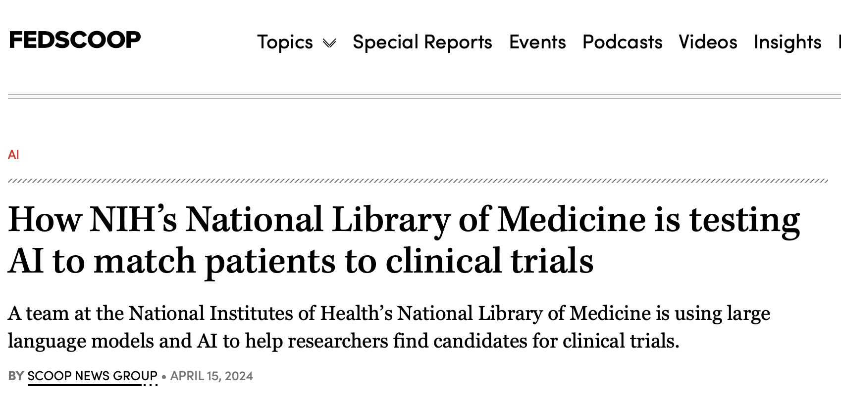

Slide 24
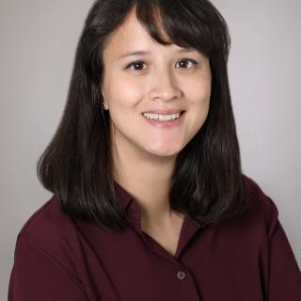
Motivation and Objectives
Clinical trials: vital for drug development and evidence-based medicine
Real-world needs at NIH/NCI (and beyond)
Goal: to increase efficiency and equity in patient-trial matching
Harris Floudas, MD, NCI
Dara Bracken-Clarke, MD, NCI
Elisabetta Xue, MD NCI

Slide 25
Previous SOTA Methods
System | Method | Pros | Cons
Criteria2Query (Yuan et al., 2019) | Converting trial criteria to SQL queries and search the EHR | Scalable Explainable (not in natural language though) | Requires accurate ontology mapping Only suitable for trial-to-patient matching Only works with a large patient database
DeepEnroll (Zhang 2020) COMPOSE (Gao 2020) | Match patients and trials with embeddings | Scalable Match both directions | Not explainable Requires a lot of training data
Notes:
Criteria2Query: https://academic.oup.com/jamia/article/26/4/294/5308980
DeepEnroll: https://arxiv.org/abs/2001.08179
COMPOSE: https://arxiv.org/abs/2006.08765

Slide 26
Technical novelty
TrialGPT
Prediction
TrialGPT
Aggregation
Patient Note
Clinical trial candidate
Criterion-level
Explanation
Relevant sentences
Eligibility
Trial-level
Relevance score
Eligibility score

Slide 27
TrialGPT Predicts Criterion-level Eligibility with Explanations

Slide 28
Expert-level performance
TrialGPT
Prediction
Three MDs evaluated 1,000 patient-criterion pairs
Prediction | Metric | TrialGPT
Explanation | Accuracy (%) | 87.8
Relevant sentences | F1 score (%) | 88.6
Eligibility | Accuracy (%) | 87.3
Criterion-level
Explanation
Relevant sentences
Eligibility

Slide 29
Trial-level Scores For Ranking & Excluding Clinical Trials
TrialGPT
Prediction
TrialGPT
Aggregation
Applications
Ranking
1
2
3
4
Excluding
Criterion-level
Explanation
Relevant sentences
Eligibility
Trial-level
Relevance score
Eligibility score
❌
❌
💬
💬

Slide 30
Evaluation setups and results
Three benchmarking datasets: ~200 patients and ~20,000 trials in total
Achieves best accuracy to date
81.7% vs. 55.6% (best previous performance)
On par with human performance
Pilot user study shows ~40% time reduction (with vs. without AI)
Jin et al., Matching Patients to Clinical Trials with Large Language Models, Nature Communications, under revision.

Slide 31
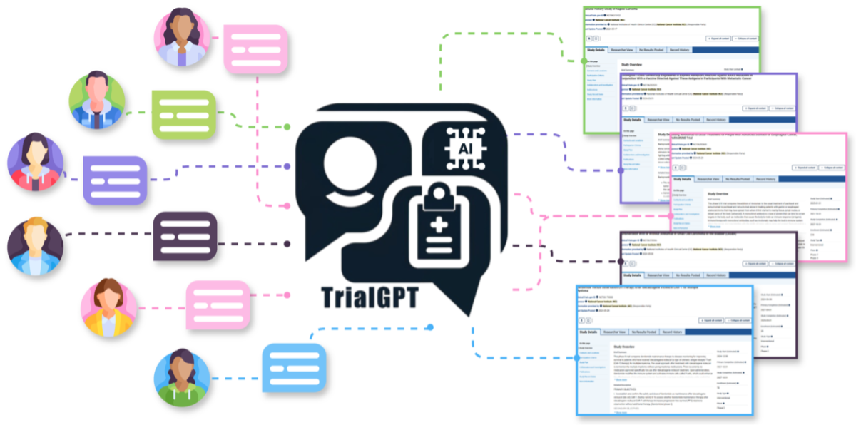
TrialGPT 2.0
Custom Chatbox for trans-NIH users (and elsewhere)
Large-scale user study
Expansion beyond oncology (NEI, NICHD)

Slide 32
Acknowledgments
Lu lab at NLM/NCBI: Don Comeau, Rezarta Dogan, Amr Elsawy, Won Kim, Qiao Jin, Robert Leaman, Po-Ting Lai, Ashley Shin, Shubo Tian, Zhizheng Wang, Chih-Hsuan Wei, John Wilbur, Natalie Xie, Yifan Yang, Lana Yeganova, Qingqing Zhu
NEI: Emily Chew, Michael Chiang, Tiarnan Keenan
CC: Ron Summers, Le Lu, Xiaosong Wang, Ke Yan, etc.
NCATS: Tyler Beck, Christine Colvis
NCI: Harris Floudas, James Gulley
PubMed: Grisha Starchenko, Jessica Chan, Kathi Canese, etc.
dbSNP: Lon Phan, Juliana Feltz, Rama Maiti, Tim Hefferon
ClinVar: Melissa Landrum
BioCreative: Cecilia Arighi, Graciela Gonzalez-Hernandez, Martin Krallinger, Lynette Hirschman
UniProt: Alex Bateman, Alan Bridge, Livia Famiglietti, Michele Magrane, Sylvain Poux, Cathy Wu
GWAS Catalog: Jackie MacArthur, Fiona Cunningham, Helen Parkinson

