Slide 1
Comparative Proteomics Data Analysis
Example using Public Dataset
Yana Stackpole, PhD
Application Support

Slide 2
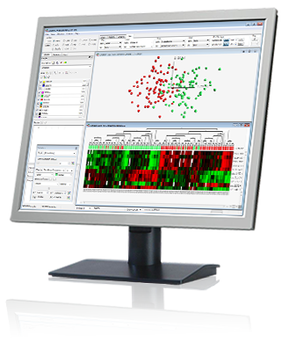
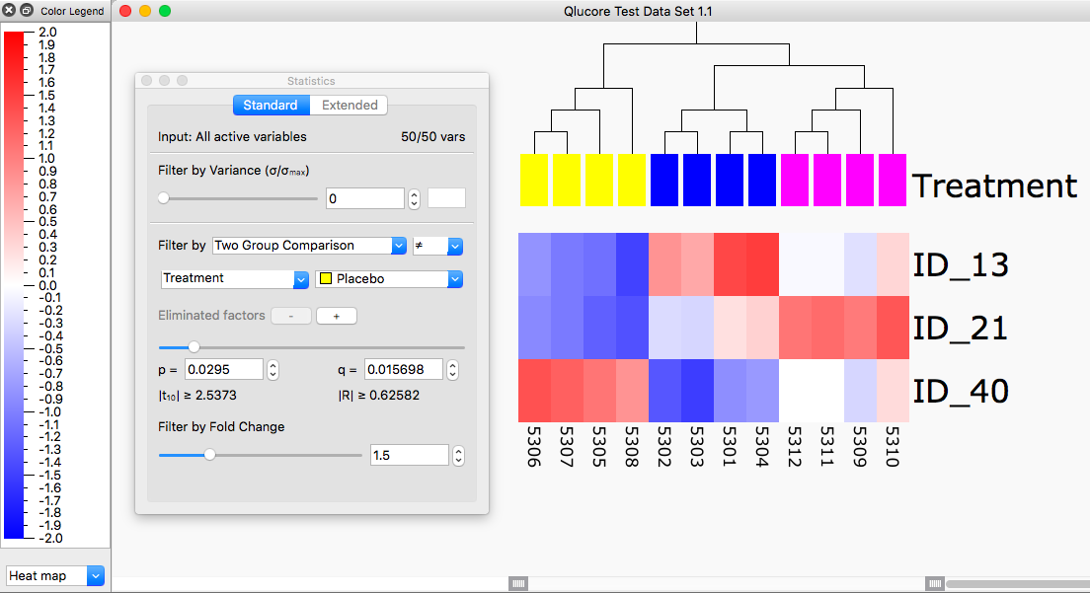
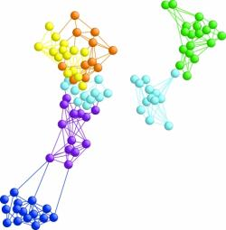
Visualize and Explore
QC (outliers, mislabeled samples)
Make observations - identify structures, patterns
Generate new hypotheses
Browse the genome
Analysis
t-test, ANOVA, Regressions, R scripts. Open API to R, Batch exec
Variant calling
Easy generation and export of reports, status, and plots
Save your session, share
Biological Insight
Gene Set Enrichment using MSigDB, reactome, or custome sets
Explore annotations
GO Browser
Classify and Predict
Build classifiers
kNN, SVM, RT
Predict sample class, outcome, etc.

Slide 3
Enjoy fantastic computing speed on a laptop to boost your discovery and scientific creativity
Benchmark examples (static). Compared to R | Times faster
ANOVA (22k var. + 130 samples) | 2800
t-test (two-groups, selected from 22k var. + 130 samples) | 1000
Kruskal-Wallis (22k var. + 130 samples) | 900
Mann-Whitney U-test (two groups, 30k var. + 5k samples) | 480
ANOVA (30k var. + 5000 samples) | 180
PCA calculations (30k var. + 150 samples) | 77
UMAP (22k var. + 130 samples) | 13
The speed enables a more flexible workflow – generating better results faster.
Details at: https://qlucore.com/calculation-benchmarks
"This tool might literally save you years of your life"
Prof. Ulrich Steidl at Albert Einstein College of Medicine

Slide 4
Proteomics – Data Processing (prior to Qlucore)
Handling the raw data produced by the masspec - noise reduction, feature detection, and correspondence. However, many require preliminary conversion out of the proprietary data format of the instrument and into open data formats.
Prior to analyte identification, the data must be denoised, peak-picked, feature-detected, deisotoped, and deconvoluted.
Analyte identification using DBs like Sequest follows data processing. Due to incomplete databases and noisy data, closest match is prone to false positives and mismatches, hence significance measures are used.
4. The ultimate goal of data processing is to yield the quantity of each analyte. However, MS signal intensity is related to but not equivalent to analyte quantity.
5. Normalization is done to determine a sample-wise scaling factors, by:
Use of housekeeping proteins
Use of sample size, and related methods ← seems to be the most popular method
Notes:
Goals
Needs
Easier said than done

Slide 5
Workflow
Between instrument & Qlucore: Raw data → extract MS/MS spectra → Identify peptides → identify proteins → validate with false discovery rate → then either summarize by: → protein groups → or, localized sites on protein chains → Table of normalized intensities for selected Protein IDs is imported into Qlucore for statistical analysis and visualization/interpretation

Slide 6
Errors and FDR
Major sources of error:
Database (just like metabolomics): Peptide not in DB; Mutation; unknown MS/MS;
Unanticipated protein chemistry makes interpreting spectra difficult;
Enzyme/Ion source: non-specific cleavage makes DB search difficult.
Calculating FDR on results:
Typically FDR of 1%
Target-decoy approach (typically preferred)
Have two databases: one is a target database; another is a decoy database.
Idea is to have true positives match the target database and false positives match the decoy database.
The decoy database is typically designed by hand although some labs use a random database.

Slide 7
Comparative proteomics of dying and surviving cancer cells
Chemotherapeutics cause the detachment and death of adherent cancer cells.
When studying the proteome to determine the protein target and mechanism of action of anticancer drugs, the attached cells are normally used, while the detached cells are usually ignored.
This study tested the hypothesis that proteomes of detached cells contain valuable information.

Slide 8
Study
The authors determined that the majority (~80%) of detached cells were dying and therefore talk about dying and detaching interchangeably within the context of the article. Hence here Dethatched = Dead
The authors made the following comparisons:
Detached vs attached cancer cells, and
Drug-A vs drug-B vs drug-C vs control
Life vs death
Cases (or samples) are stratified into 5-factors: set; cell; drug; source; and, replicate.
Set → a blocking factor made during processing that may or may not have bias
Cell → HCT-116, A375 and RKO cancerous cell lines
Drug → 5-fluorouracil, methotrexate and paclitaxel and control (vehicle only)
Source → Attached or detached cells
Replicate → A biological replicate, unfortunately run in the same set.

Slide 9
Study
Combined proteome data provided a more accurate identification of drug targets.
Six proteins consistently up- or down-regulated in the detached vs attached cells regardless of the drug and cell type. (Two-group comparisons Dead/Alive for each chemo, Venn for find overlapping). New hypotheses formulated.
Hypotheses tested by siRNA next -- Knocking down USP11, CTTN, ACAA2 and EIF4H had anti-proliferative effects, targeting UHRF1 additionally sensitized the cells to the anticancer drugs, while knocking down RNF-40 increased cell survival against the treatments.
Therefore, these proteins are likely to be involved in general cell death and survival decisions here.
Adding detached cells to the analysis could become a standard practice in expression proteomics of drug-treated cells.”, taken from the PRIDE archive.

Slide 10
Study Hypotheses
Round 1:
Proteome of dead cells is useful in studying chemo drugs
Round 2, more specifically based on comparative proteome:
USP11 is involved in general cell death and survival decisions.
CTTN is involved in general cell death and survival decisions.
ACAA2 is involved in general cell death and survival decisions.
EIF4H is involved in general cell death and survival decisions.
UHRF is involved in general cell death and survival decisions.
RNF-40 is involved in general cell death and survival decisions.
Round 3, follow up using knock down experiments:
Knocking down USP11, CTTN, ACAA2 and EIF4H shows anti-proliferative effects.
Knocking down UHRF1 additionally sensitized the cells to the anticancer drugs.
Knocking down RNF-40 increased cell survival against the treatments.

Slide 11
Study questions
Q.1: Which factor or factors have the greatest impact on the proteome?
Sample PCA. We can conclude that the majority of proteomic information is determined by whether or not the cells were detached or attached. “Life and death have the greatest impact on the cellular proteome.”. Remember that detached cells are mostly dying.

Slide 12
Study questions
Q.2: What is the behavior of detached vs attached cells given different drugs?
Given the dataset, this is an involved question. We will make use of the statistics tool
First, we should remove signal from factors that might confuse the results. The question is only concerned with “Source” and “Drug”, so we should eliminate the other two factors, “Cell” and “Set”.
Then we do a two-group comparison between each drug and the control by using the annotations box to remove samples of the other drugs.
Set the false discovery threshold to 0.05.
Notice that 5-fluorouracil separates groups in both Source and Drug in the first 2 PCs. The other drugs are harder to separate. This indicates that the proteome after 5-flourouracil treatment is more distinct/unique in attached living cells vs detached dying cells.

Slide 13
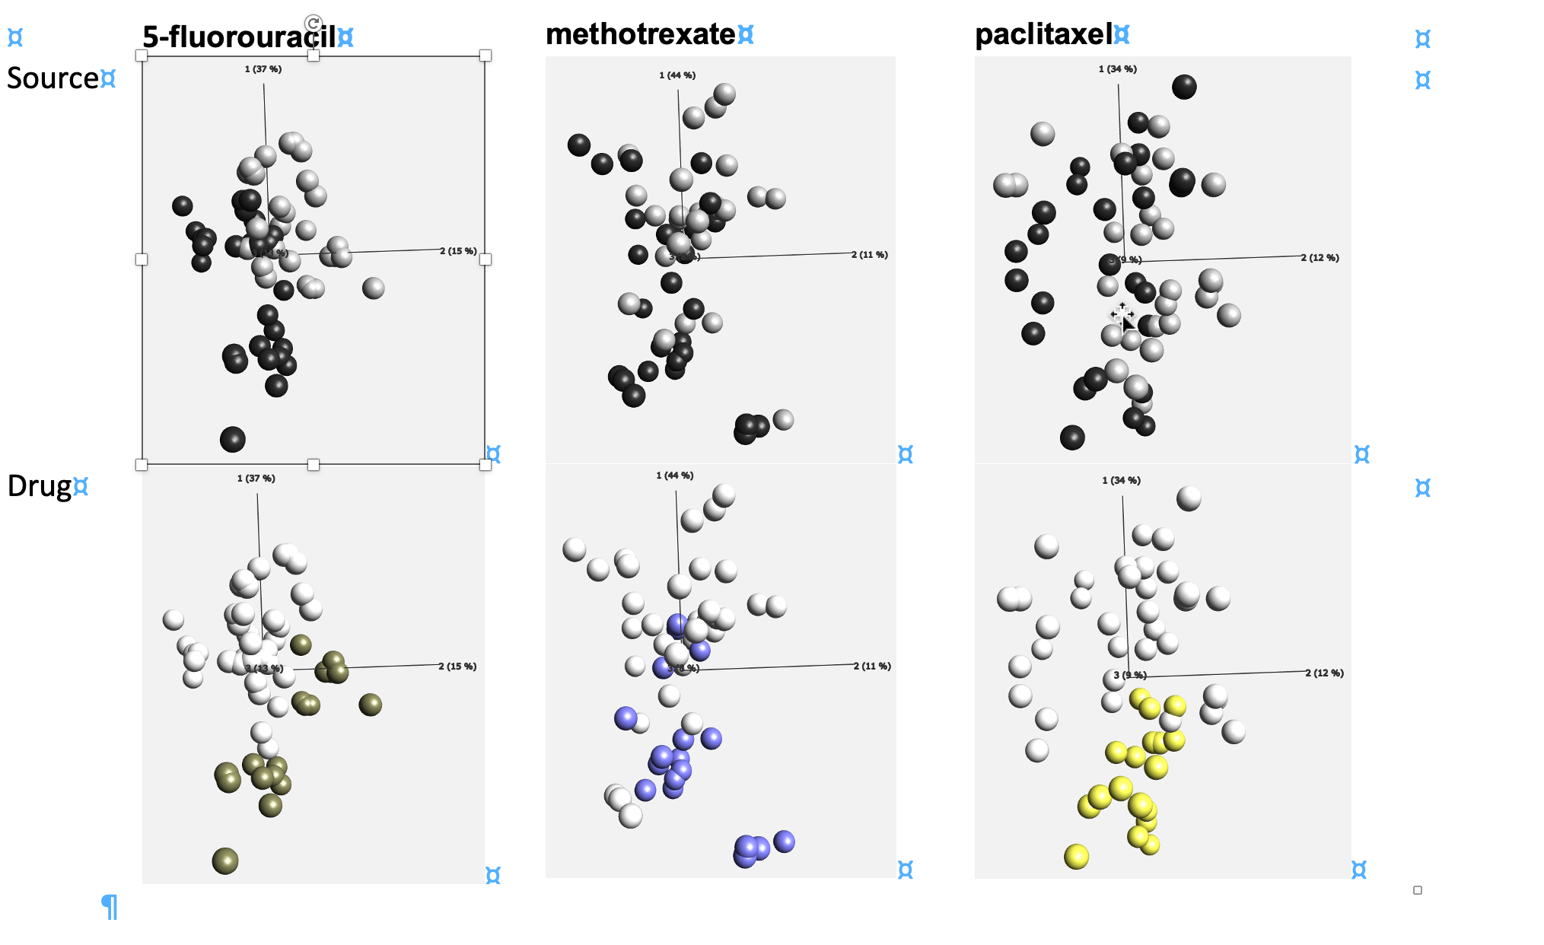
Study questions
Q.2: What is the behavior of detached vs attached cells given different drugs?
Given the dataset, this is an involved question. We will make use of the statistics tool.
First, we should remove signal from factors that might confuse the results. The question is only concerned with “Source” and “Drug”, so we should eliminate the other two factors, “Cell” and “Set”.
Then we do a two-group comparison between each drug and the control by using the annotations box to remove samples of the other drugs.
Set the false discovery threshold to 0.05.
Notice that 5-fluorouracil separates groups in both Source and Drug in the first 2 PCs. The other drugs are harder to separate. This indicates that the proteome after 5-flourouracil treatment is more distinct/unique in attached living cells vs detached dying cells.

Slide 14
Study questions
Q.3: What proteins are involved in life and death?
Following from the previous question, we could naively take the intersection of protein IDs from all three tests we made (Venn diagram).
However, QOE gives us the tools and power to ask this question directly and with more finesse.
Using the statistics tool to make a two-group comparison between attached and detached cell samples, slide the threshold until we find about 50 of the most informative variables.
Make sure to eliminate the effect of different cell backgrounds, this will achieve the same goal as we had in mind with a Venn diagram only it will do so in a more statistically rigorous way and give us a p-value at the same time.

Slide 15
Next steps
1. Access your Qlucore site access – contact BTEP
2. Book a session with us – get help importing your data and setting up your analysis. Here is a link https://calendly.com/yana-stackpole/30min
3. Explore your data in a cool GUI in a way that makes sense to you!
Global support team Support@Qlucore.com
Local support Yana.Stackpole@Qlucore.com

Slide 16
System requirements Base module
FOR WINDOWS
Windows 7, Windows 8 or Windows 10
512 MB of RAM memory
A graphical card with support of at least Open GL 2.1
5 GB of free hard disk space
Qlucore Omics Explorer is available in both a 32-bit and 64-bit versions. The program takes full advantage of processors with multiple cores and computers with multiple processors.
FOR MAC
Max OS X 10.15 or 10.14
512 MB of RAM memory
A graphical card with support of at least Open GL 2.1
5 GB of free hard disk space

