Slide 1
Bulk RNA-seq Analysis on NIDAP Background & Theory
Presented by:
Thomas J. Meyer (“Josh”)
(CCBR/BTEP)
https://nidap.nih.gov/

Slide 2
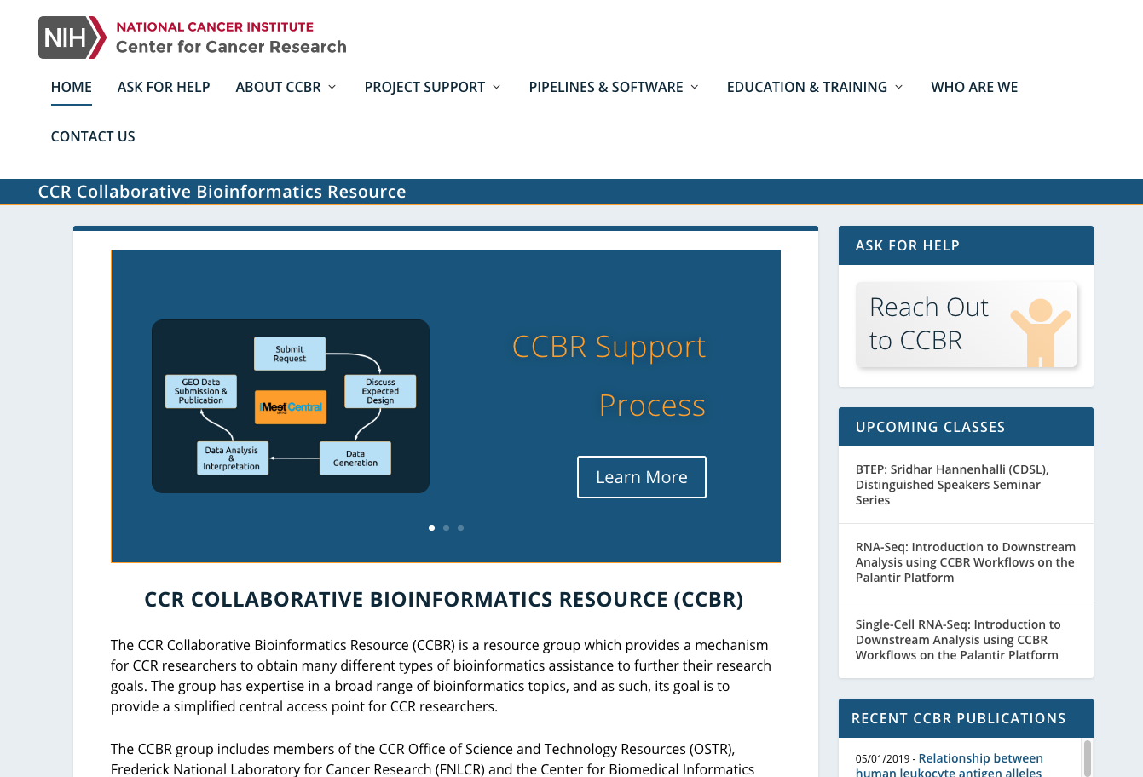
CCBR: CCR Collaborative Bioinformatics Resource
Experimental Design
Training on genomics analysis
Support on NIDAP for both bulk and single-cell RNA-seq research projects
Customized support for “non-standard” analysis
https://ccbr.ccr.cancer.gov/

Slide 3
RNA Sequencing (RNA-seq)
A diverse collection of methods for examining the presence, quantity, and sequences of RNA in a sample using next-generation-sequencing (NGS) technology
Basic steps:
Extract and isolate RNA, then convert it to cDNA
Fragmentation and size selection
Addition of any linkers, adapters, or barcodes
Next-generation sequencing (NGS) of reads
Analysis of read sequences:
Includes read QC, alignment to reference genome, counting of reads over features (e.g. genes), and within- and between-group comparisons and contrasts
Variations of RNA-seq include:
Total, mRNA, single-cell, etc.

Slide 4
Bulk RNA-seq: Basics
The use of RNA-seq analysis to investigate bulk biological samples, which contain many thousands or millions of cells
Most common type of RNA-seq analysis
Produces observations based on mean expression from all cells in a bulk sample
Two common variants of bulk RNA-seq are:
mRNA: poly-A selected; standard transcriptome profiling
Total RNA: whole transcriptome analysis (coding and non-coding)
Paired-end reads:
Each pair of reads corresponds to a single original molecule of RNA, sequenced from each end, often not all the way through the molecule
Result are two reads with some amount of sequence between them (called the “insert”) of unsequenced nucleotides

Slide 5
https://www.technologynetworks.com/genomics/articles/rna-seq-basics-applications-and-protocol-299461

Slide 6
Bulk RNA-seq: Downstream Analysis
Begins with raw counts of detected expression over annotated features (e.g. genes) in the reference genome to which reads are aligned
This is a large matrix of count values with rows for genes and columns for samples
Also need a metadata table, with sample names, groups, short labels, and any batch information
Filter out low-count genes and convert to counts-per-million (CPM)
Those with fewer than X samples per group with at least Y count value
Defaults: X = 3, Y = 1
Log2 transformation of CPM values and Normalization to ensure comparisons between samples are valid
Batch Correction (Optional) to identify and remove any batch effect
Differential Expression of Genes (DEG) Analysis to look at relative expression between two groups of samples from different experimental conditions

Slide 7
Filtered Counts

Slide 8
Normalized Counts

Slide 9
Batch Corrected Counts

Slide 10
Bulk RNA-seq: Experimental Design Tips
Hypothesis-driven design
Sample Size:
Optimal Minimum Sample Size: 4 biological replicates per group
Allows for removal of at least one outlier per group
Absolute Minimum Sample Size: 3 biological replicates per group
No outliers can be removed
Library Prep Kit:
mRNA: Standard transcriptome profiling
Total RNA: Novel transcript discovery, alternative splicing, and lncRNA
Depth & Quality:
mRNA: $≥$ 10-20 million reads per sample & RIN > 8
Total RNA: $≥$25-60 million paired-end reads per sample
Batch Effects:
Can arise when some samples are prepared or sequenced at different times or using different reagents/equipment than others
Preparing all samples identically and simultaneously is best
If batches are unavoidable, at least make sure there are some samples from every group in every batch
Can then attempt batch removal if batches are known
Lane Effects are a specific kind of batch effect that can arise when samples are run in different lanes of the sequencer
Multiplexing all samples to run on all lanes is best

Slide 11
NIDAP Training Tutorial:
You should now be ready to begin to work through the online tutorial for a basic analysis of a training bulk RNA-seq dataset on NIDAP
https://nidap.nih.gov/
You should have an email with links and instructions on how to access these materials
If you do not, please email us: NCIBTEP@mail.nih.gov
You will need to be able to access the NIH secure network
This can be done either from on campus or by using a VPN client to connect from home
You will also need your NIH username and password to log-in to the NIDAP site

Slide 12
Thank you!
Please email us at if you have any questions about this training at this address:
NCIBTEP@mail.nih.gov
A listing of all upcoming NIDAP training classes can be found here:
https://btep.ccr.cancer.gov/nidap_upcoming/
Please check back at this link to see a constantly updated list of all upcoming BTEP training offerings (not just on NIDAP):
https://btep.ccr.cancer.gov/

